Slide 1
Planning Update
Luke Mills and Sophie Pain
Principal Planners (Strategic Sites, Greater Cambridge Shared Planning)

Slide 2
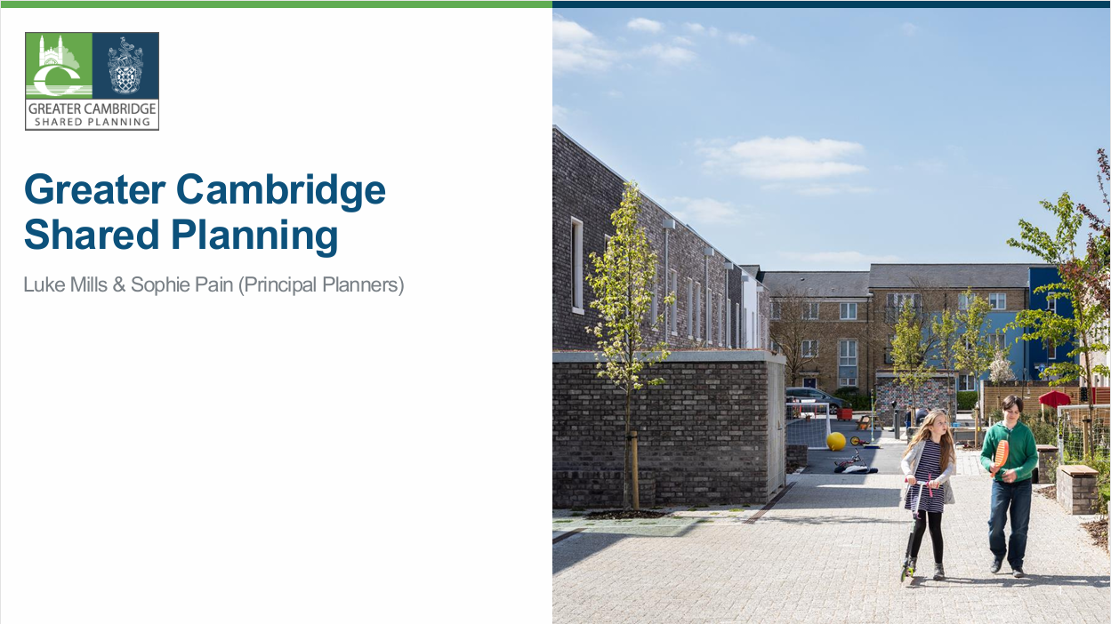

Slide 3
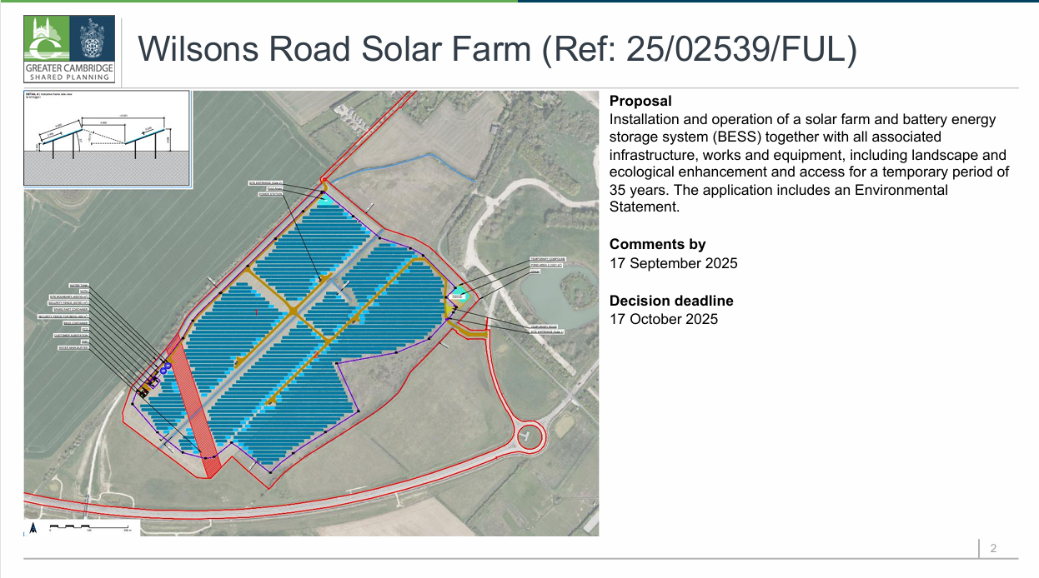

Slide 4
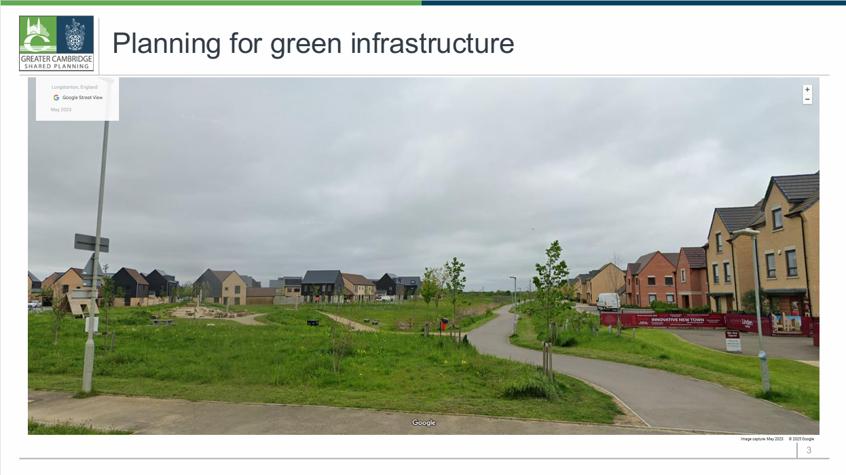

Slide 5
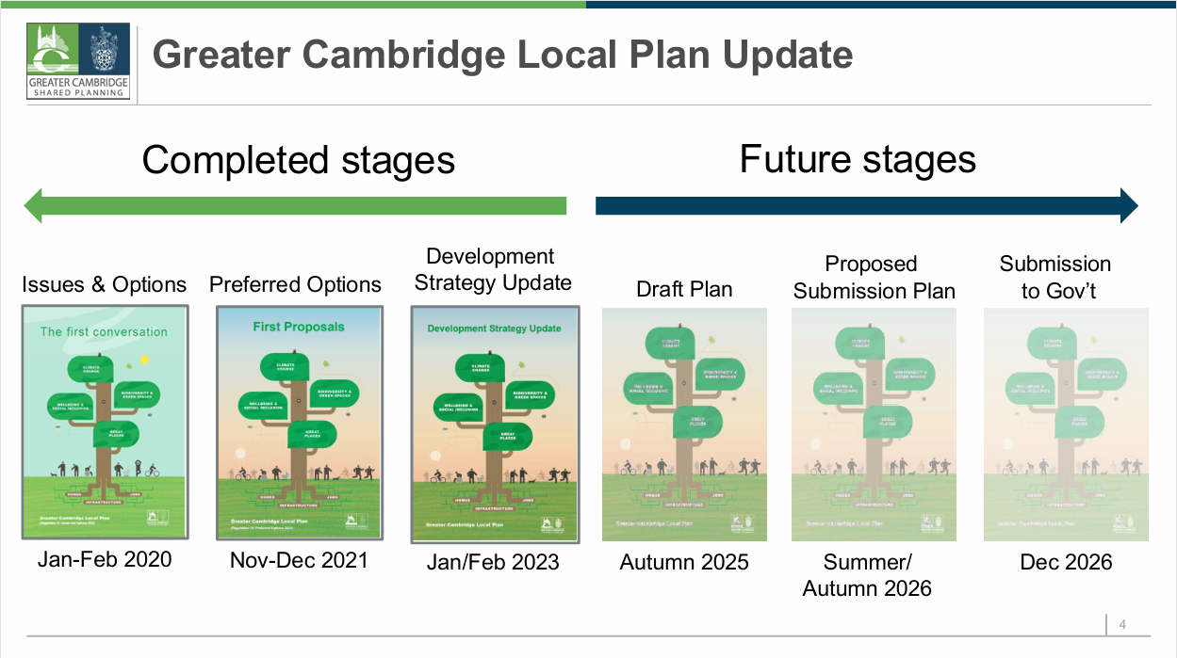

Slide 6
