Slide 1
Greater Cambridge Local Plan
Northstowe Community Forum
9 November 2022

Slide 2

What have we done so far?
First Proposals (Preferred Options) consultation held Nov-Dec 2021.
Representations received to the First Proposals were published June 2022.
Updated Greater Cambridge Local Development Scheme published August 2022 – included revised timetables for Greater Cambridge Local Plan and North East Cambridge Area Action Plan.

Slide 3
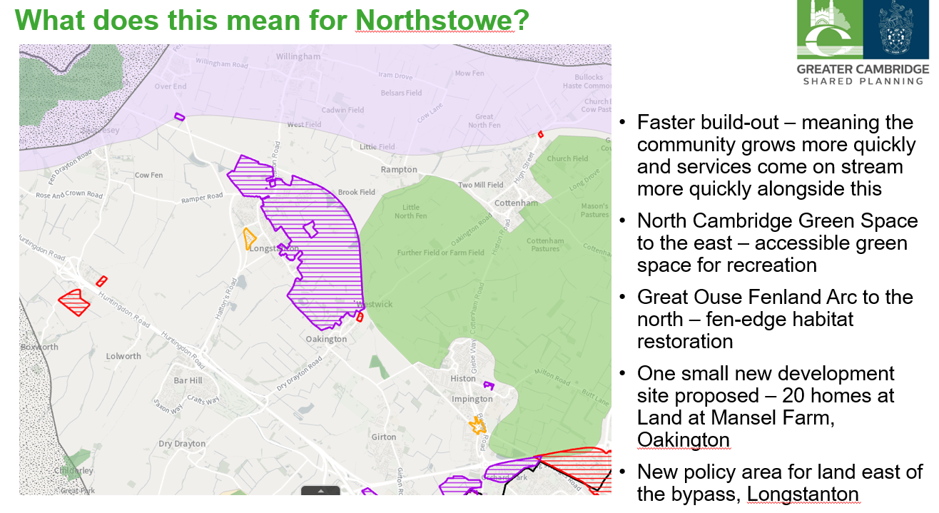
Greater Cambridge Local Plan First Proposals 2021

Slide 4
What are the next steps?
Series of Joint Local Planning Advisory Group meetings Oct 2022 – Mar 2023 to discuss key feedback from public consultation and seek Member views on next steps for each theme.
Formal Committee Meetings in Jan 2023 to consider responses received to the GLCP Strategy and Sites and confirm the Preferred Strategy and Sites
Full draft Local Plan (Reg 18) to be considered by Members in summer 2023 and then be subject to public consultation in Autumn 2023.

Slide 5
What is the rest of the plan making process?
Consider responses to Draft GCLP consultation and need for any changes to the plan.
Proposed Submission (Reg 19) GCLP and NECAAP stages will await the outcome of the CWWTP DCO process – they are predicated on the Cambridge WWTP relocating and if the DCO is approved it will provide evidence that redevelopment of NEC in both plans can be delivered.
LDS assumes consultation on Proposed Submission plans (Reg 19) in Autumn 2024, to follow the outcome of Cambridge WWTP DCO. This will be kept under review in light of progress of DCO.
LDS assumes Submission to Secretary of State for independent Examination (Reg 22) in Summer/ Autumn 2025, again subject to the outcome and timing of Cambridge WWTP DCO.

