Slide 1
Northstowe & Longstanton Heritage
Quinton Carroll
November 2022

Slide 2
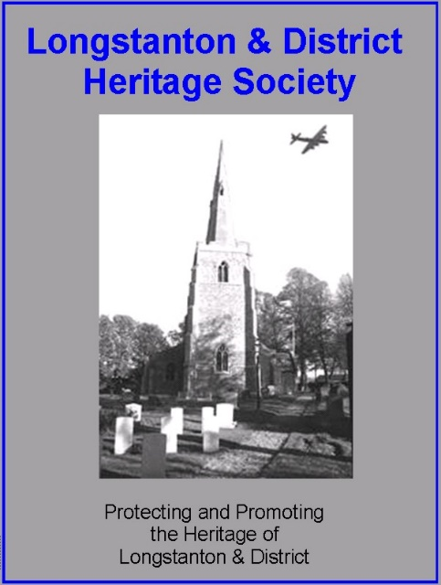
Partnership

Slide 3
Objectives
To provide Highways England & Northstowe Heritage Group with a new distinctive building to showcase the finds and artefacts from excavations,
To portray the history of Longstanton and RAF Oakington and surrounding area,
To provide a venue for public heritage related activities,
To form a focus for the new community in Northstowe,
To act as a broader culture and arts centre with a heritage bias which can eventually link in with other community centres as and when developed,
To offer promotional opportunities for all parties,
To act as a flagship venue for major heritage presentations in Cambridge,

Slide 4
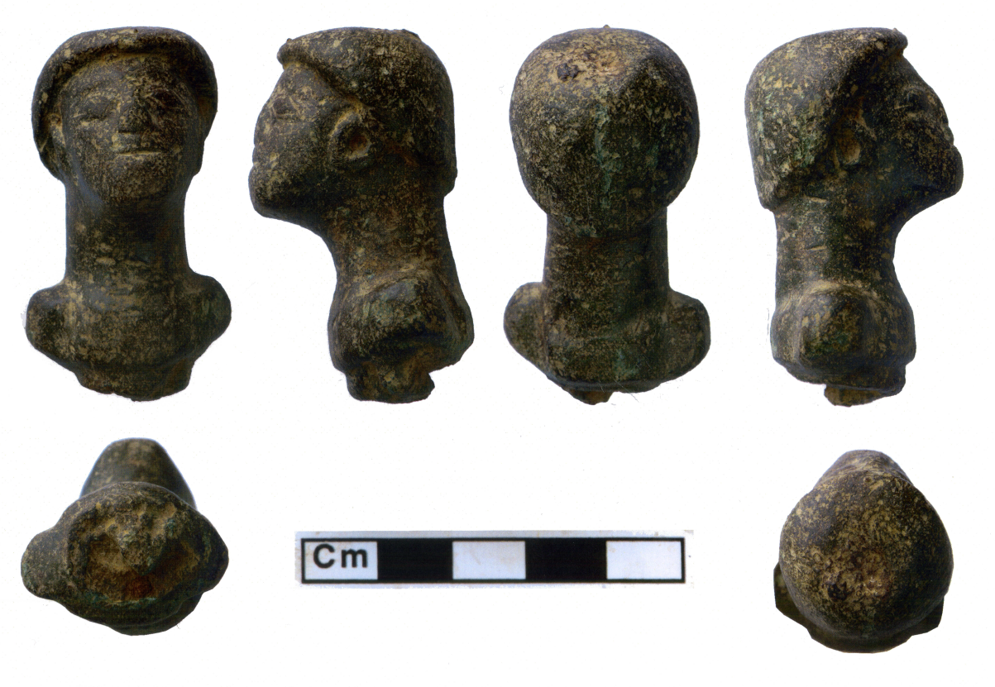
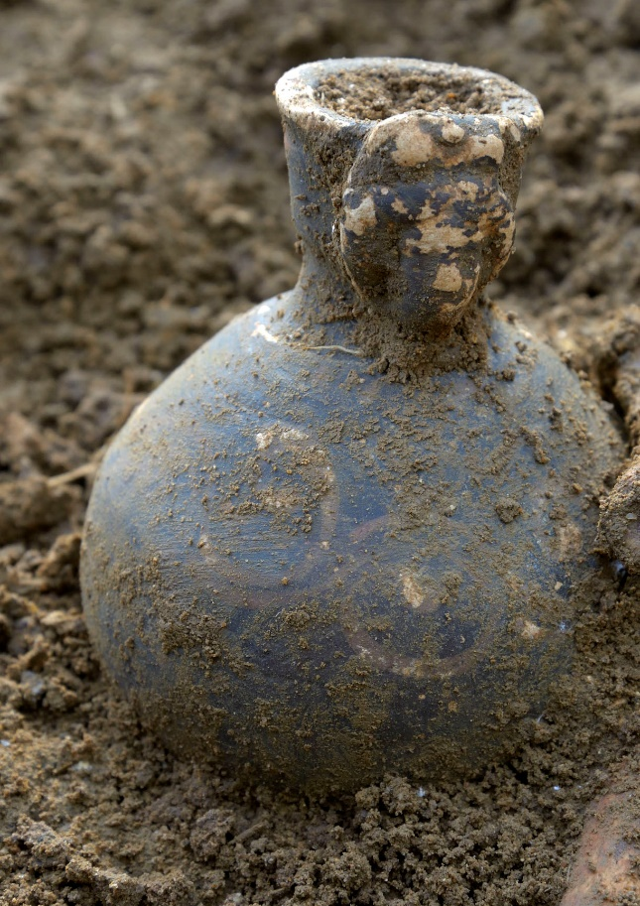
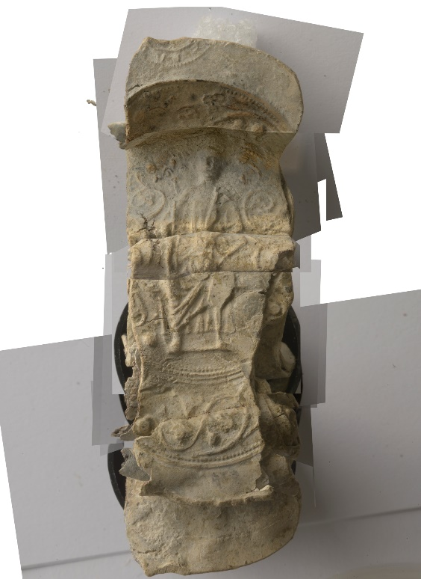
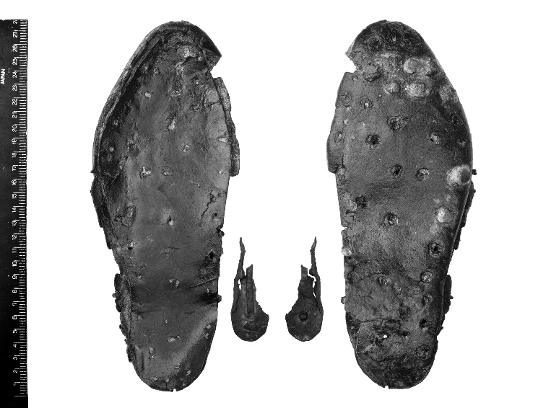

Slide 5
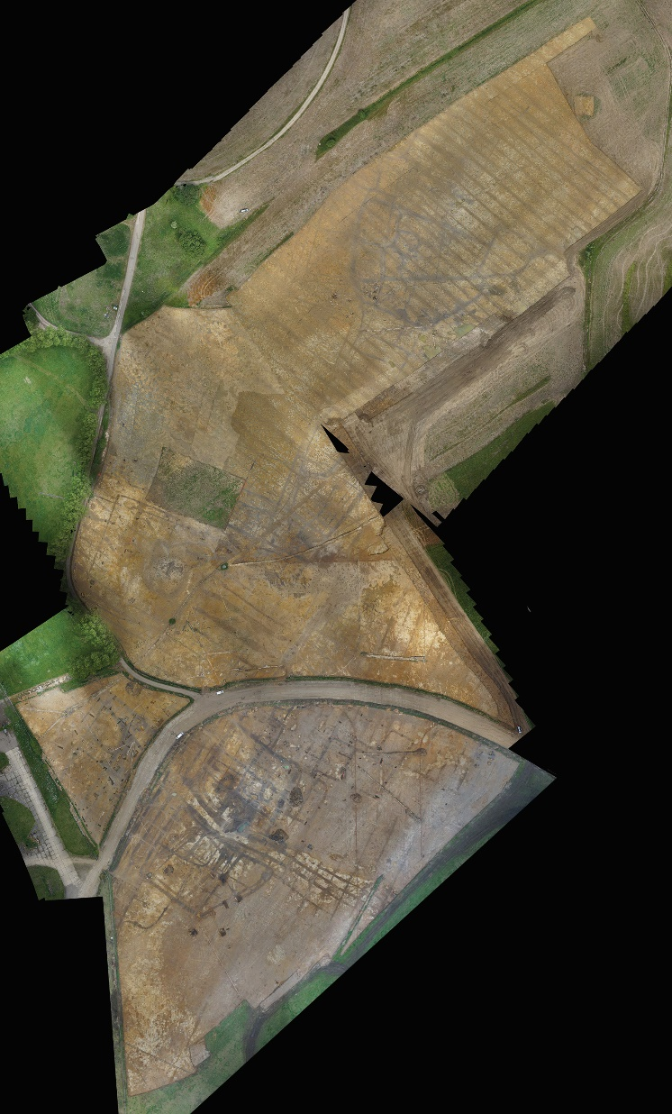

Slide 6
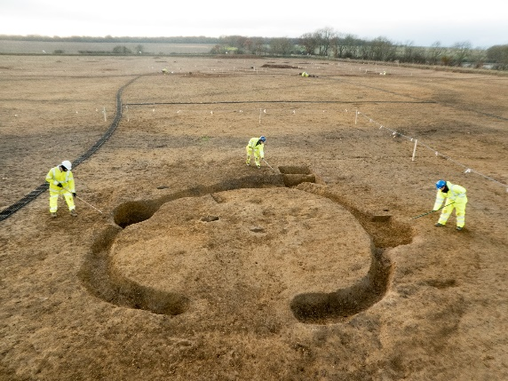
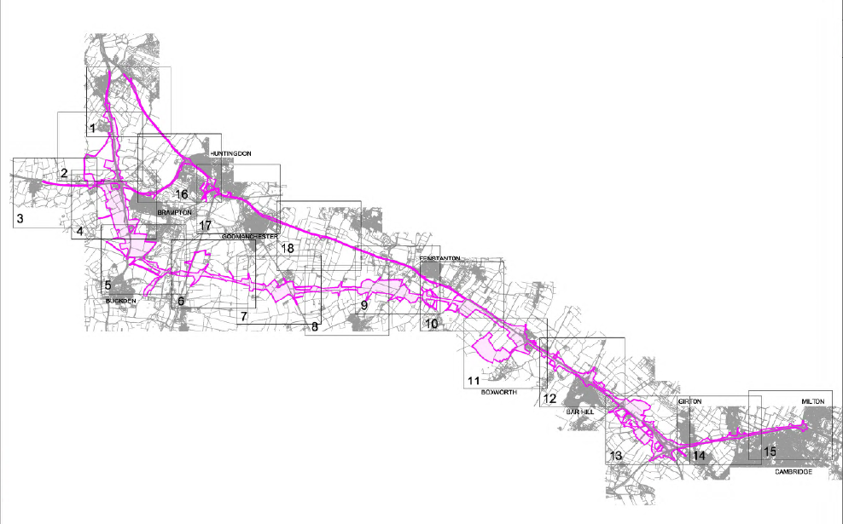
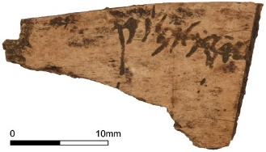
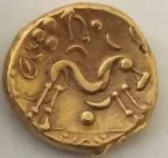
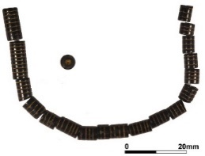
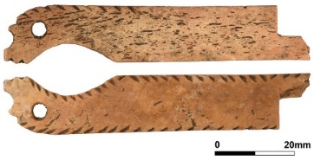
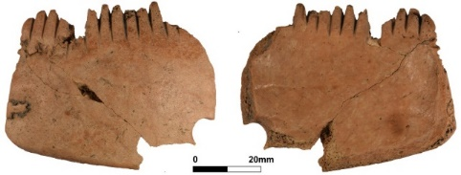
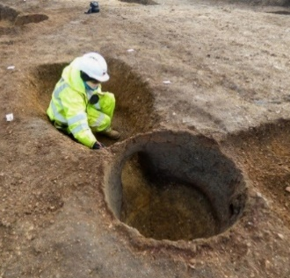
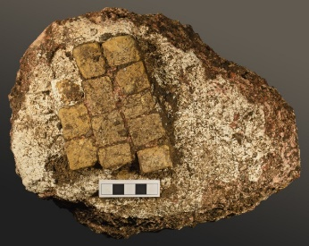
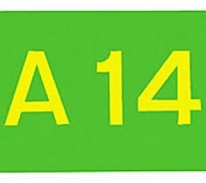
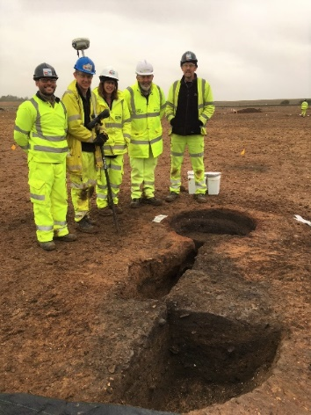
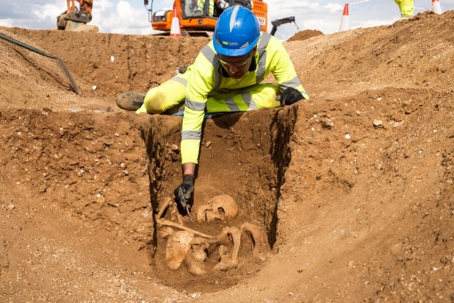
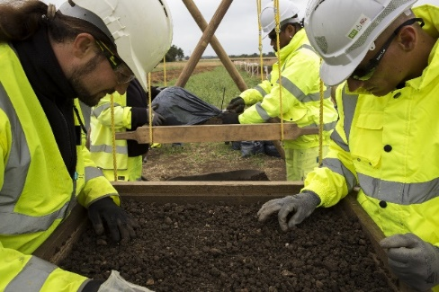
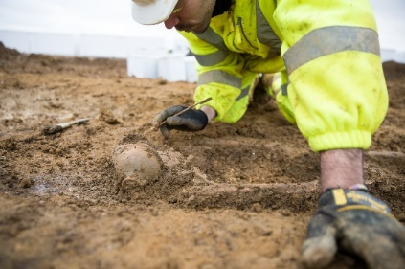
Example:

Slide 7
Content Working Group
A14 IDT
LDHS
Cambridge Archaeological Unit
MHI (MOLA Headland Infrastructure)
Programme of themed exhibitions
Local Content/Stories

Slide 8
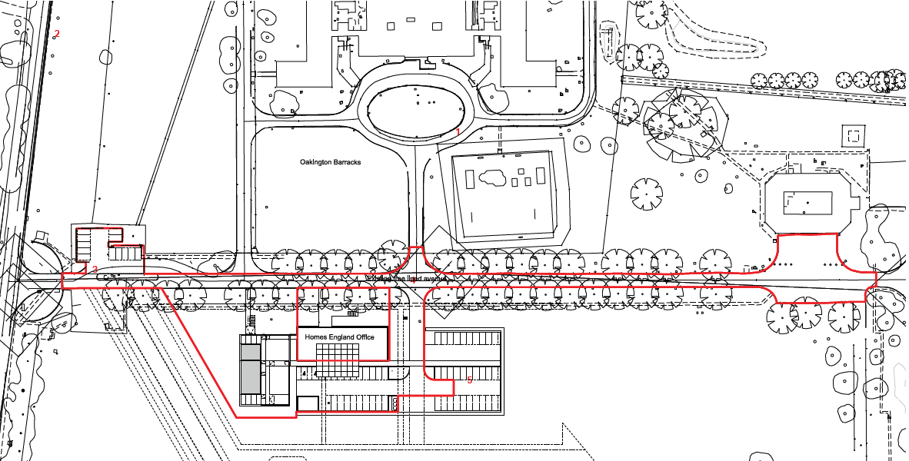

Slide 9
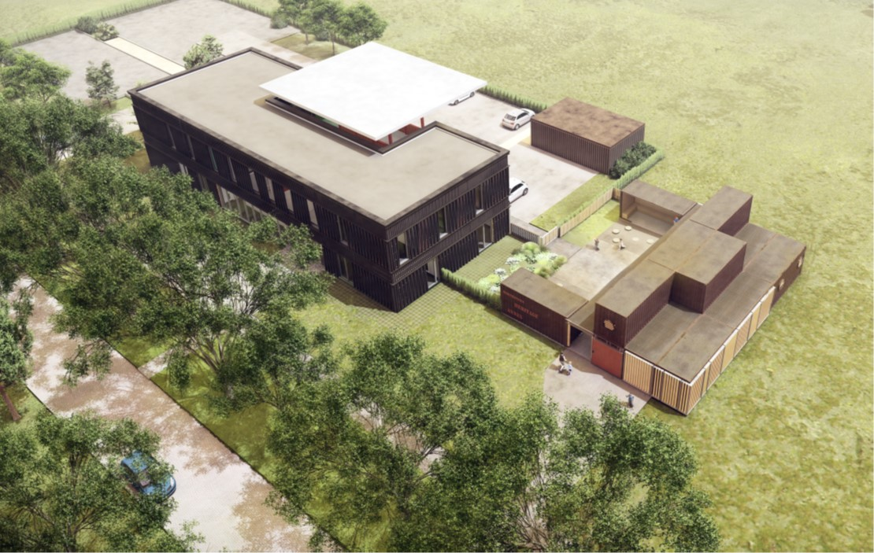

Slide 10
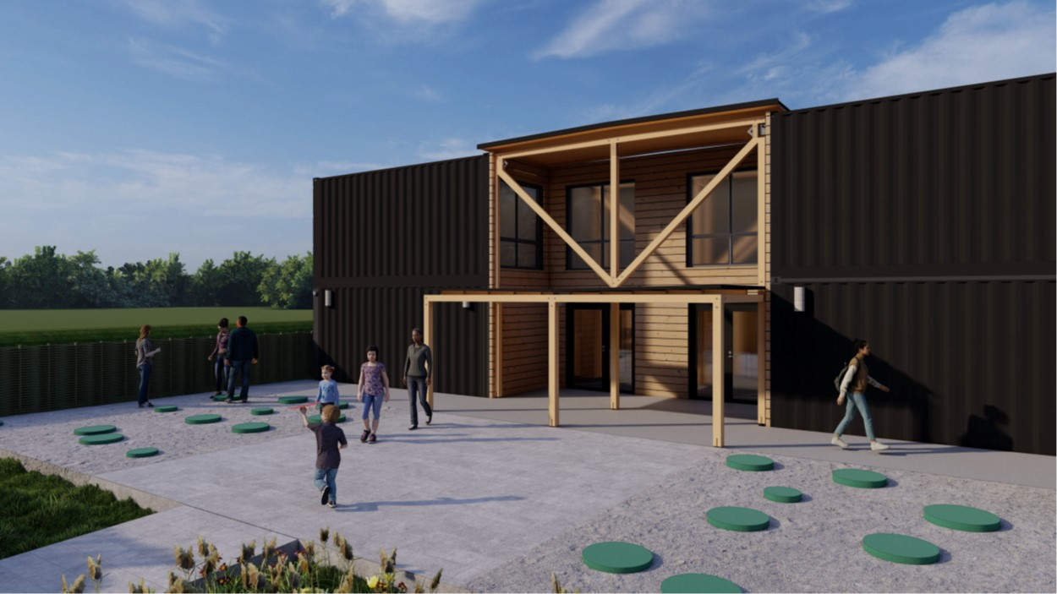

Slide 11
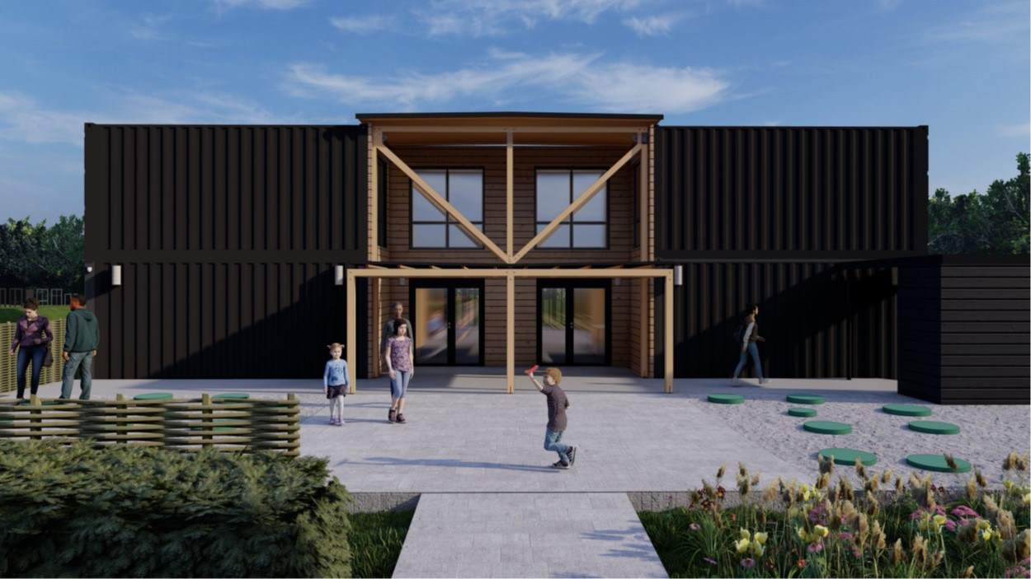

Slide 12
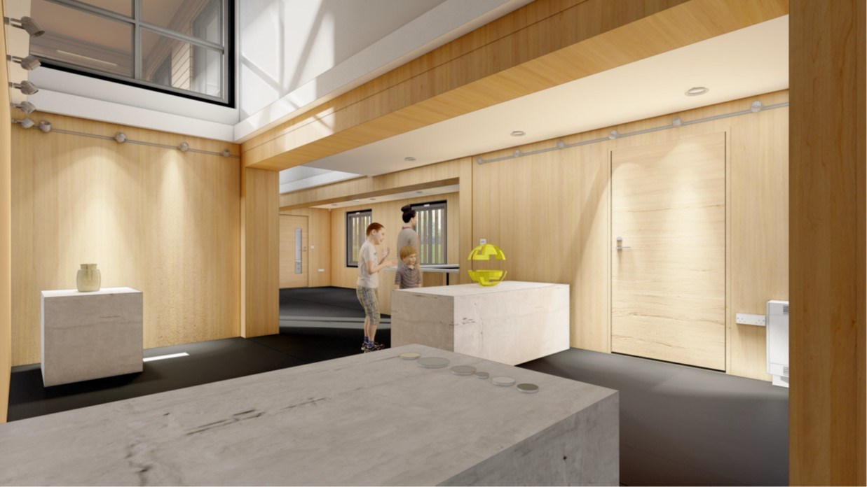

Slide 13
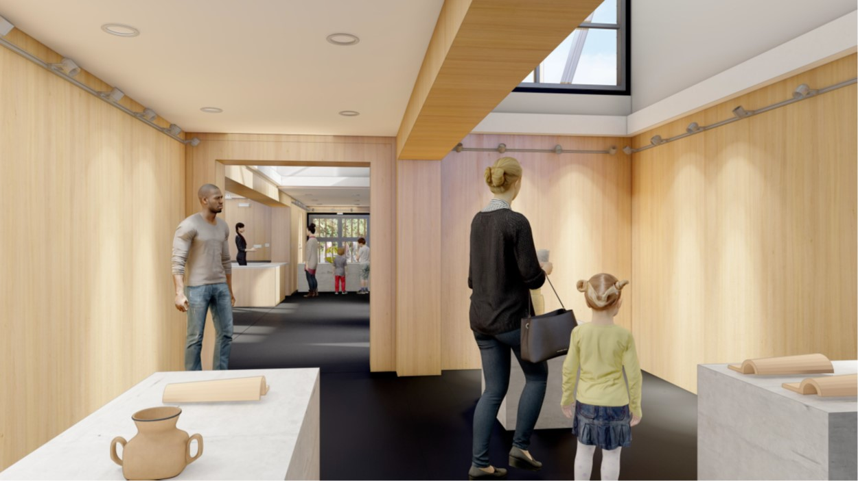

Slide 14
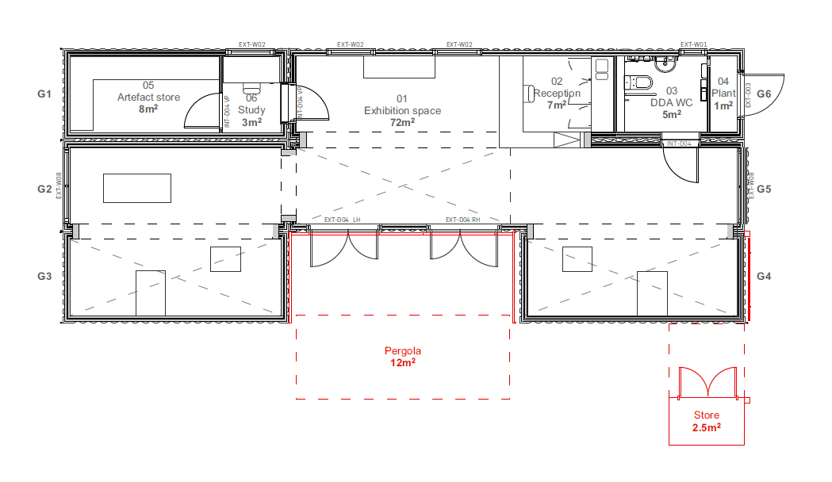

Slide 15
Visitor Numbers (SHARE 2016/7)
Cambs museums
16 small-medium
127,400 visitors
£2.3m contribution to local economy
1095 outreach sessions – 28,500 participants
263 schools visits
One off events
Local Heritage Day – 5,500
‘Childhood in Archaeology’ (MAA & CCC) – 60,000 visitors over 12 months

Slide 16
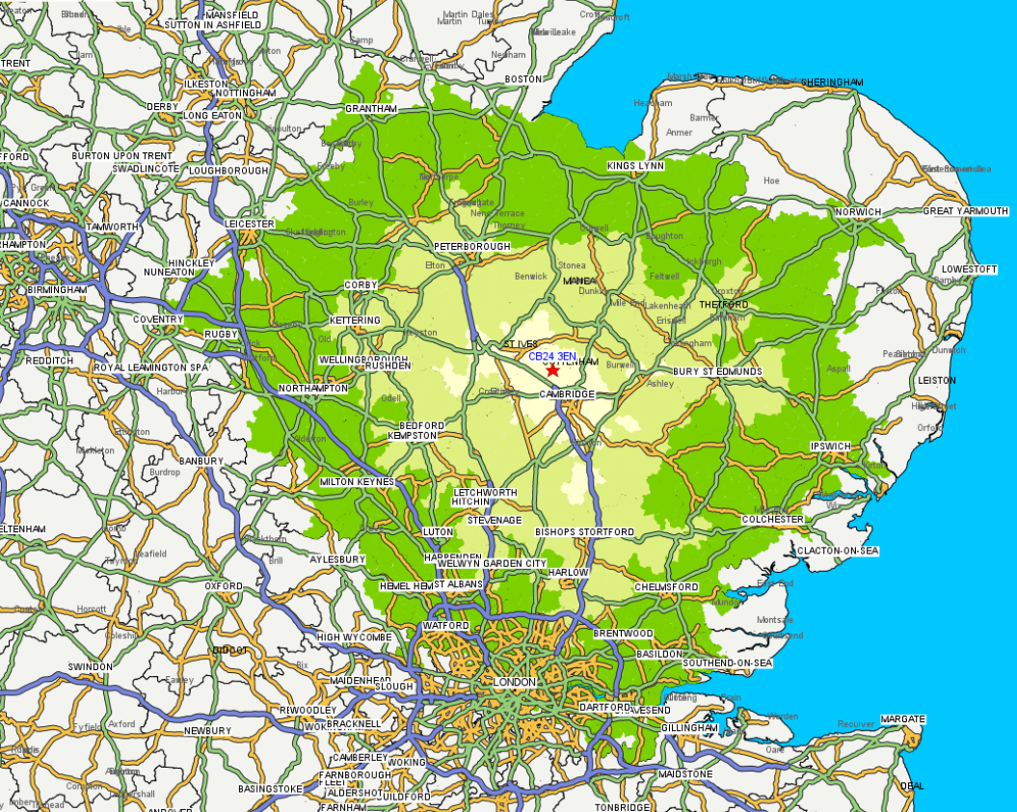

Slide 17
Timetable
Foundations commenced October 2022
Module fit out underway
Module Delivery End January 2023
Assembly and fit out February 2023
Exhibition installation March 2023
Open Easter 2023

Slide 18
For more information
Historic Environment Team,
Cambridgeshire County Council
Tel: 01223 728564
Email: archaeology@cambridgeshire.gov.uk
www.cambridgeshire.gov.uk/archaeology
www.facebook.com/CambridgeshireArchaeology
@CambsArch

