Slide 1
COMMUNITY FORUM NORTHSTOWE : PHASE 2:
The first primary school in Northstowe, Pathfinder CE Primary School is managed by the Diocese of Ely Multi-Academy Trust Board of Education. The school has 630 primary places, offers 60 pre-school places and an out-of-school club.
•
The first secondary school, Northstowe Secondary College, is run by the Meridian Trust. The school opened for 600 pupils aged 11-16 in its first phase and will be extended in phase 2 to 1,200 places from September 2024 and finally to 1,800 pupils
Also from September 2024, Northstowe Secondary College will extend its age range with facilities to offer up to 78 early years places, 630 primary places and 400 sixth form places.
•
The early years provision offered at Northstowe Secondary College will be commissioned through the Council’s Pseudo Dynamic Purchasing System (PDPS). The Council is considering whether it should be full day care or another pre-school. The setting will offer the full range of funded entitlements, including both the universal (15 hours) and extended entitlement (30 hours) and funded places for 2 year olds, who meet the government’s eligibility criteria.
The current plan is to open the primary phase of Northstowe Secondary College with one class in Reception (Age 4+). This will help to minimise the impact on surrounding schools and ensure that there is sufficient capacity for residents on the new development. The Council will work in collaboration with the Trust to monitor growth in its first few years so that this can be adjusted accordingly.
•
The Martin Bacon Academy also run by the Meridian Trust provides 120 places for children aged 3-19 with SEND.
Further schools will be built as the housing development progresses. Forecasts currently suggest a total of six primary schools and one secondary school will be required to serve the development but this will be kept under review.

Slide 2
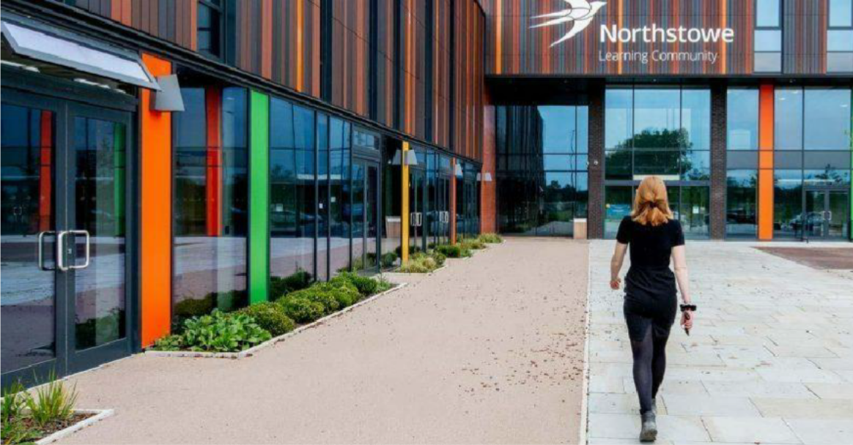
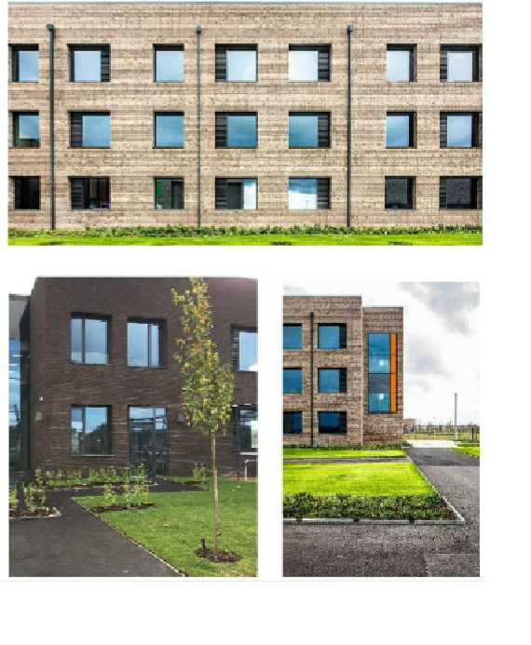
URBAN DESIGN : WIDER CONTEXT PHASE 1: EXISTING SECONDARY SCHOOL

Slide 3
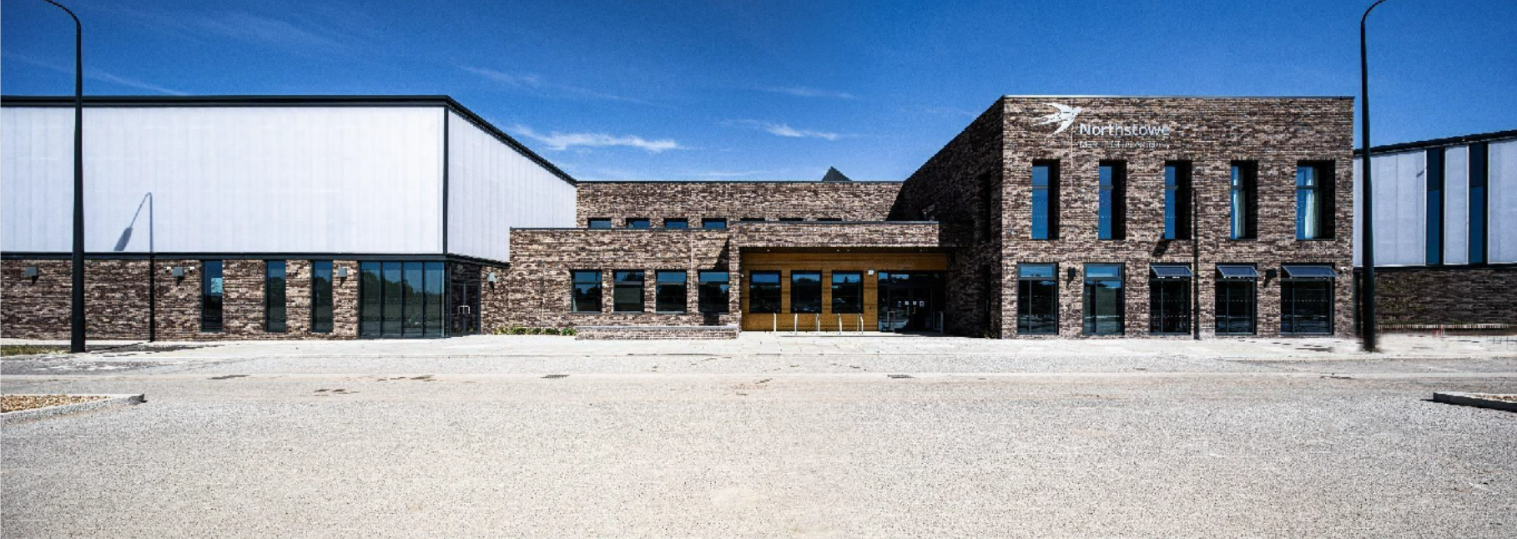
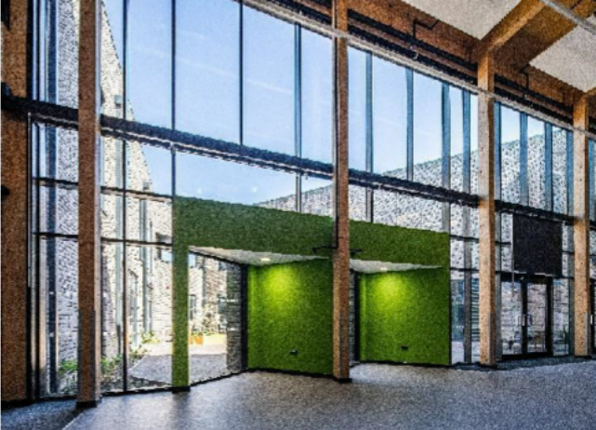
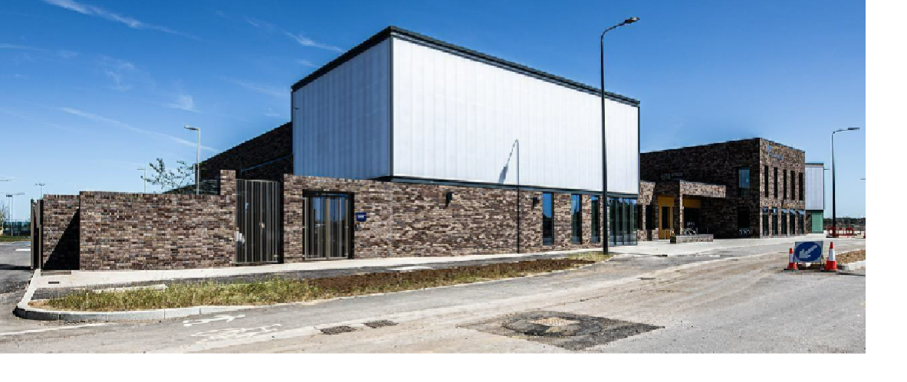
URBAN DESIGN : WIDER CONTEXT PHASE 1: EXISTING SEN - MBA

Slide 4
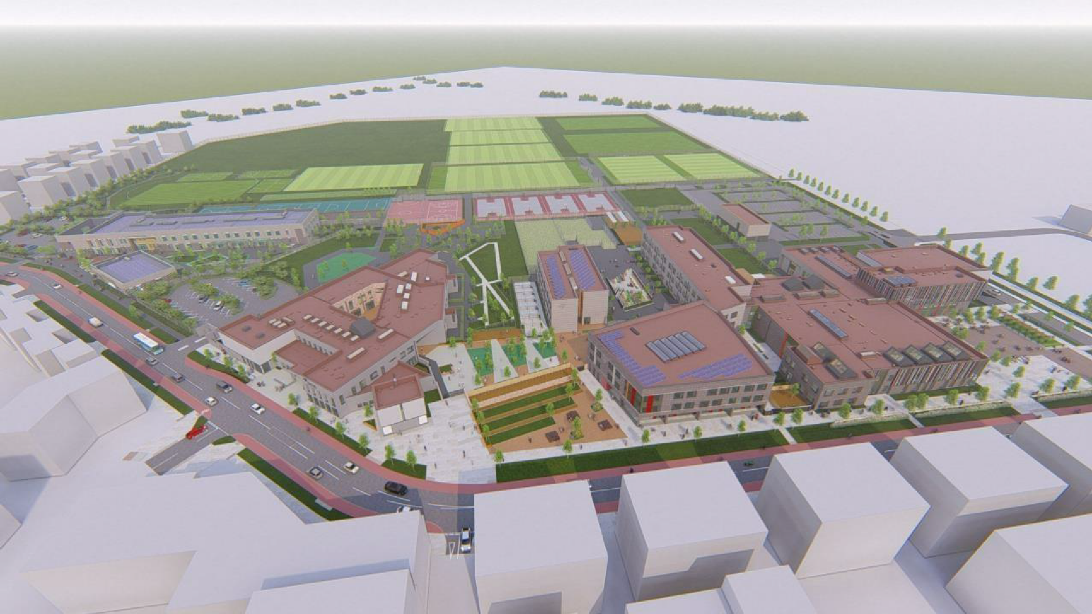
MASTERPLAN : 3D

Slide 5
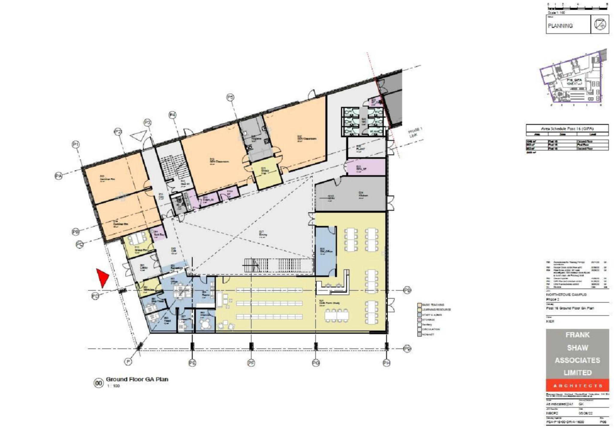
P16:
GA PLAN - GF

Slide 6
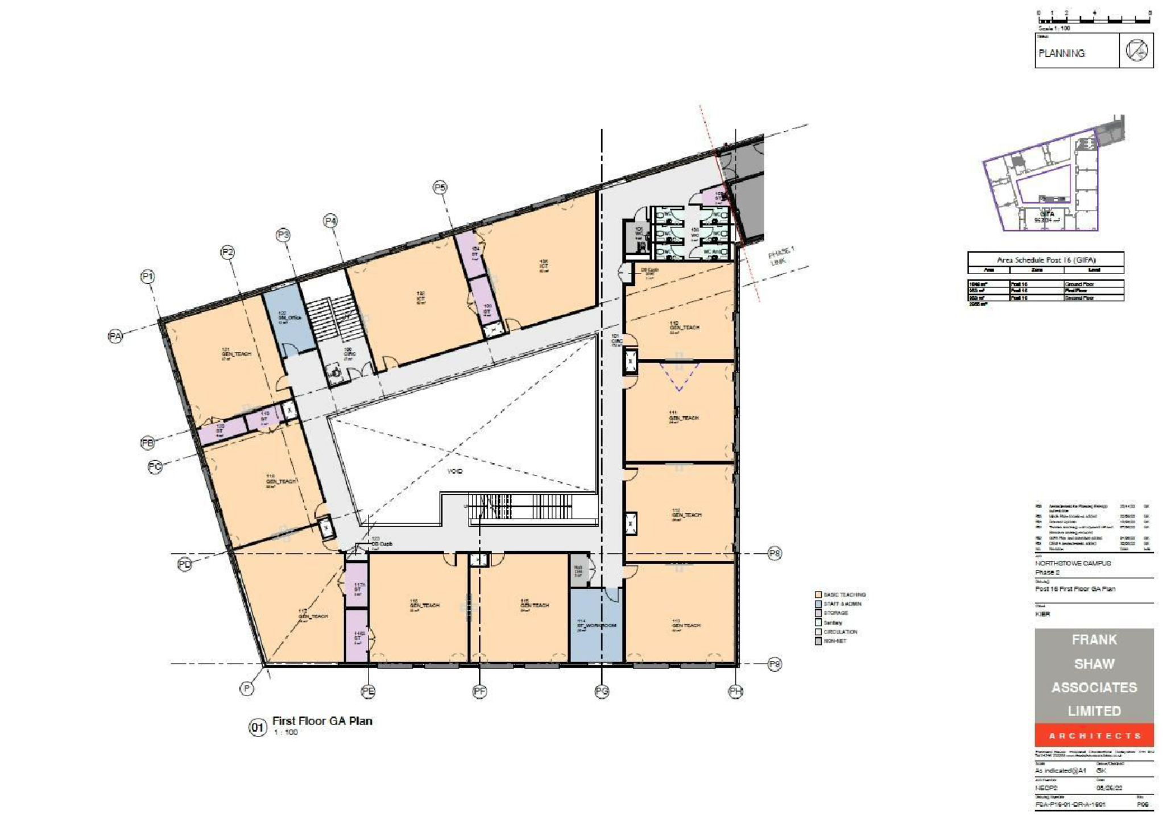
P16:
GA PLAN - FIRST

Slide 7
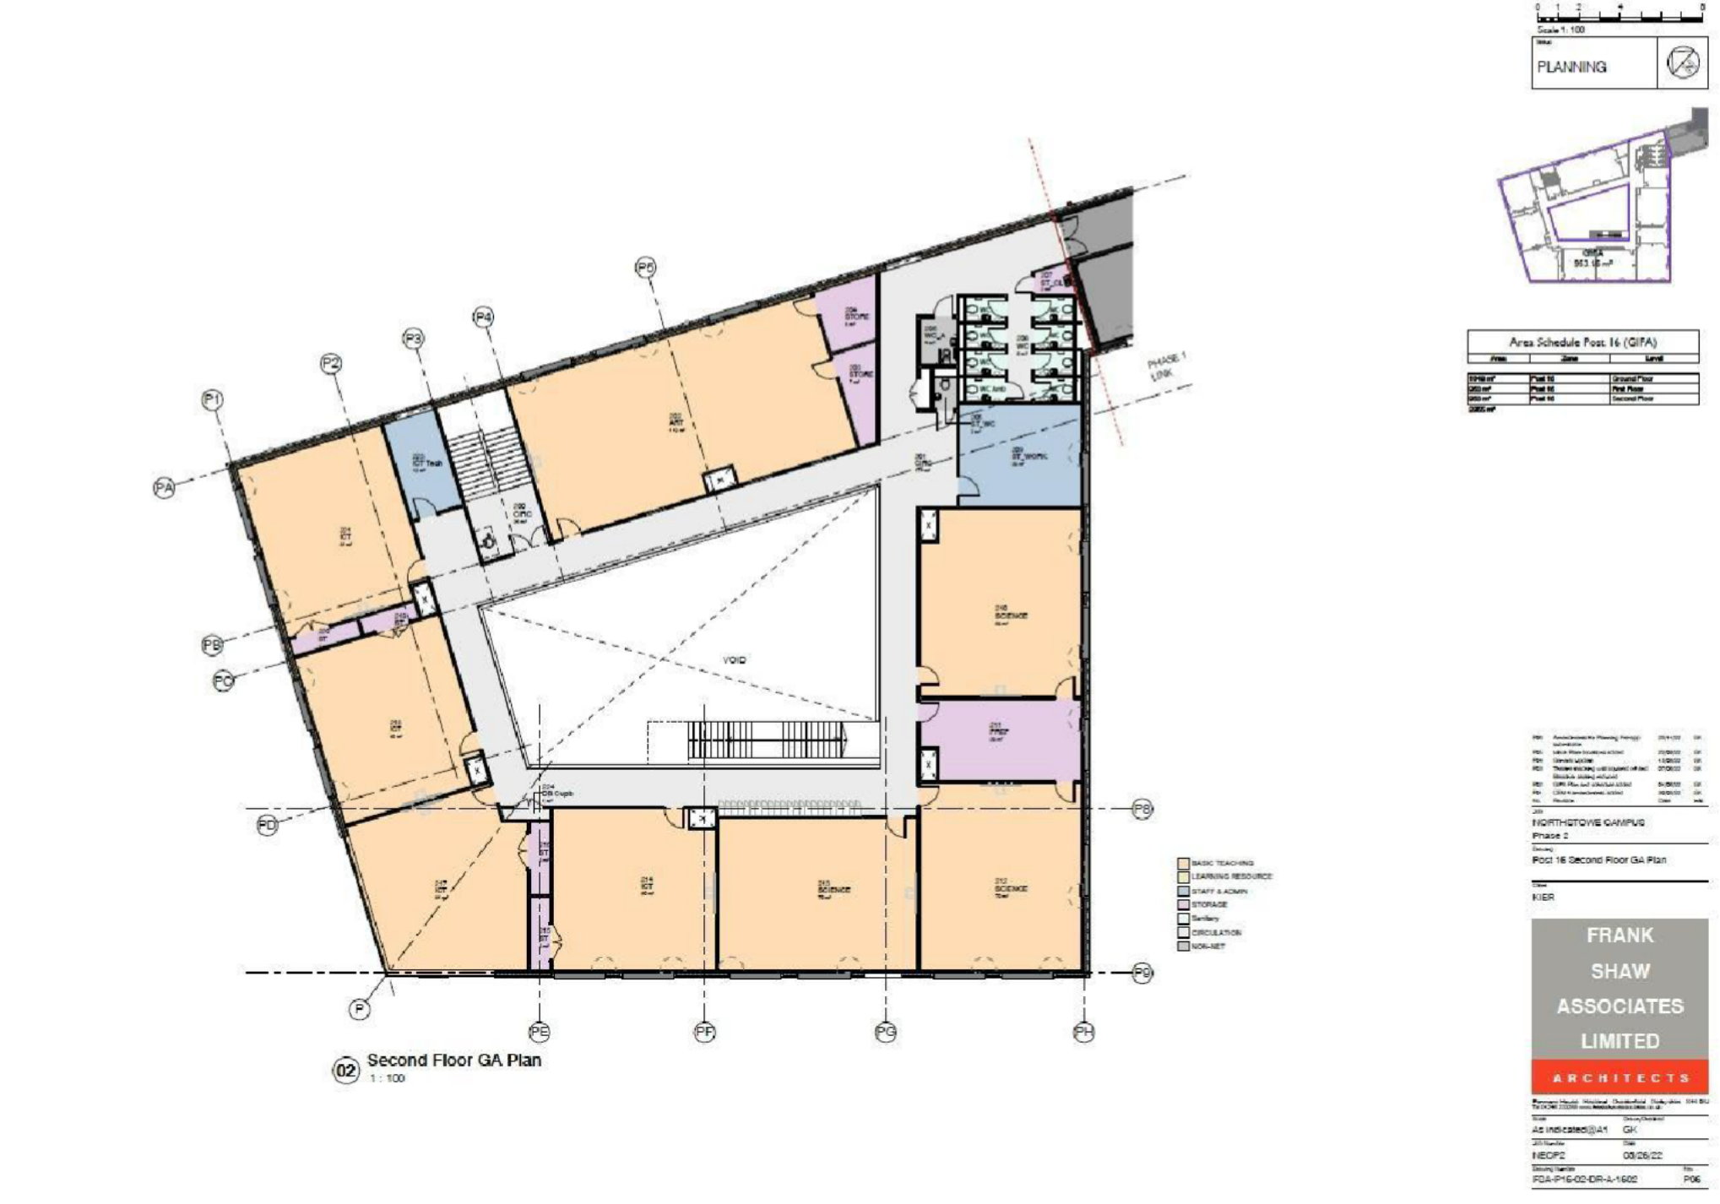
P16:
GA PLAN - SECOND

Slide 8
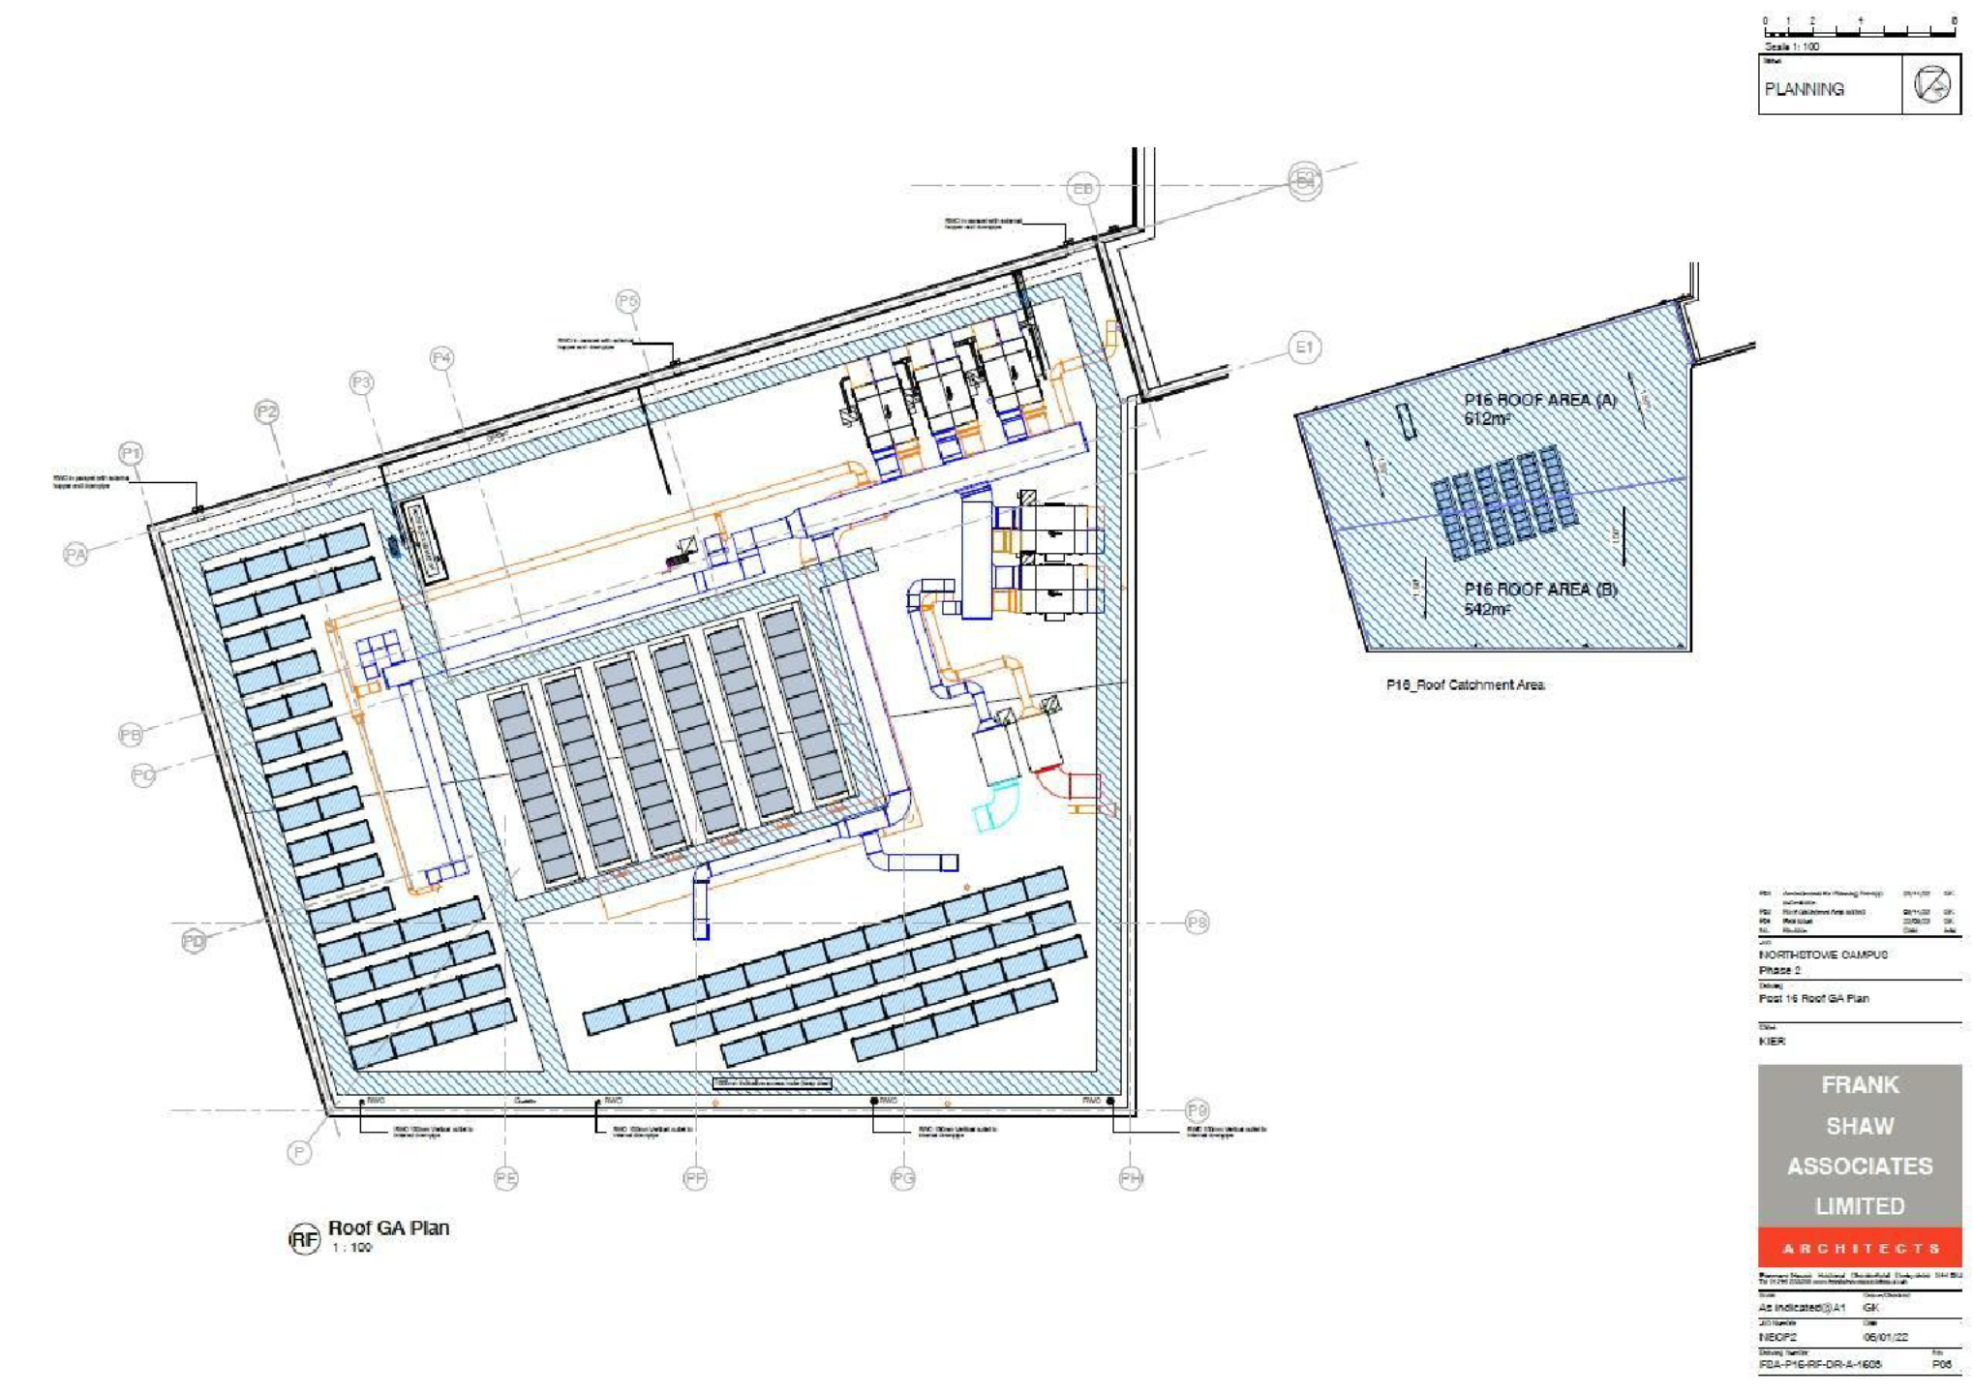
P16:
GA PLAN - SECOND

Slide 9
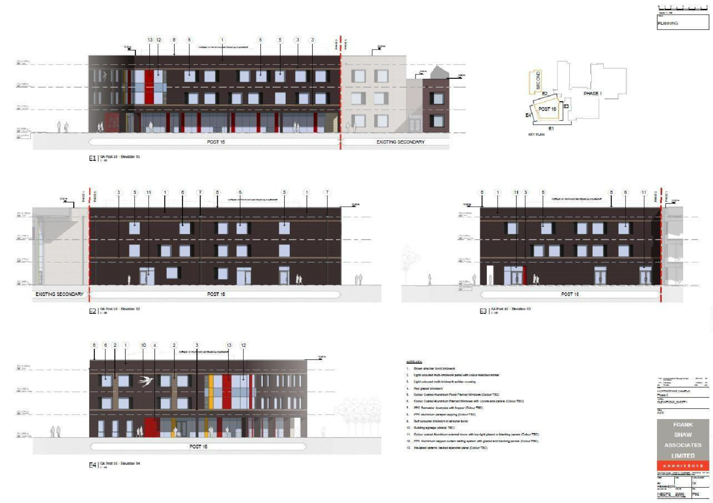
P16: ELEVATIONS

Slide 10
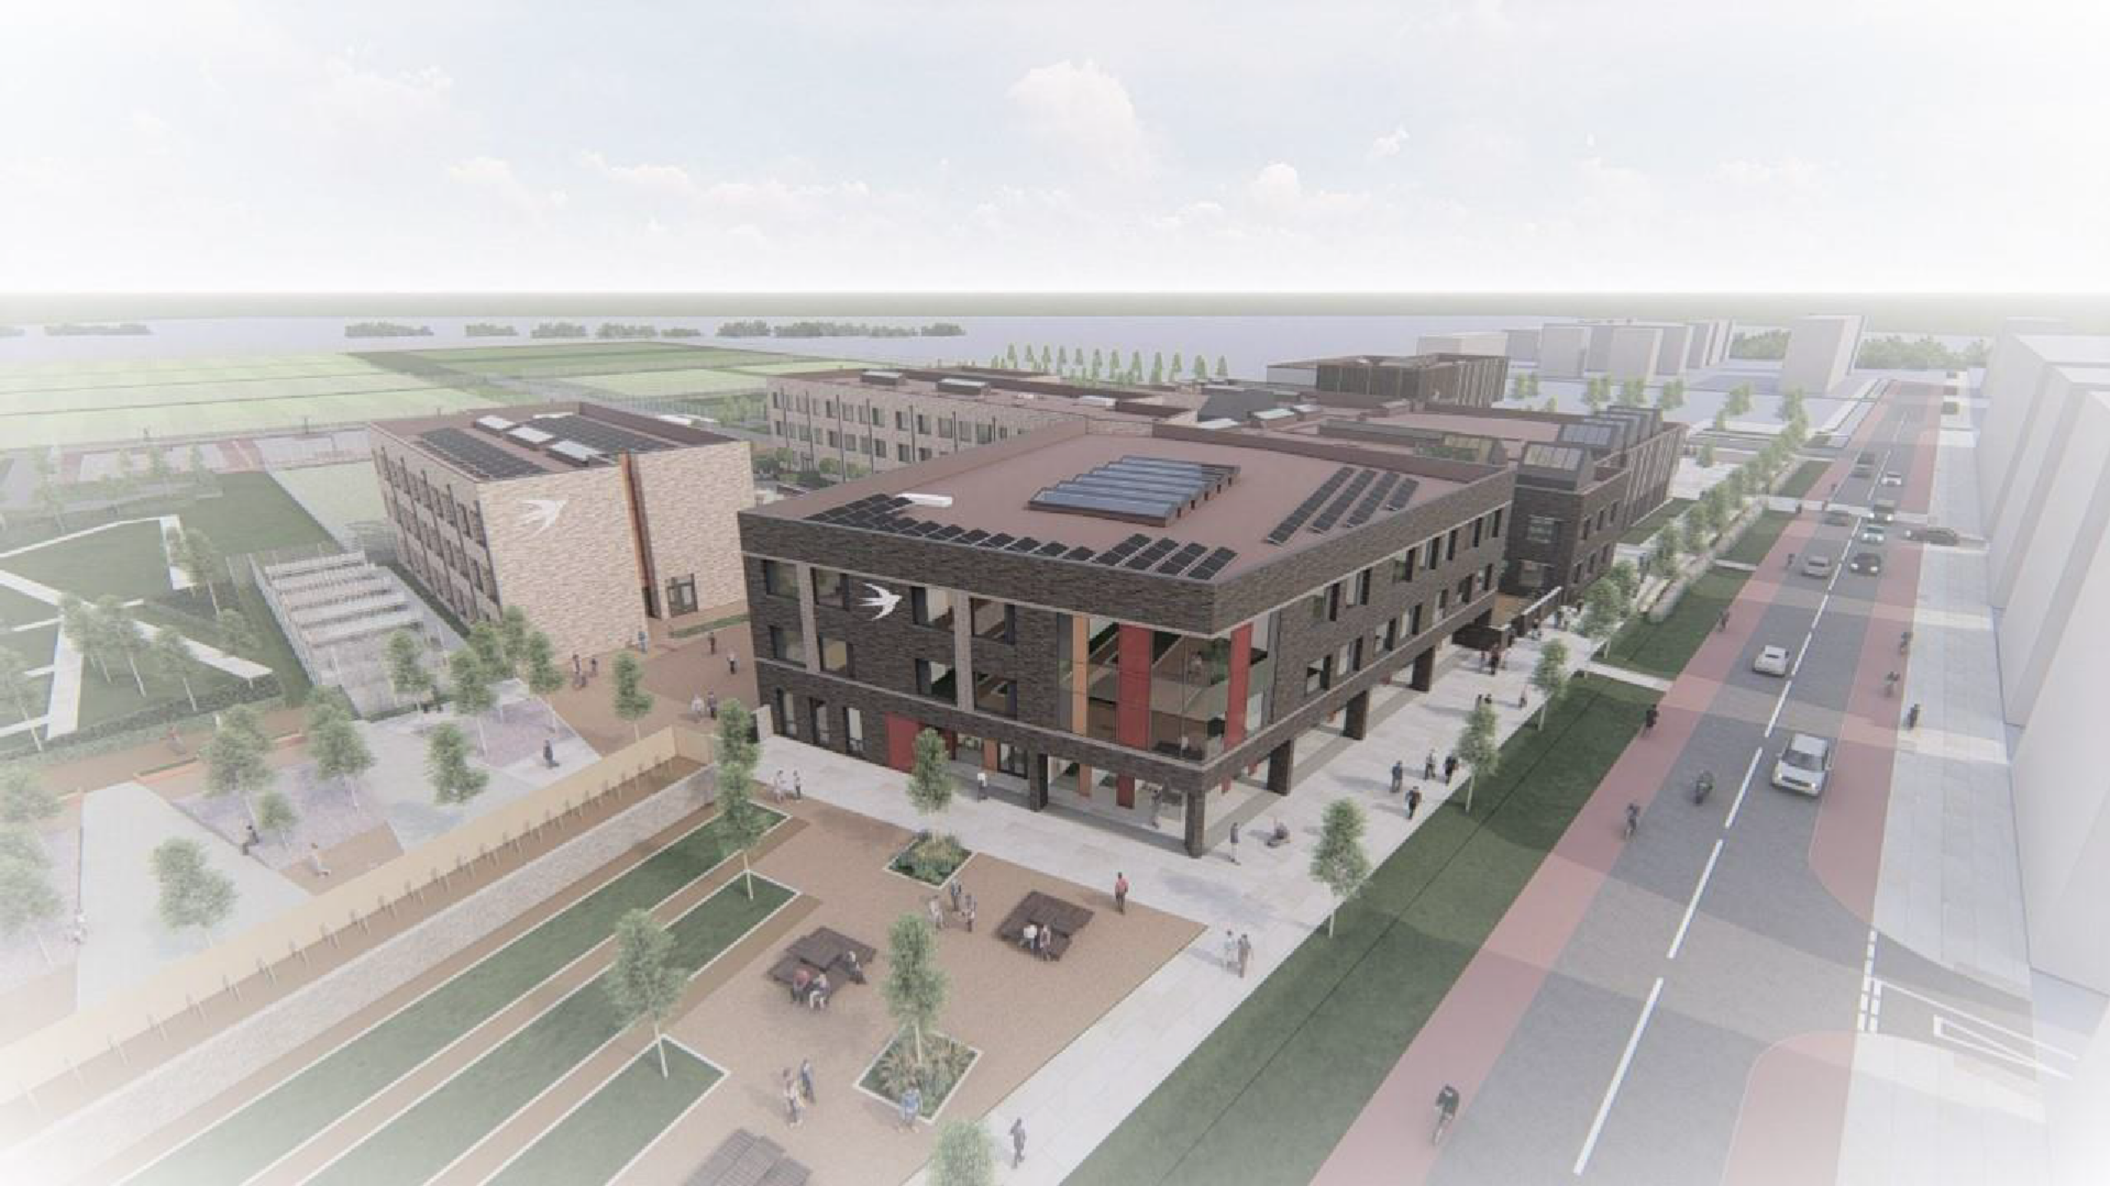
P16: 3D

Slide 11
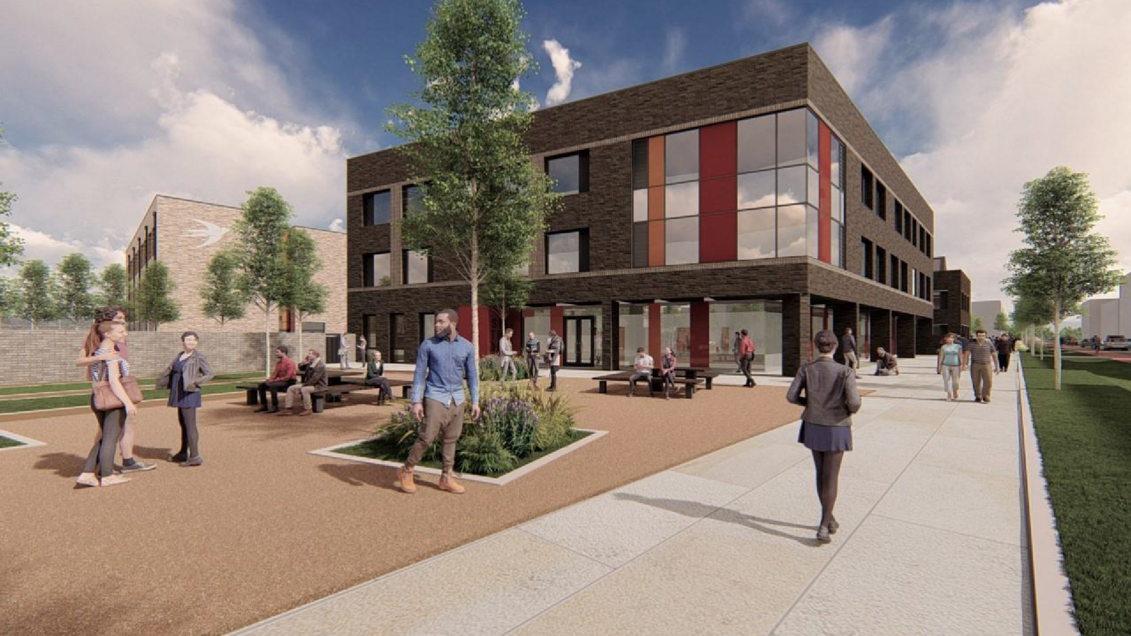
P16: 3D

Slide 12
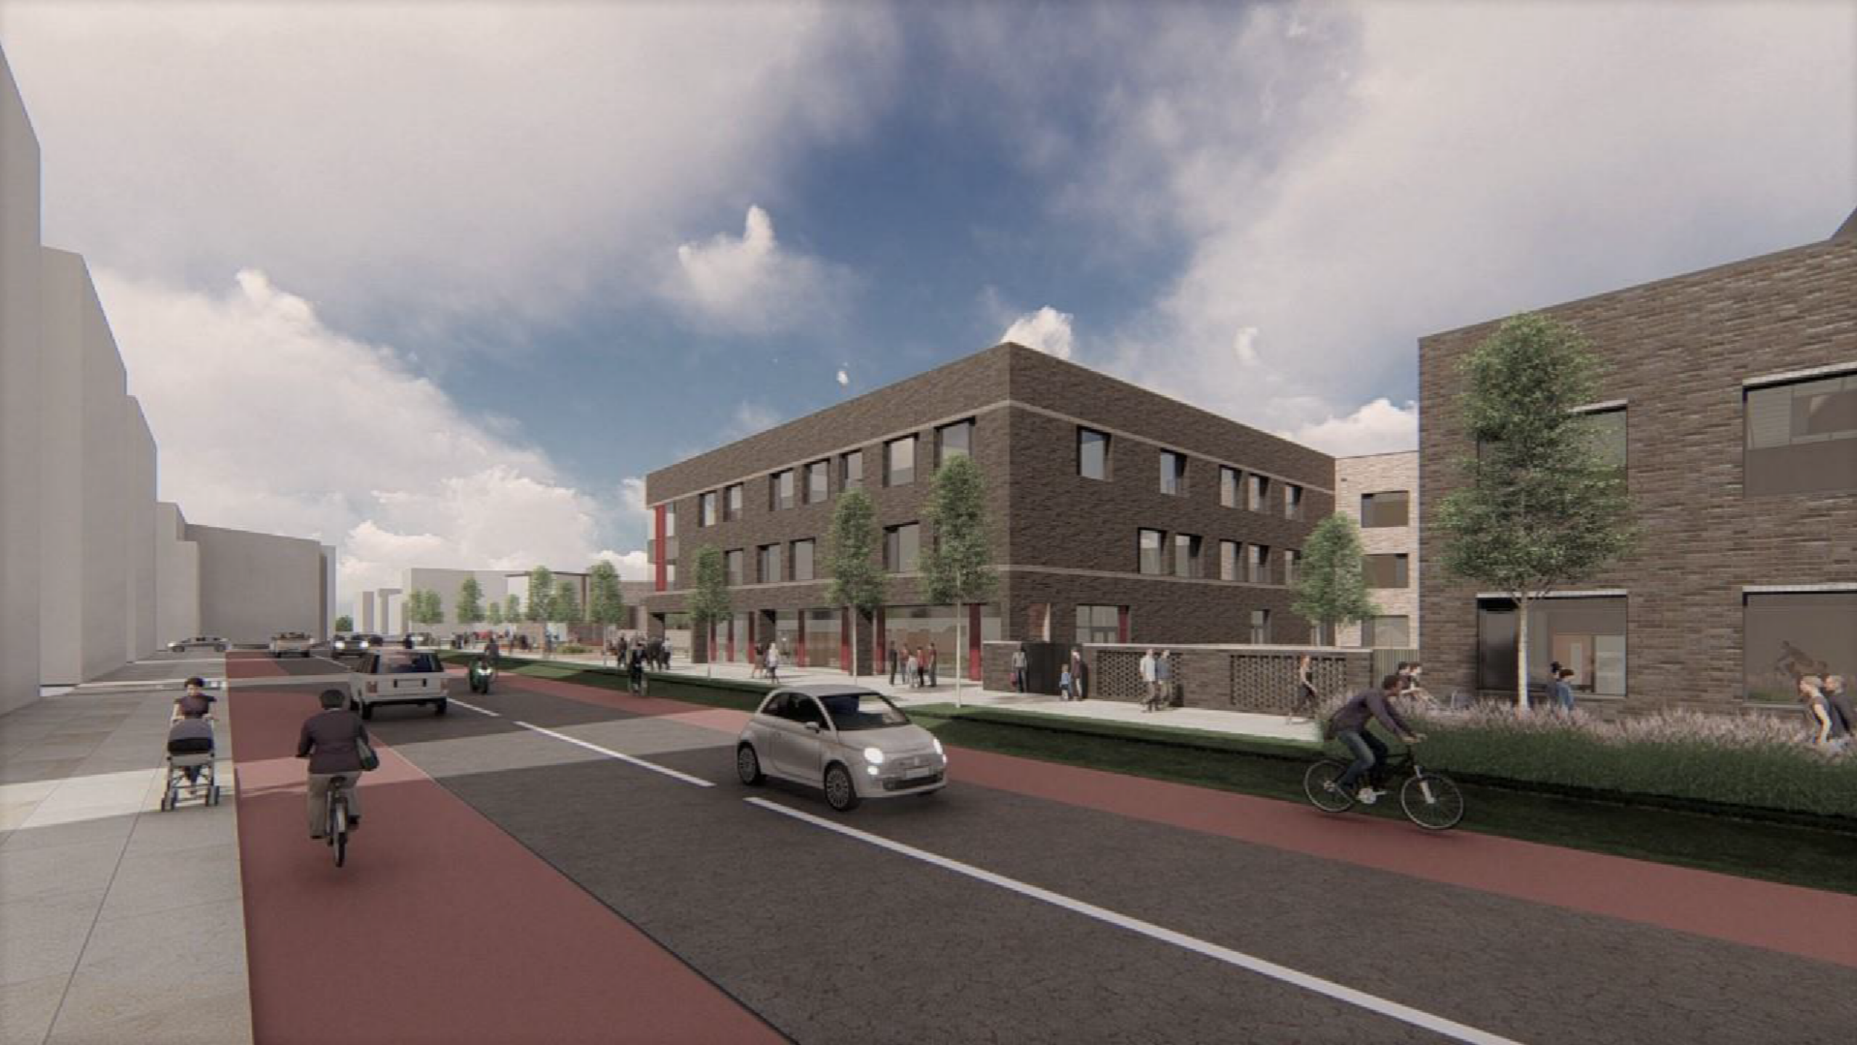
P16: 3D

Slide 13
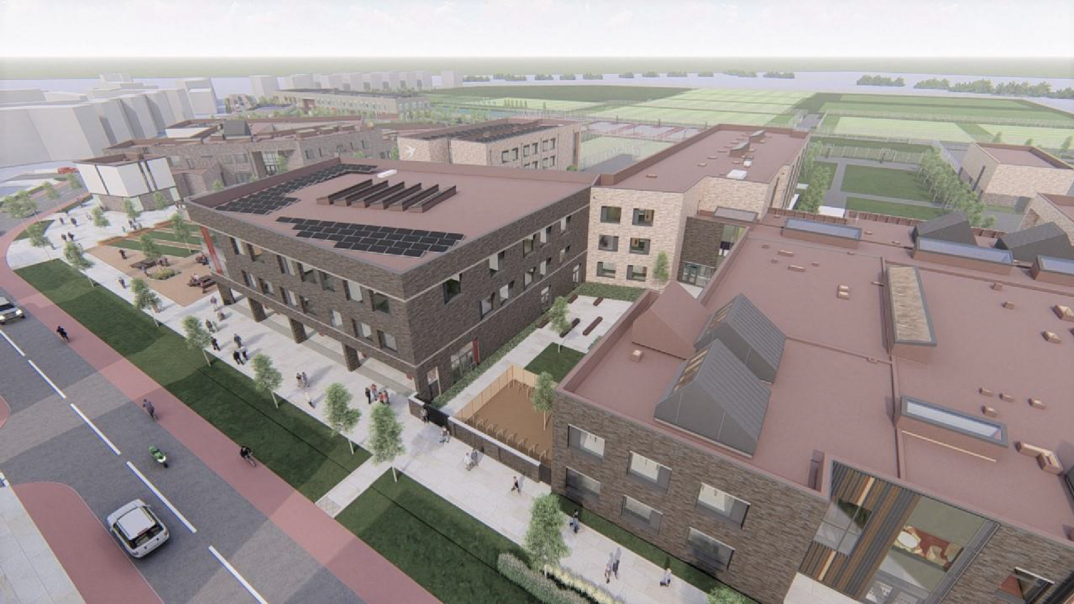
P16: 3D

Slide 14
MASTERPLAN : 3D

Slide 15
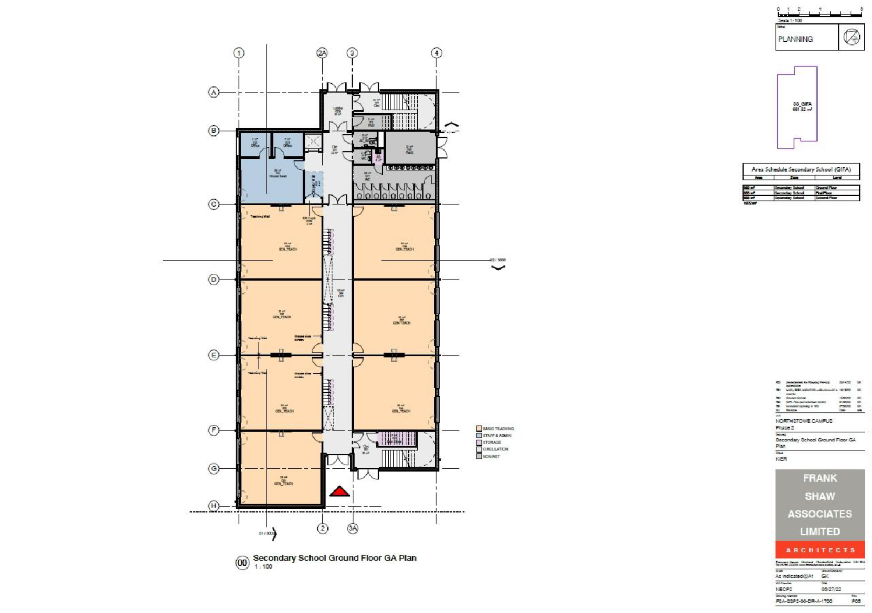
SECONDARY SCHOOL EXTENSION: GA PLAN - GF

Slide 16
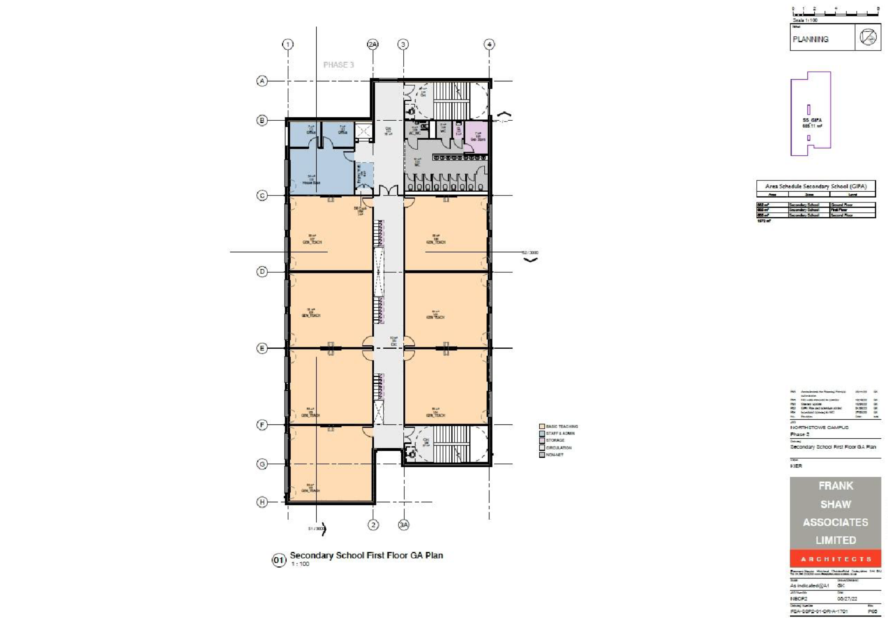
SECONDARY SCHOOL EXTENSION: GA PLAN - FF

Slide 17
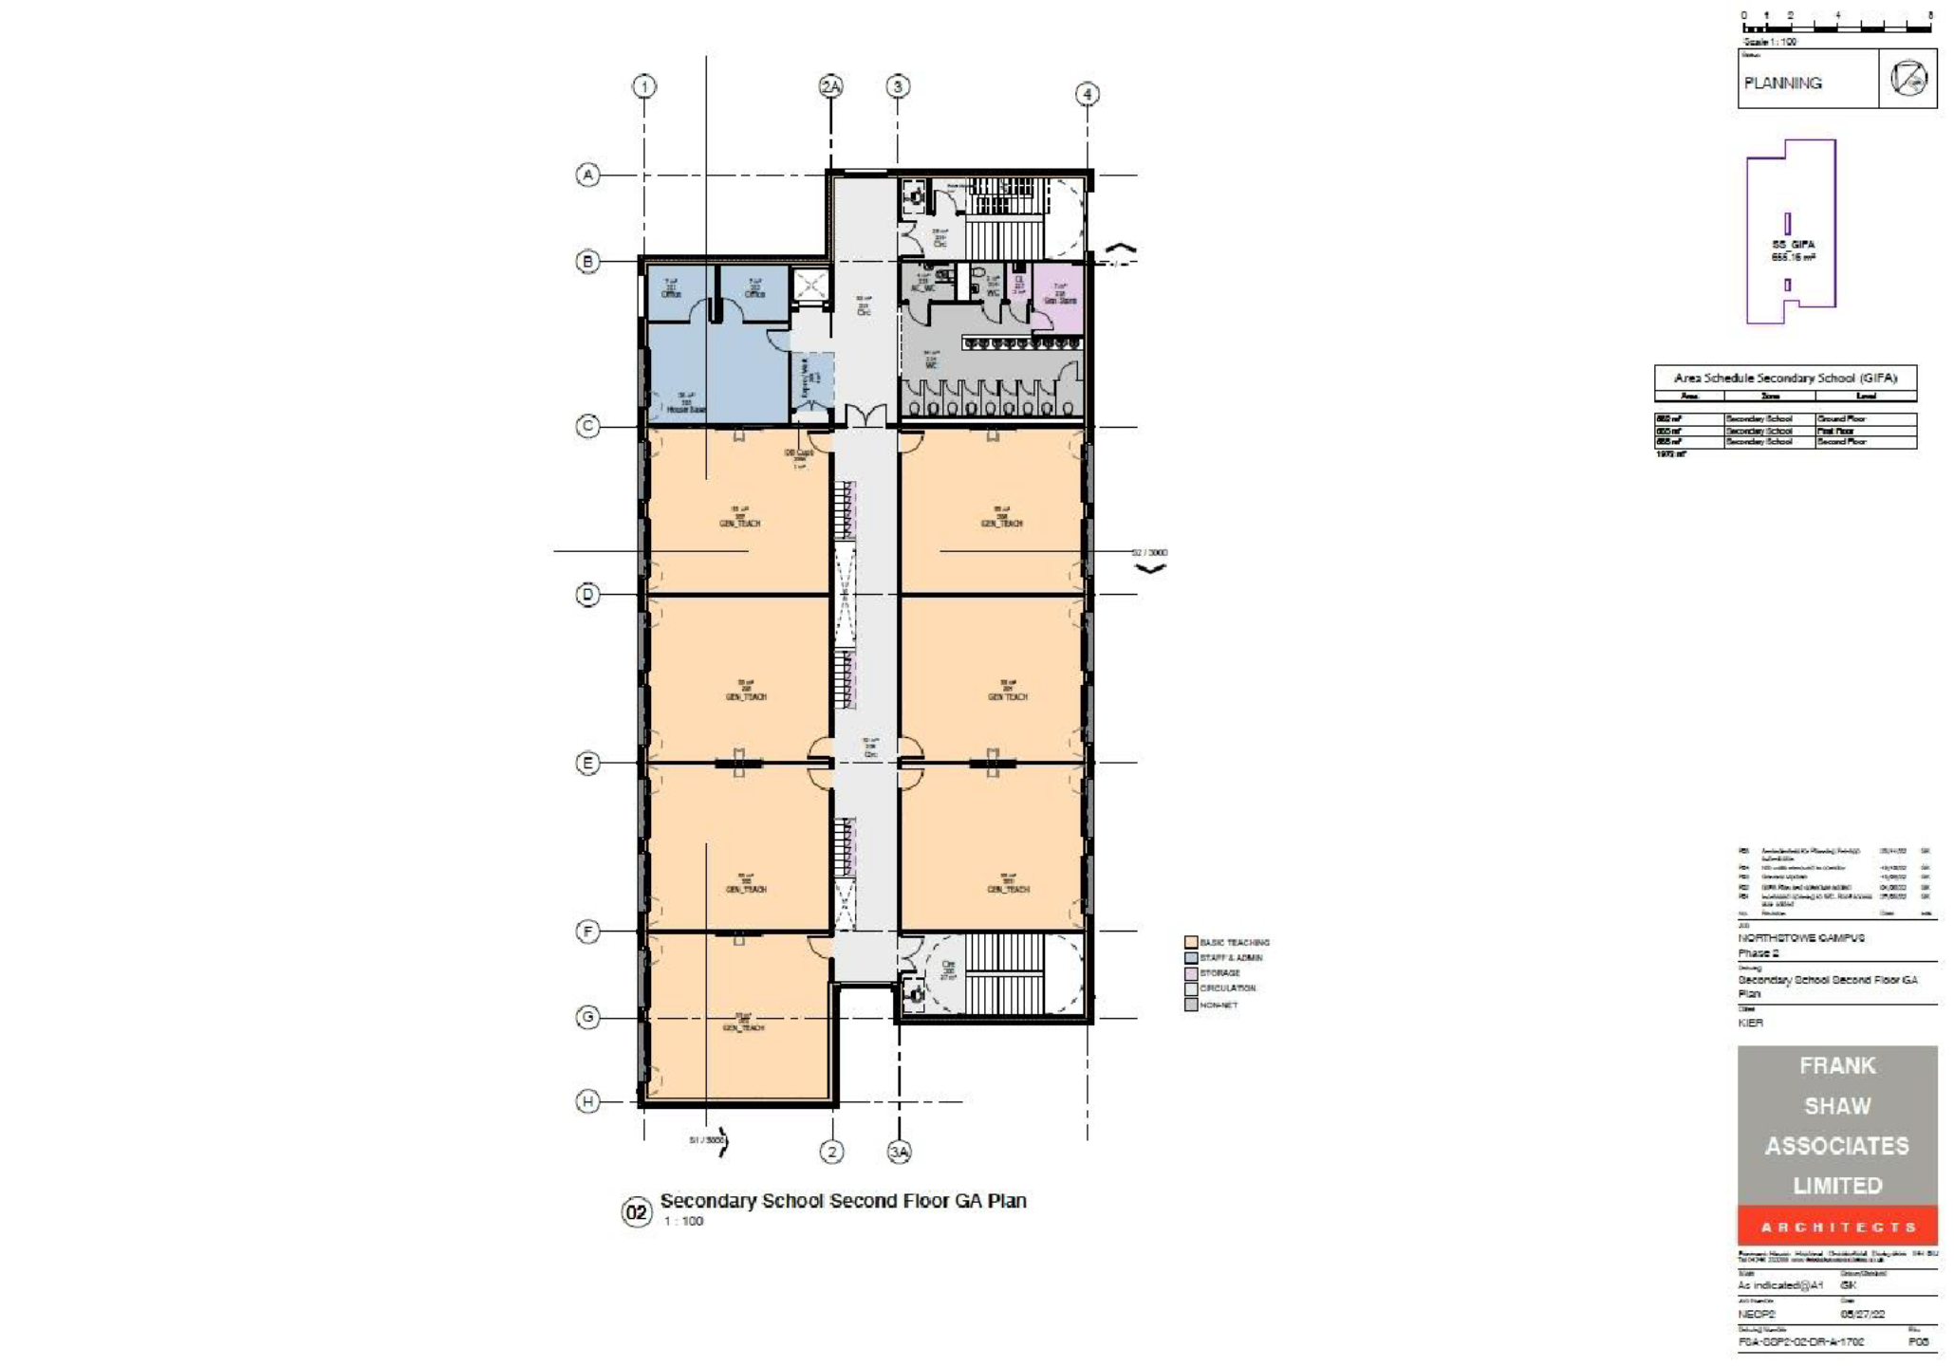
SECONDARY SCHOOL EXTENSION: GA PLAN - SECOND

Slide 18
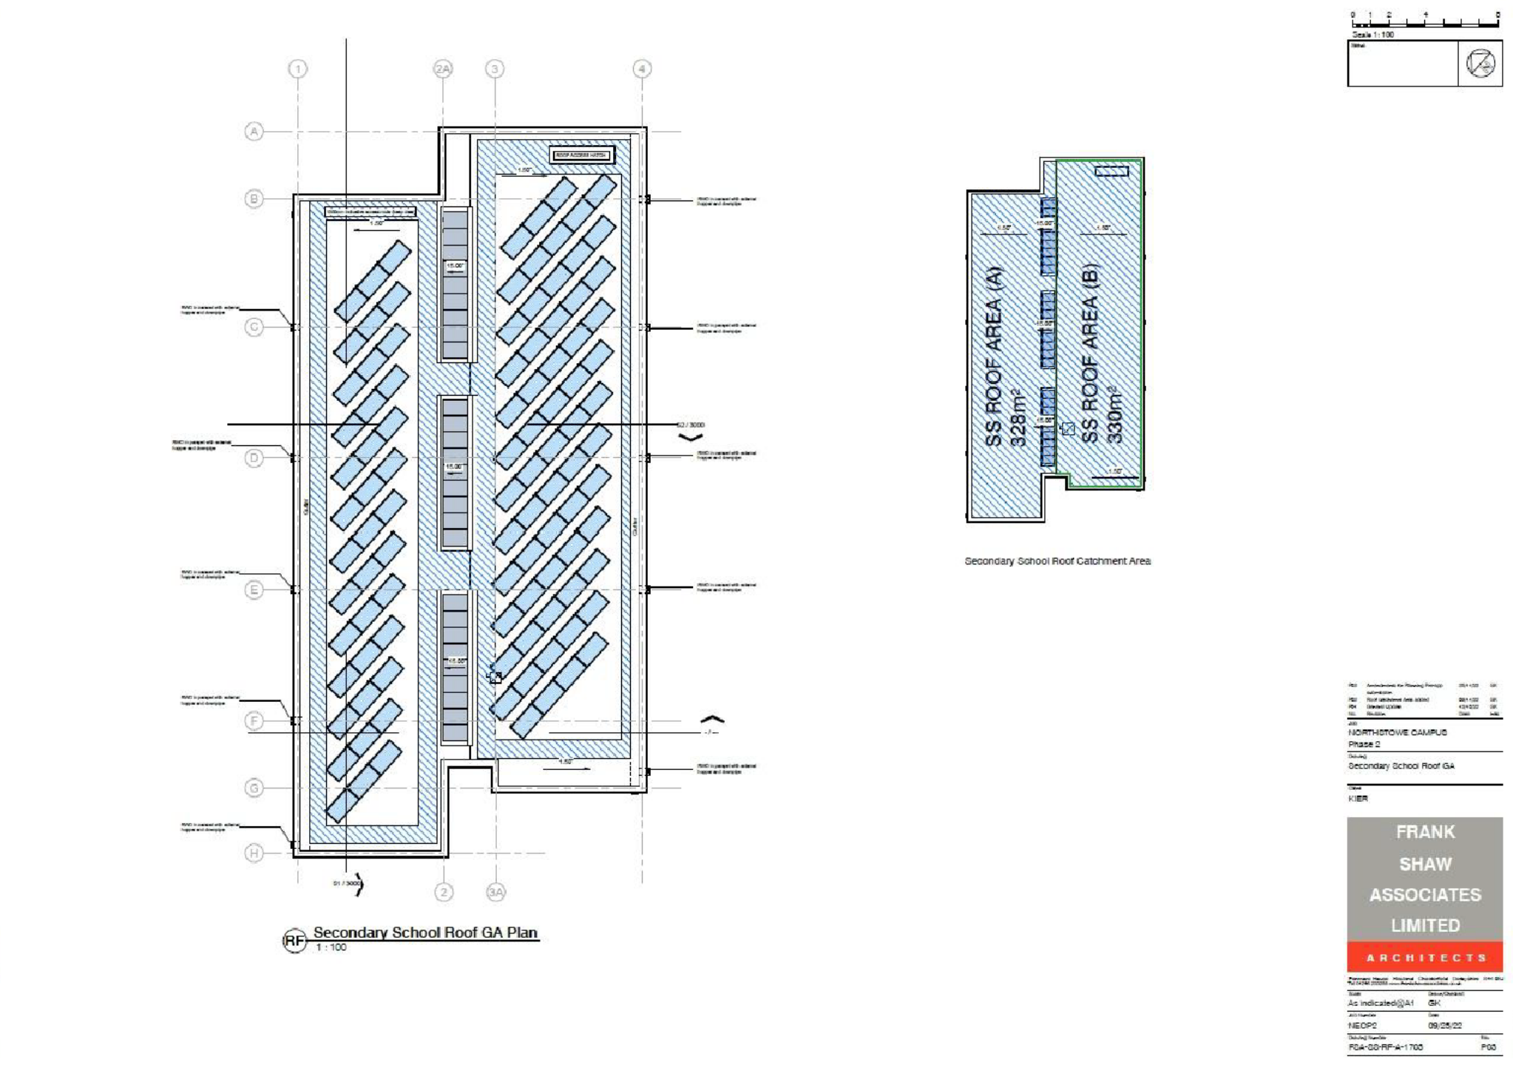
SECONDARY SCHOOL EXTENSION: GA PLAN - ROOF

Slide 19
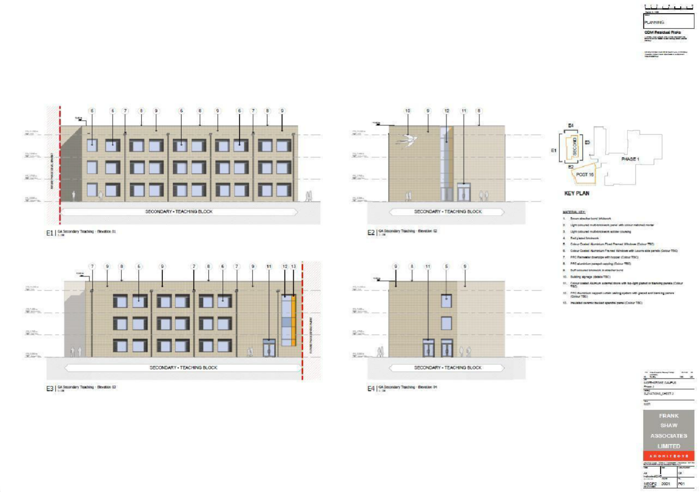
SECONDARY SCHOOL EXTENSION: ELEVATIONS

Slide 20
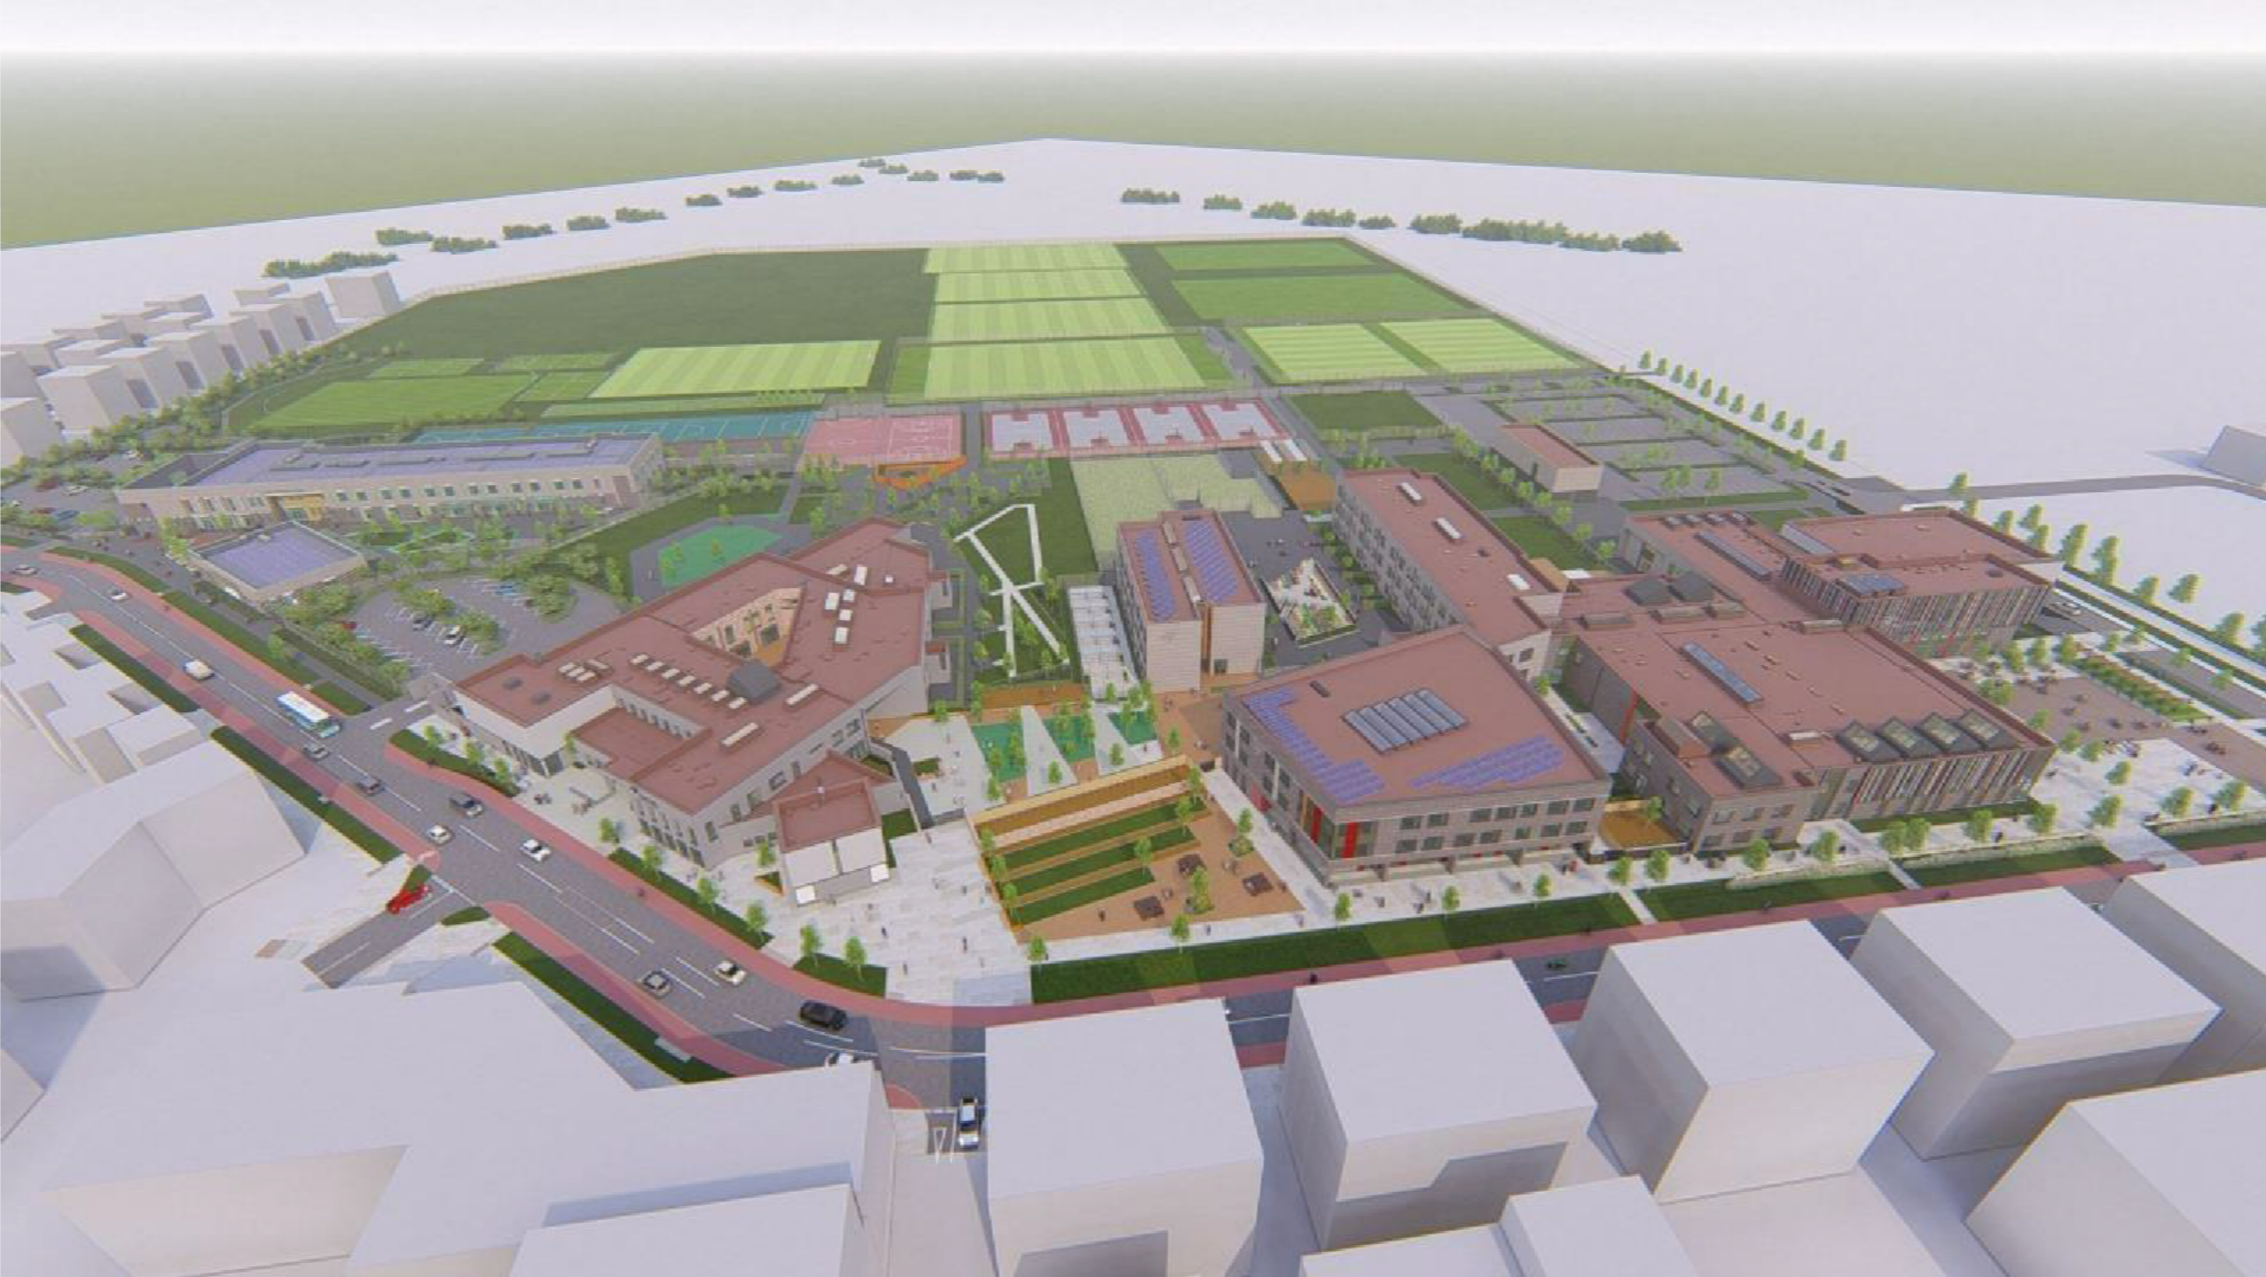
MASTERPLAN : 3D

Slide 21
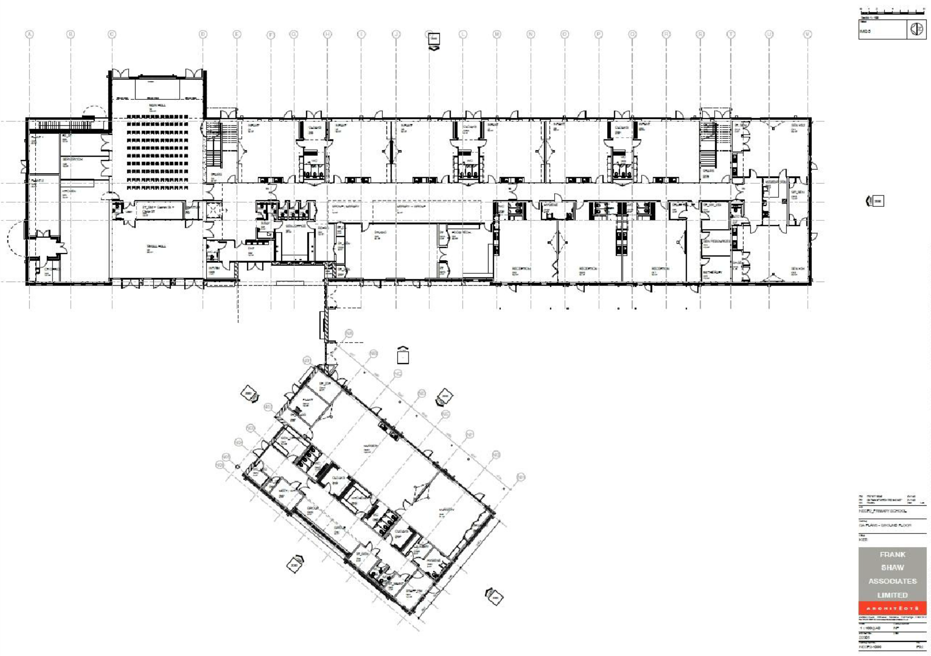
PRIMARY SCHOOL: GA PLAN - GF

Slide 22
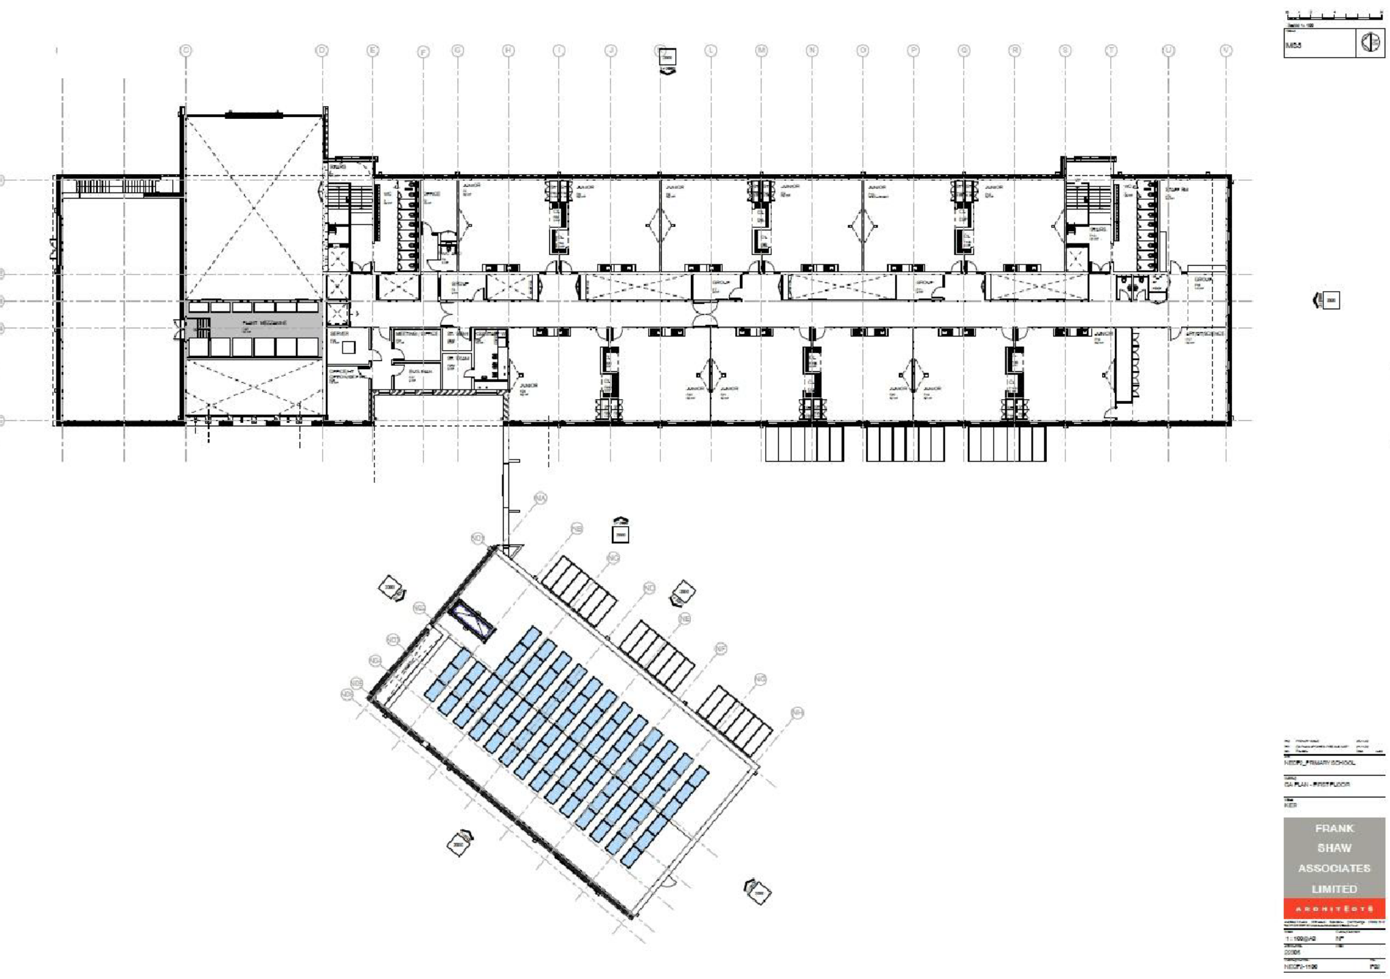
PRIMARY SCHOOL: GA PLAN - FF

Slide 23
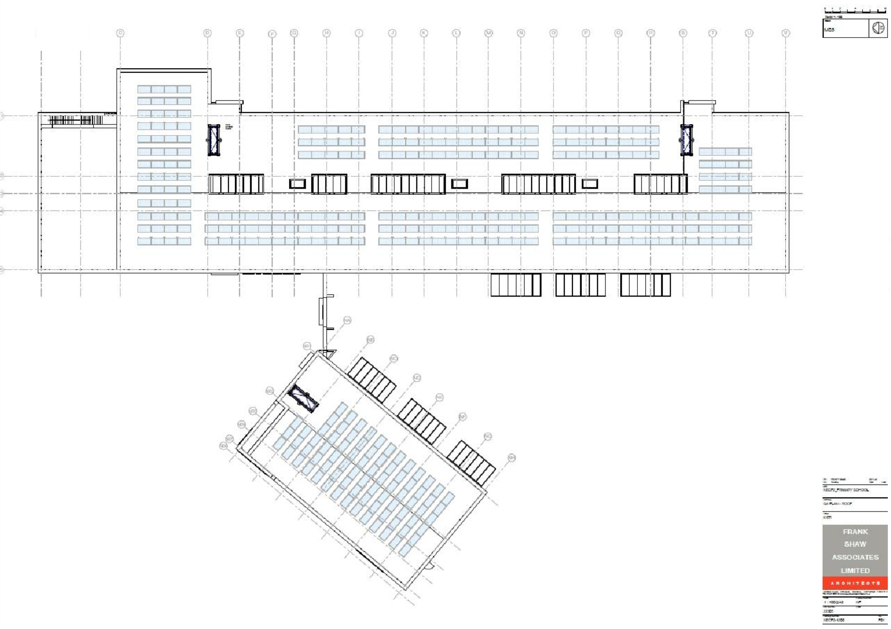
PRIMARY SCHOOL:
GA PLAN – ROOF PLAN

Slide 24
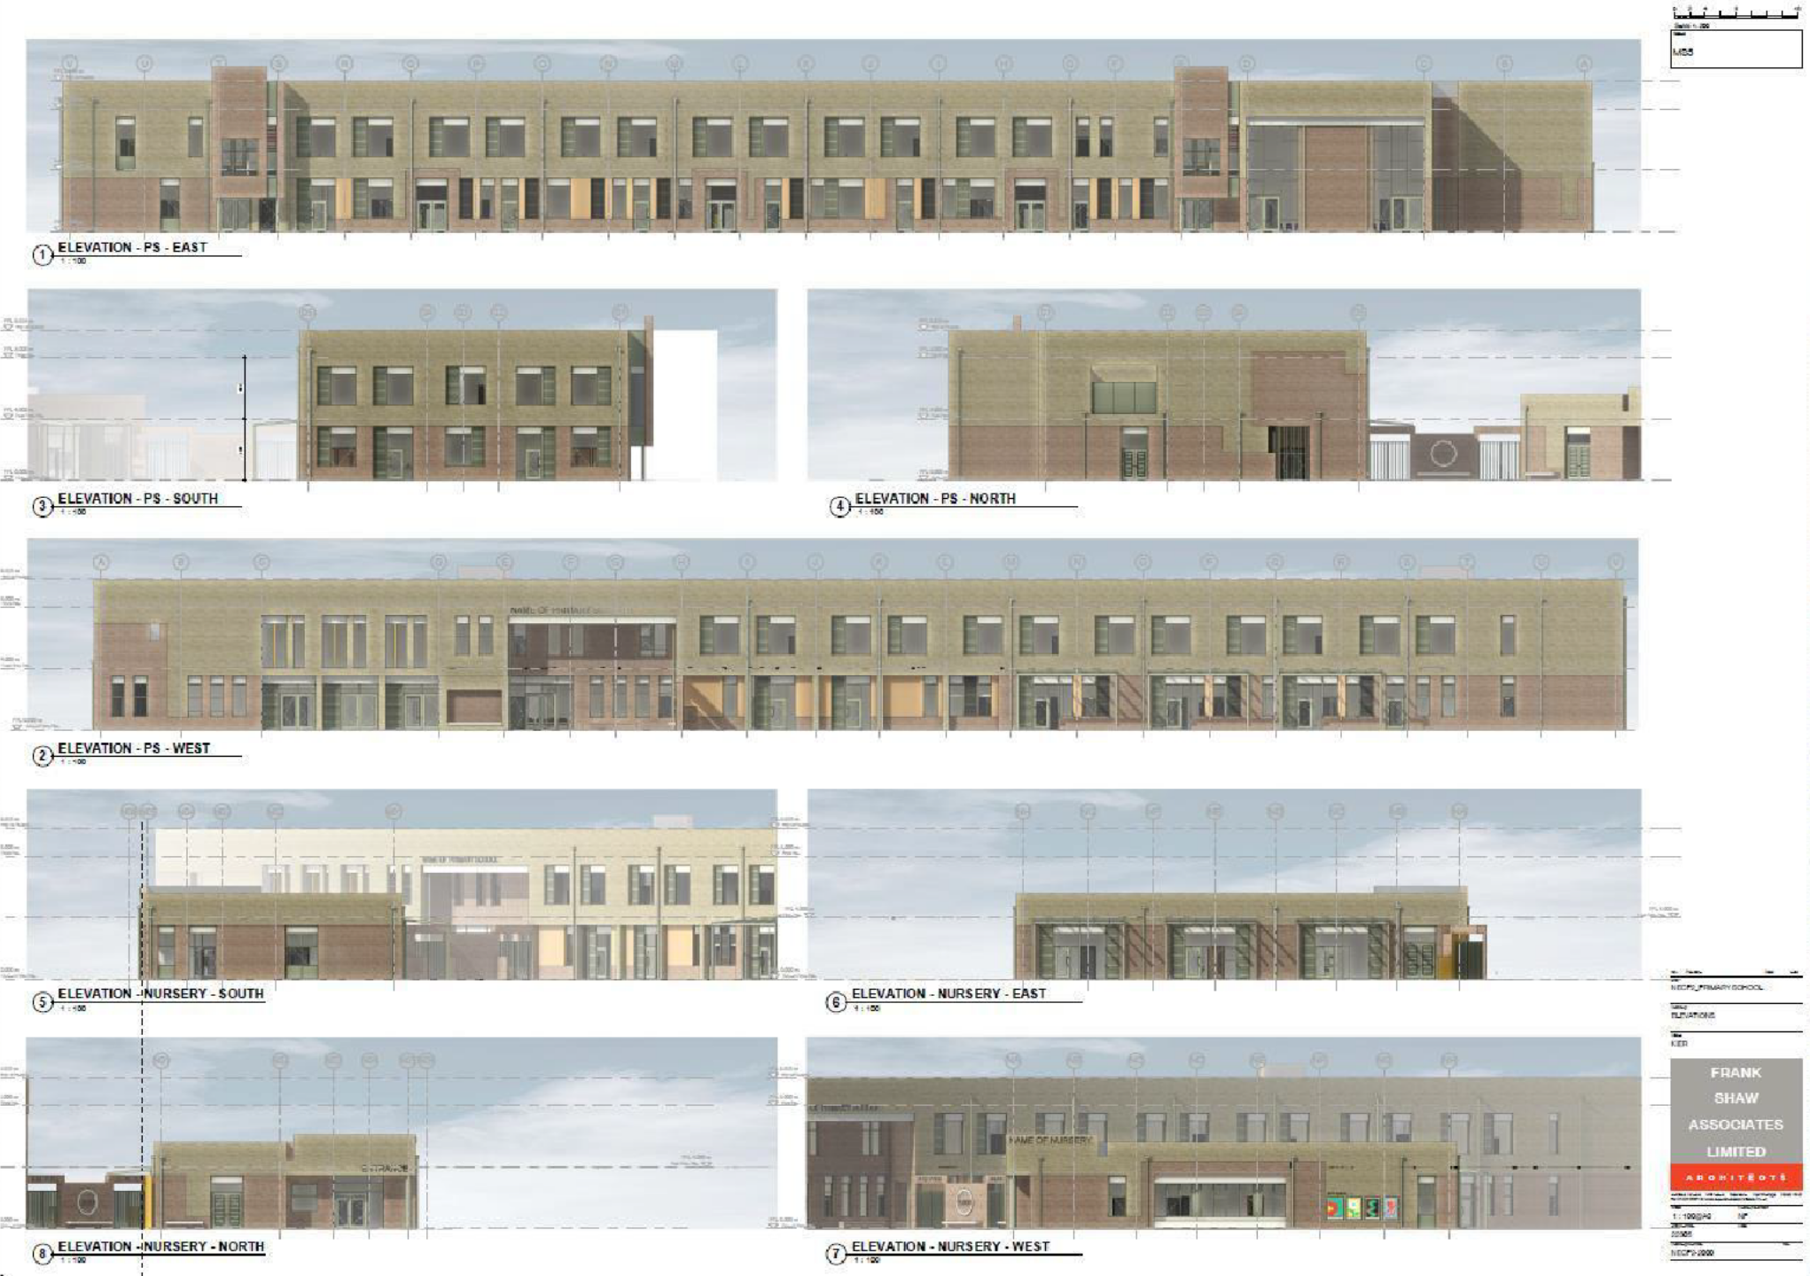
PRIMARY SCHOOL: ELEVATIONS

Slide 25
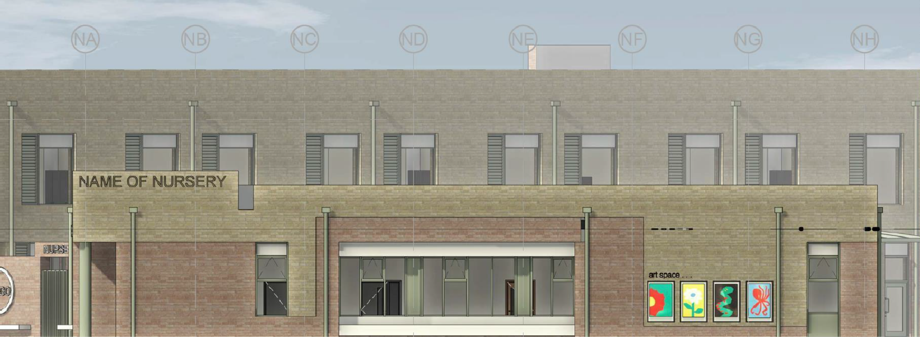
PRIMARY SCHOOL: ELEVATION: NURSERY

Slide 26
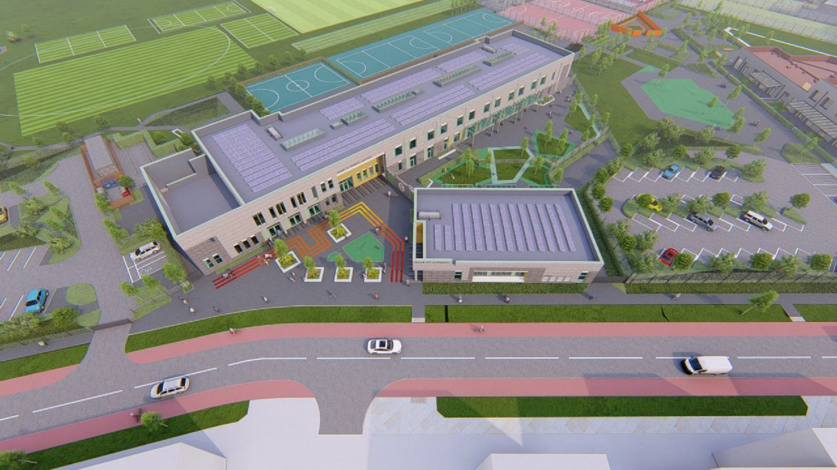
PRIMARY SCHOOL: 3D

Slide 27
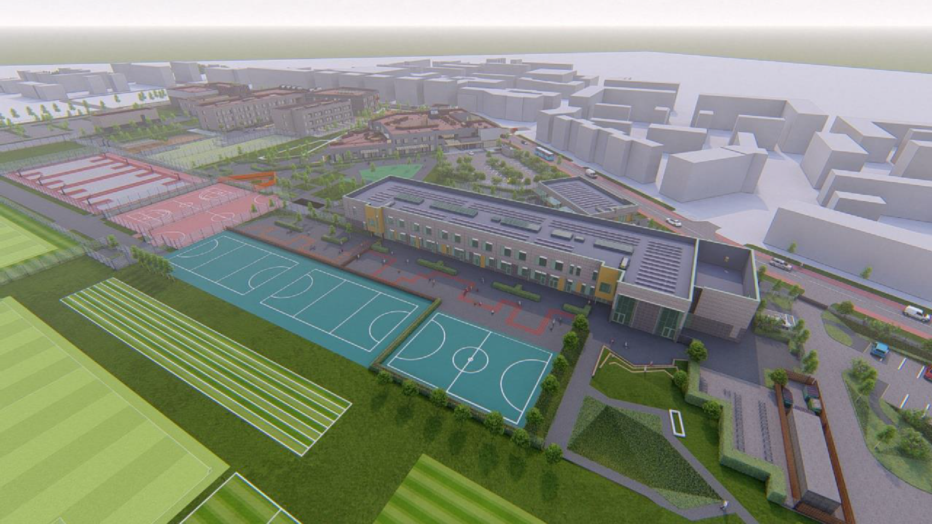
P16: 3D

Slide 28
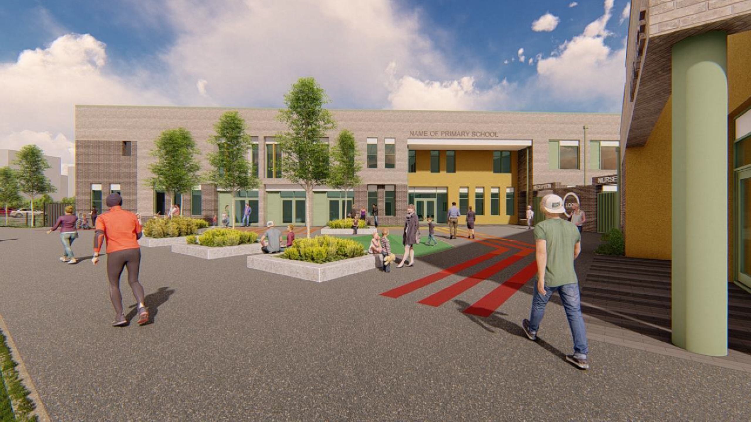
PRIMARY SCHOOL: 3D

Slide 29
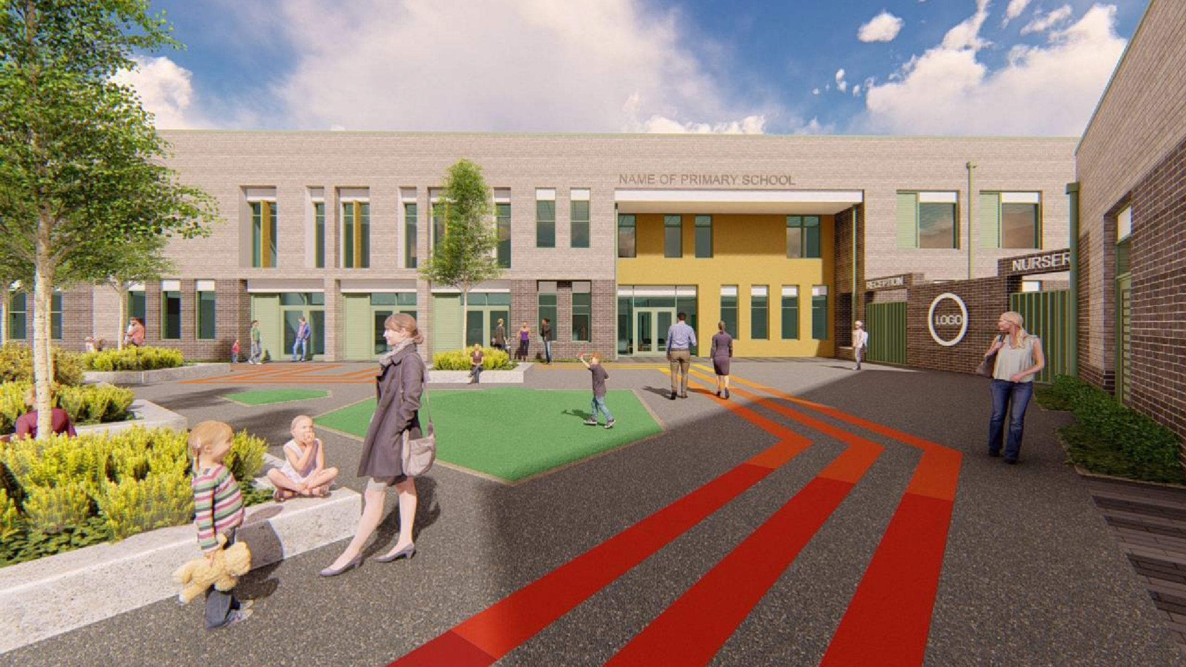
PRIMARY SCHOOL: 3D

Slide 30
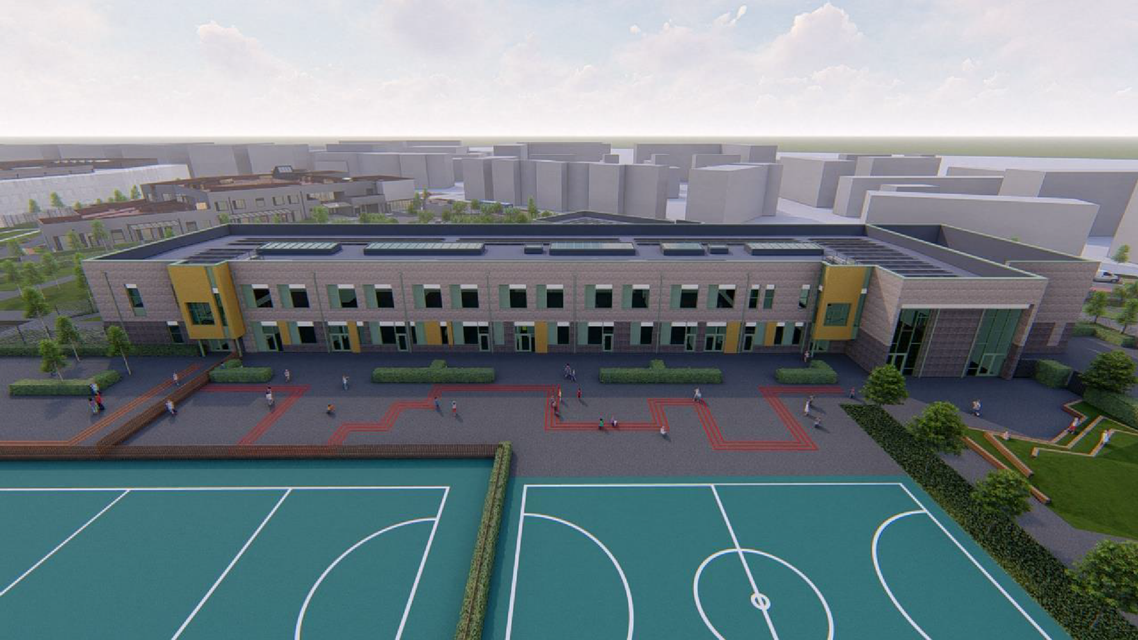
PRIMARY SCHOOL: 3D

Slide 31
COMMUNITY FORUM
PHASE 2 PROJECT PROGRAMME :
Proposed Pre-contract Timeline
Planning Validation – January 23
Planning Consultations – February/March 23 Planning Determination – April 23 MS4/Tender Submission – May 23
Proposed Contract Period
Phased Site Commencement – July 23 First School Occupations – August 24 Full Completion – December 24
Project Contacts CCC Client
Alan Fitz 0-19 Area Education Officer, People Services, Cambridgeshire County Council (alan.fitz@cambridgeshire.gov.uk) Alison Revell Education Capital Framework & Programme Manager (Major Works) (Alison.Revell@cambridgeshire.gov.uk) Project Team
Project Management and Cost Consultants - Faithful+Gould (Simon.Carter@atkinsglobal.com) Design and Build Contractor – Kier Construction (kcenorthstoweec@kier.co.uk)

