Slide 1
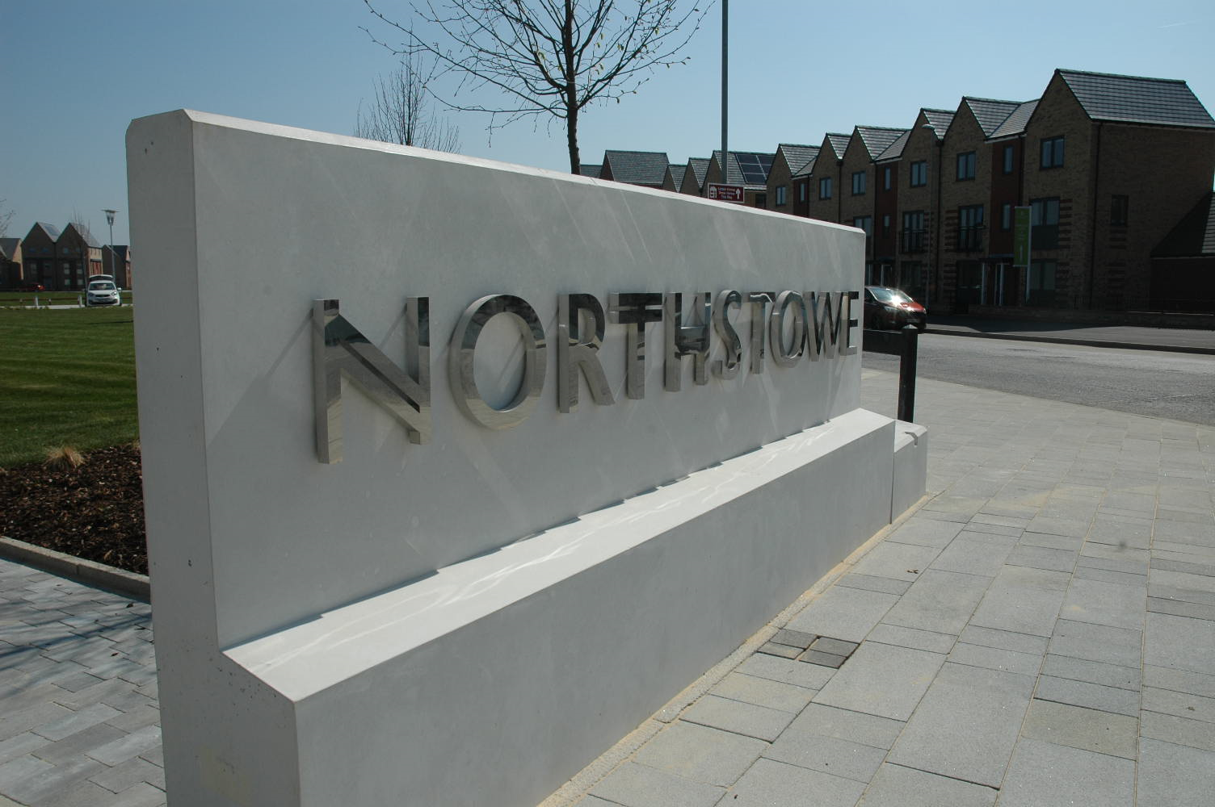
Northstowe Programme Update

Slide 2
Interim Community Facilities
Located next to The Green, on Pathfinder Way.
Sits alongside the area earmarked for Northstowe permanent community centre.
Will include provision for a wide range of activities for all ages including:
Community cafes
Baby and toddler groups
Private hire for events such as birthday parties
Children and youth activities
Art workshops and events
Meeting spaces for sport and activity groups

Slide 3
Interim Community Facilities
Contractor procured December 2022.
Planning Application submitted yesterday.
Aim is to go to planning Committee March.
Will then update further on the timeline – planning for a 10 week build but it will depend on approval; how soon we can start on site and any planning conditions.
Thanks go to local groups and representatives from the Town Council whose input has been invaluable, and people gave up their time before Christmas, we are so grateful. Thank you.

Slide 4
Permanent Community Facility
Working towards a planning application being submitted for decision in the Autumn.
Have reflected on feedback from previous consultation exercises, including those for the Enterprise Zone.
We aim to undertake further public consultation around March/April.

Slide 5
Phase 1 Sports Pavilion & Phase 2 Civic Hub
Sports Pavilion:
Work on going at site.
Additional work associated with piling and challenges of winter working has led to a delay in completion – will try to recover some lost time
Current project anticipate completion early August.
Civic Hub:
Next step is to develop the specification for the building
Once achieved we will consult with you
Conversations with partners on-going

