Slide 1

Phase 1 Community Centre for
Northstowe

Slide 2














The Team
2

Slide 3
Timeline
Ongoing development
of the Masterplan area
January 2023
Summer 2023
Winter 2025/26
• Temporary
• Permanent Community
Centre Planning Applicaꢀon
Submission
• Permanent Community
Community Centre
Planning Applicaꢀon
Submission
Centre Opens
• Temporary Community
Centre closes
• Temporary Community
Centre in Operaꢀon
3

Slide 4
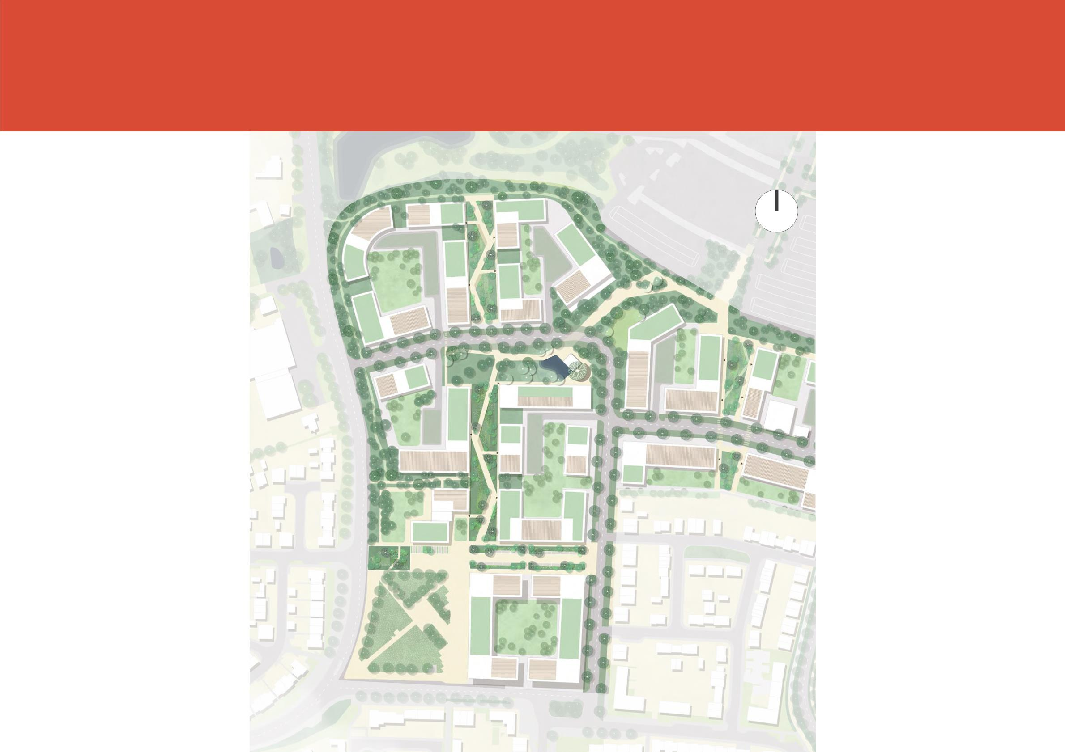
Local Centre & Employment Zone Masterplan
N

Slide 5

The Story So Far
Yo u told us you would like your new Community Centre to:
Support Local Economy
Connect with businesses · Start-ups · Pop-up space · Meanwhile use · Coworking · Meeting rooms · Circular economy
Encourage Socialising
Leisure facilities · Food and drink · Places to meet and relax · Family gathering · Out door spaces · Group activities
5

Slide 6
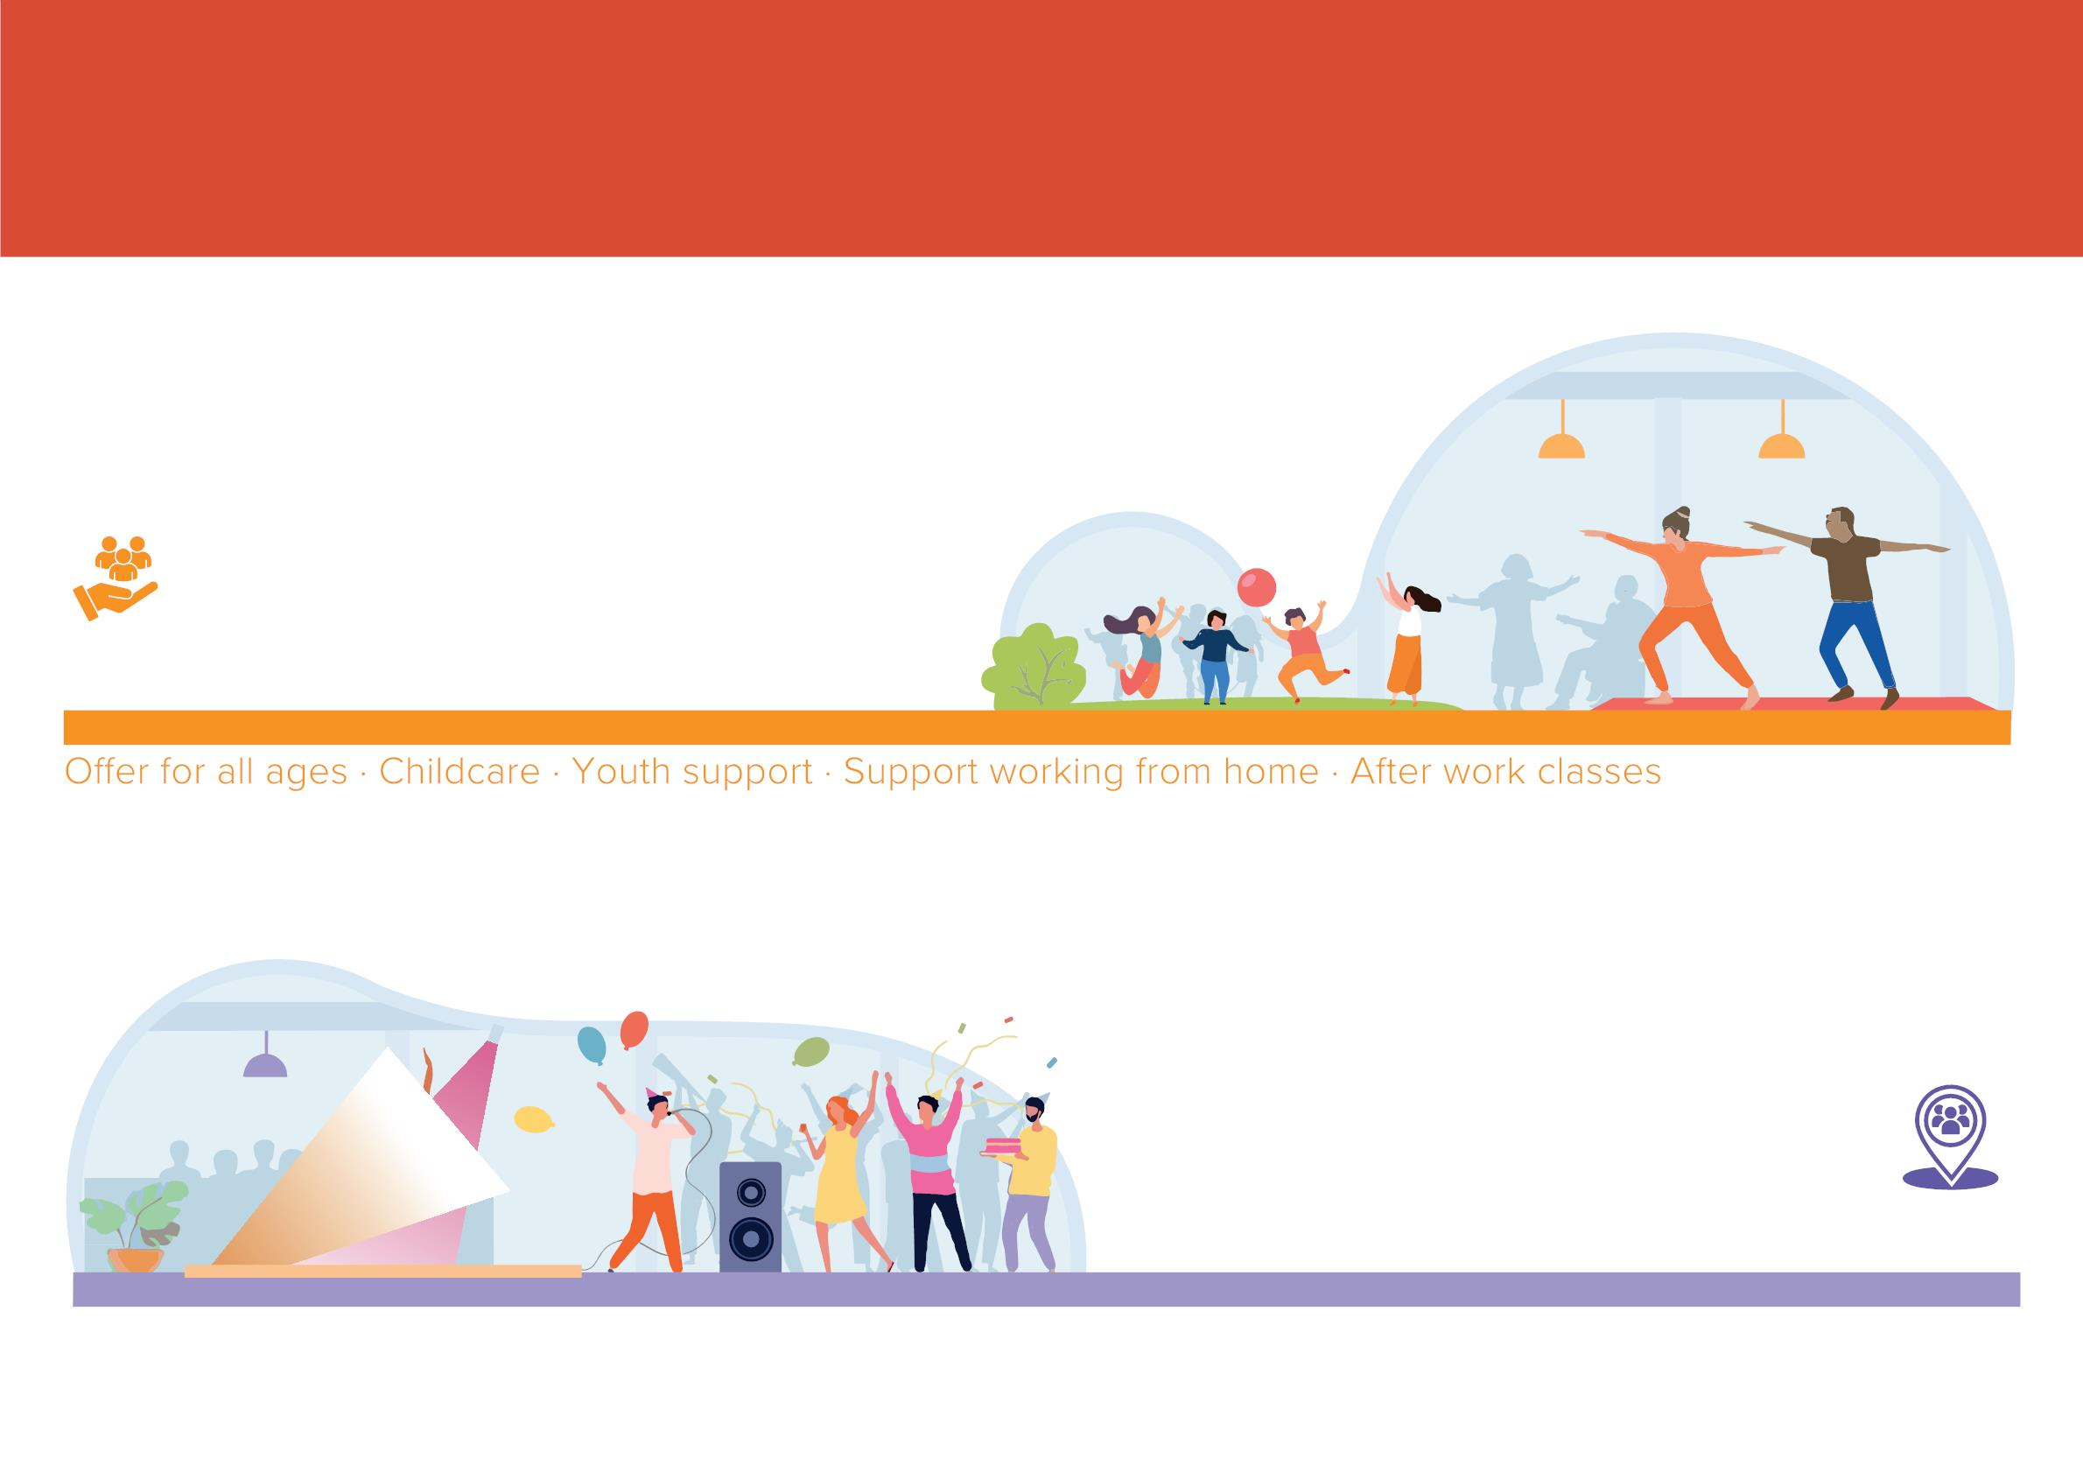
The Story So Far
Be an Attractive Centre for All
· Health · Wellbeing
Support Community
Flexible activity and meeting space · Community events · Arts and performance spaces · Build on local strengths
6

Slide 7
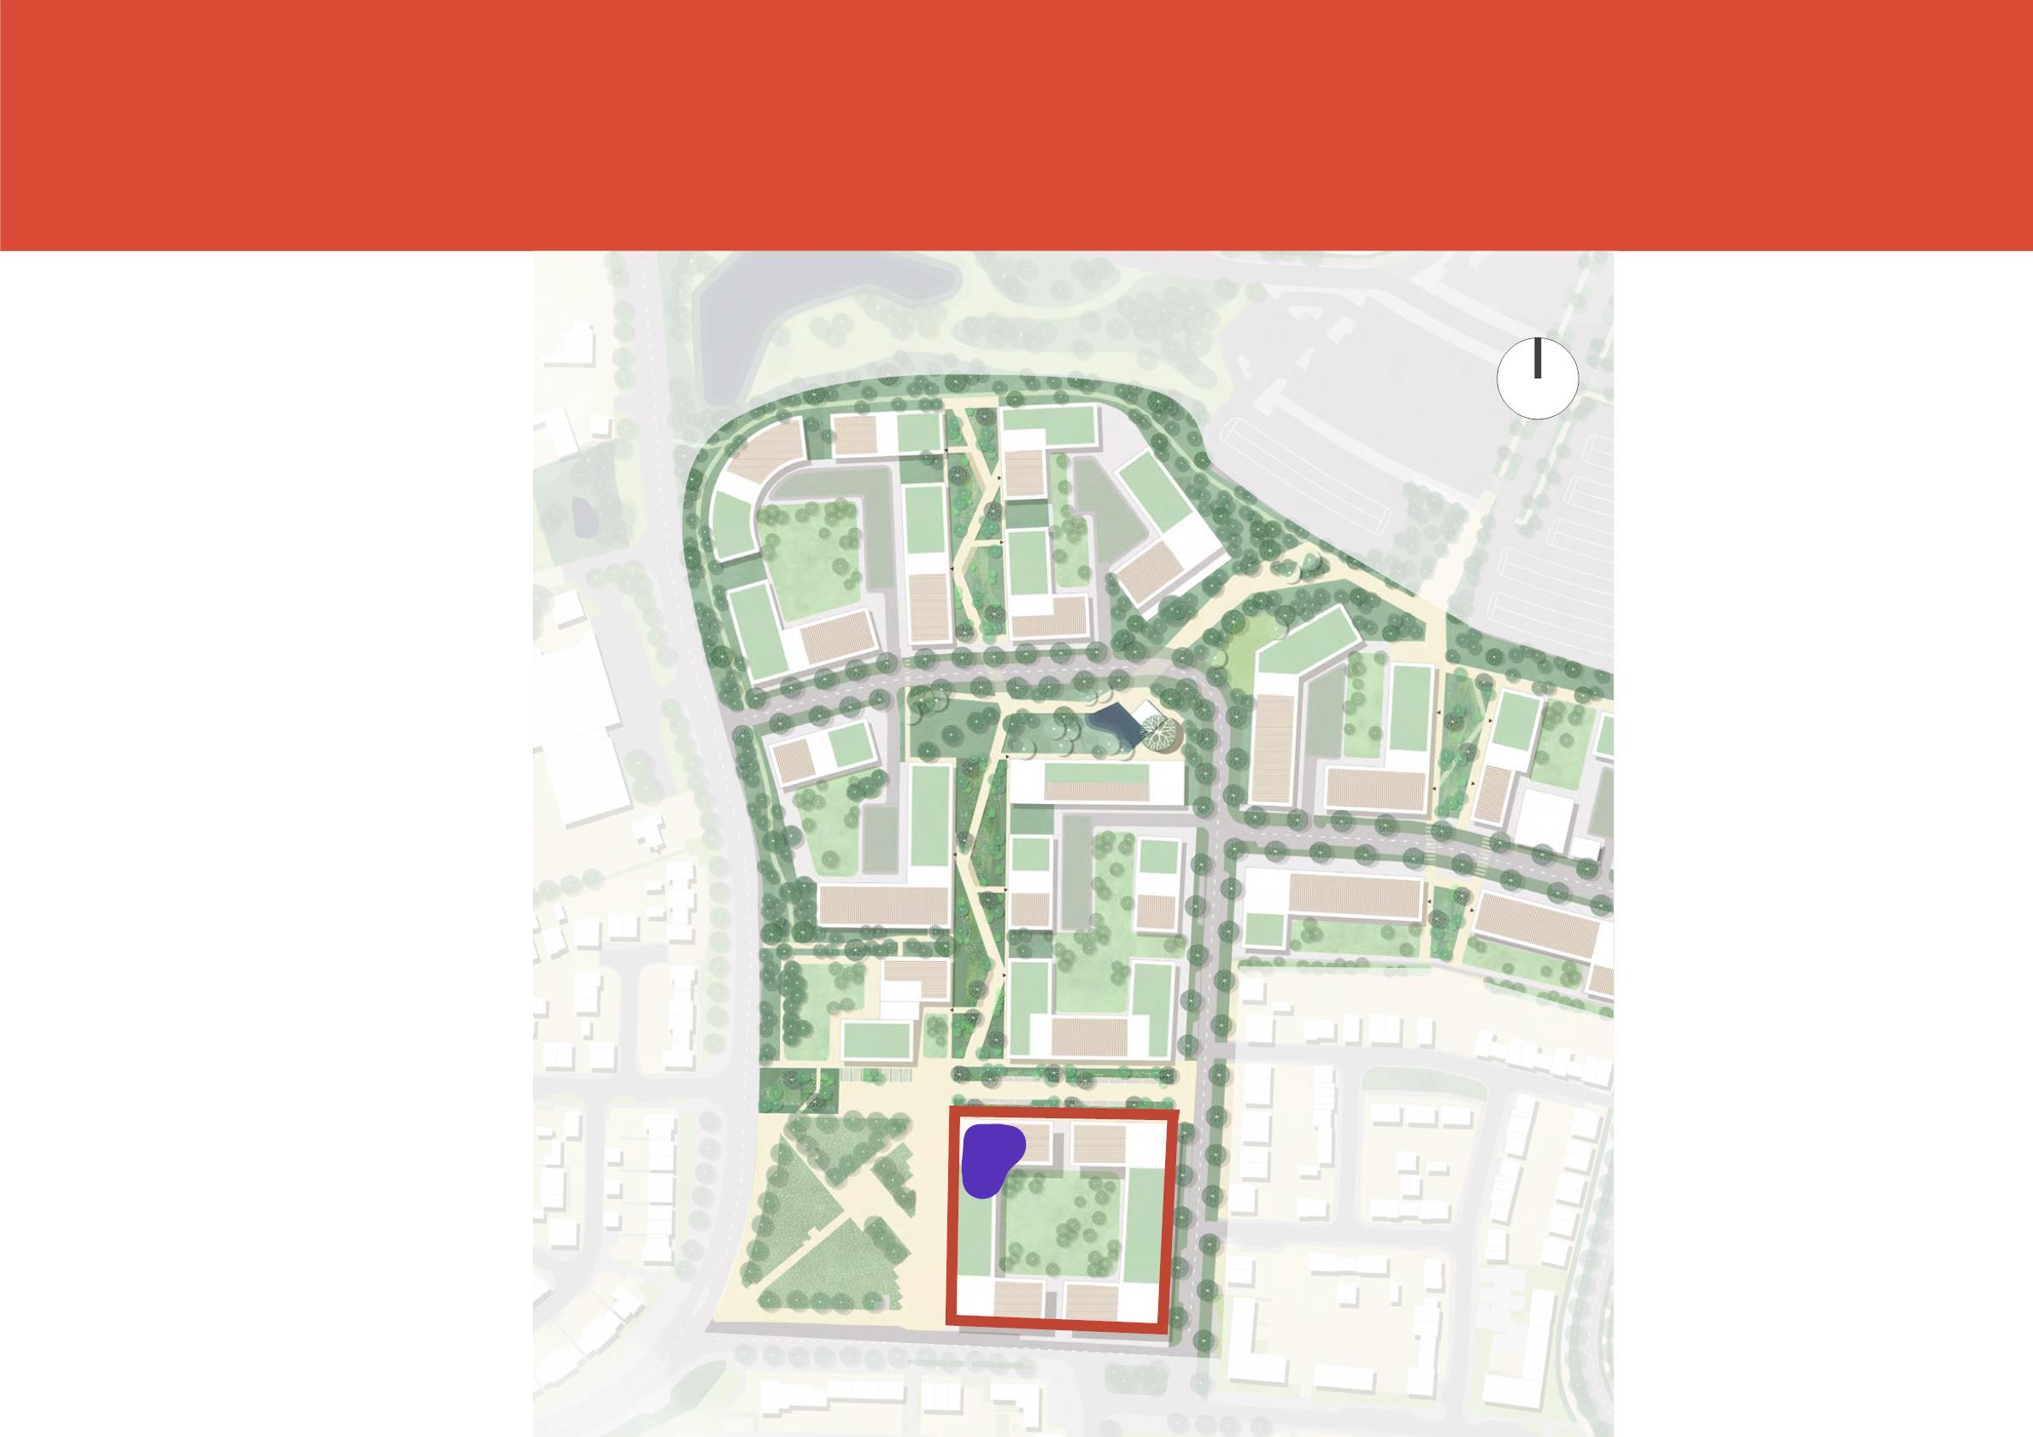
Where we are now
N
Local Centre &
Employment Zone
Masterplan
The Green
Parcel 6

Slide 8
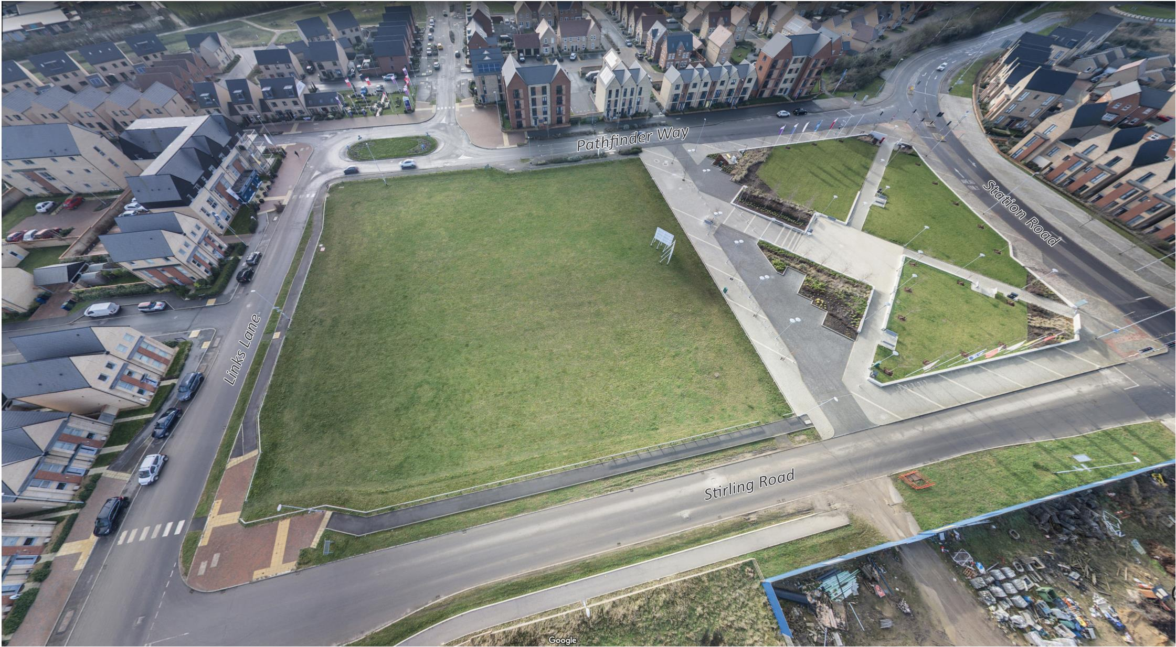
Where we are now
The Green
Parcel 6
8

Slide 9
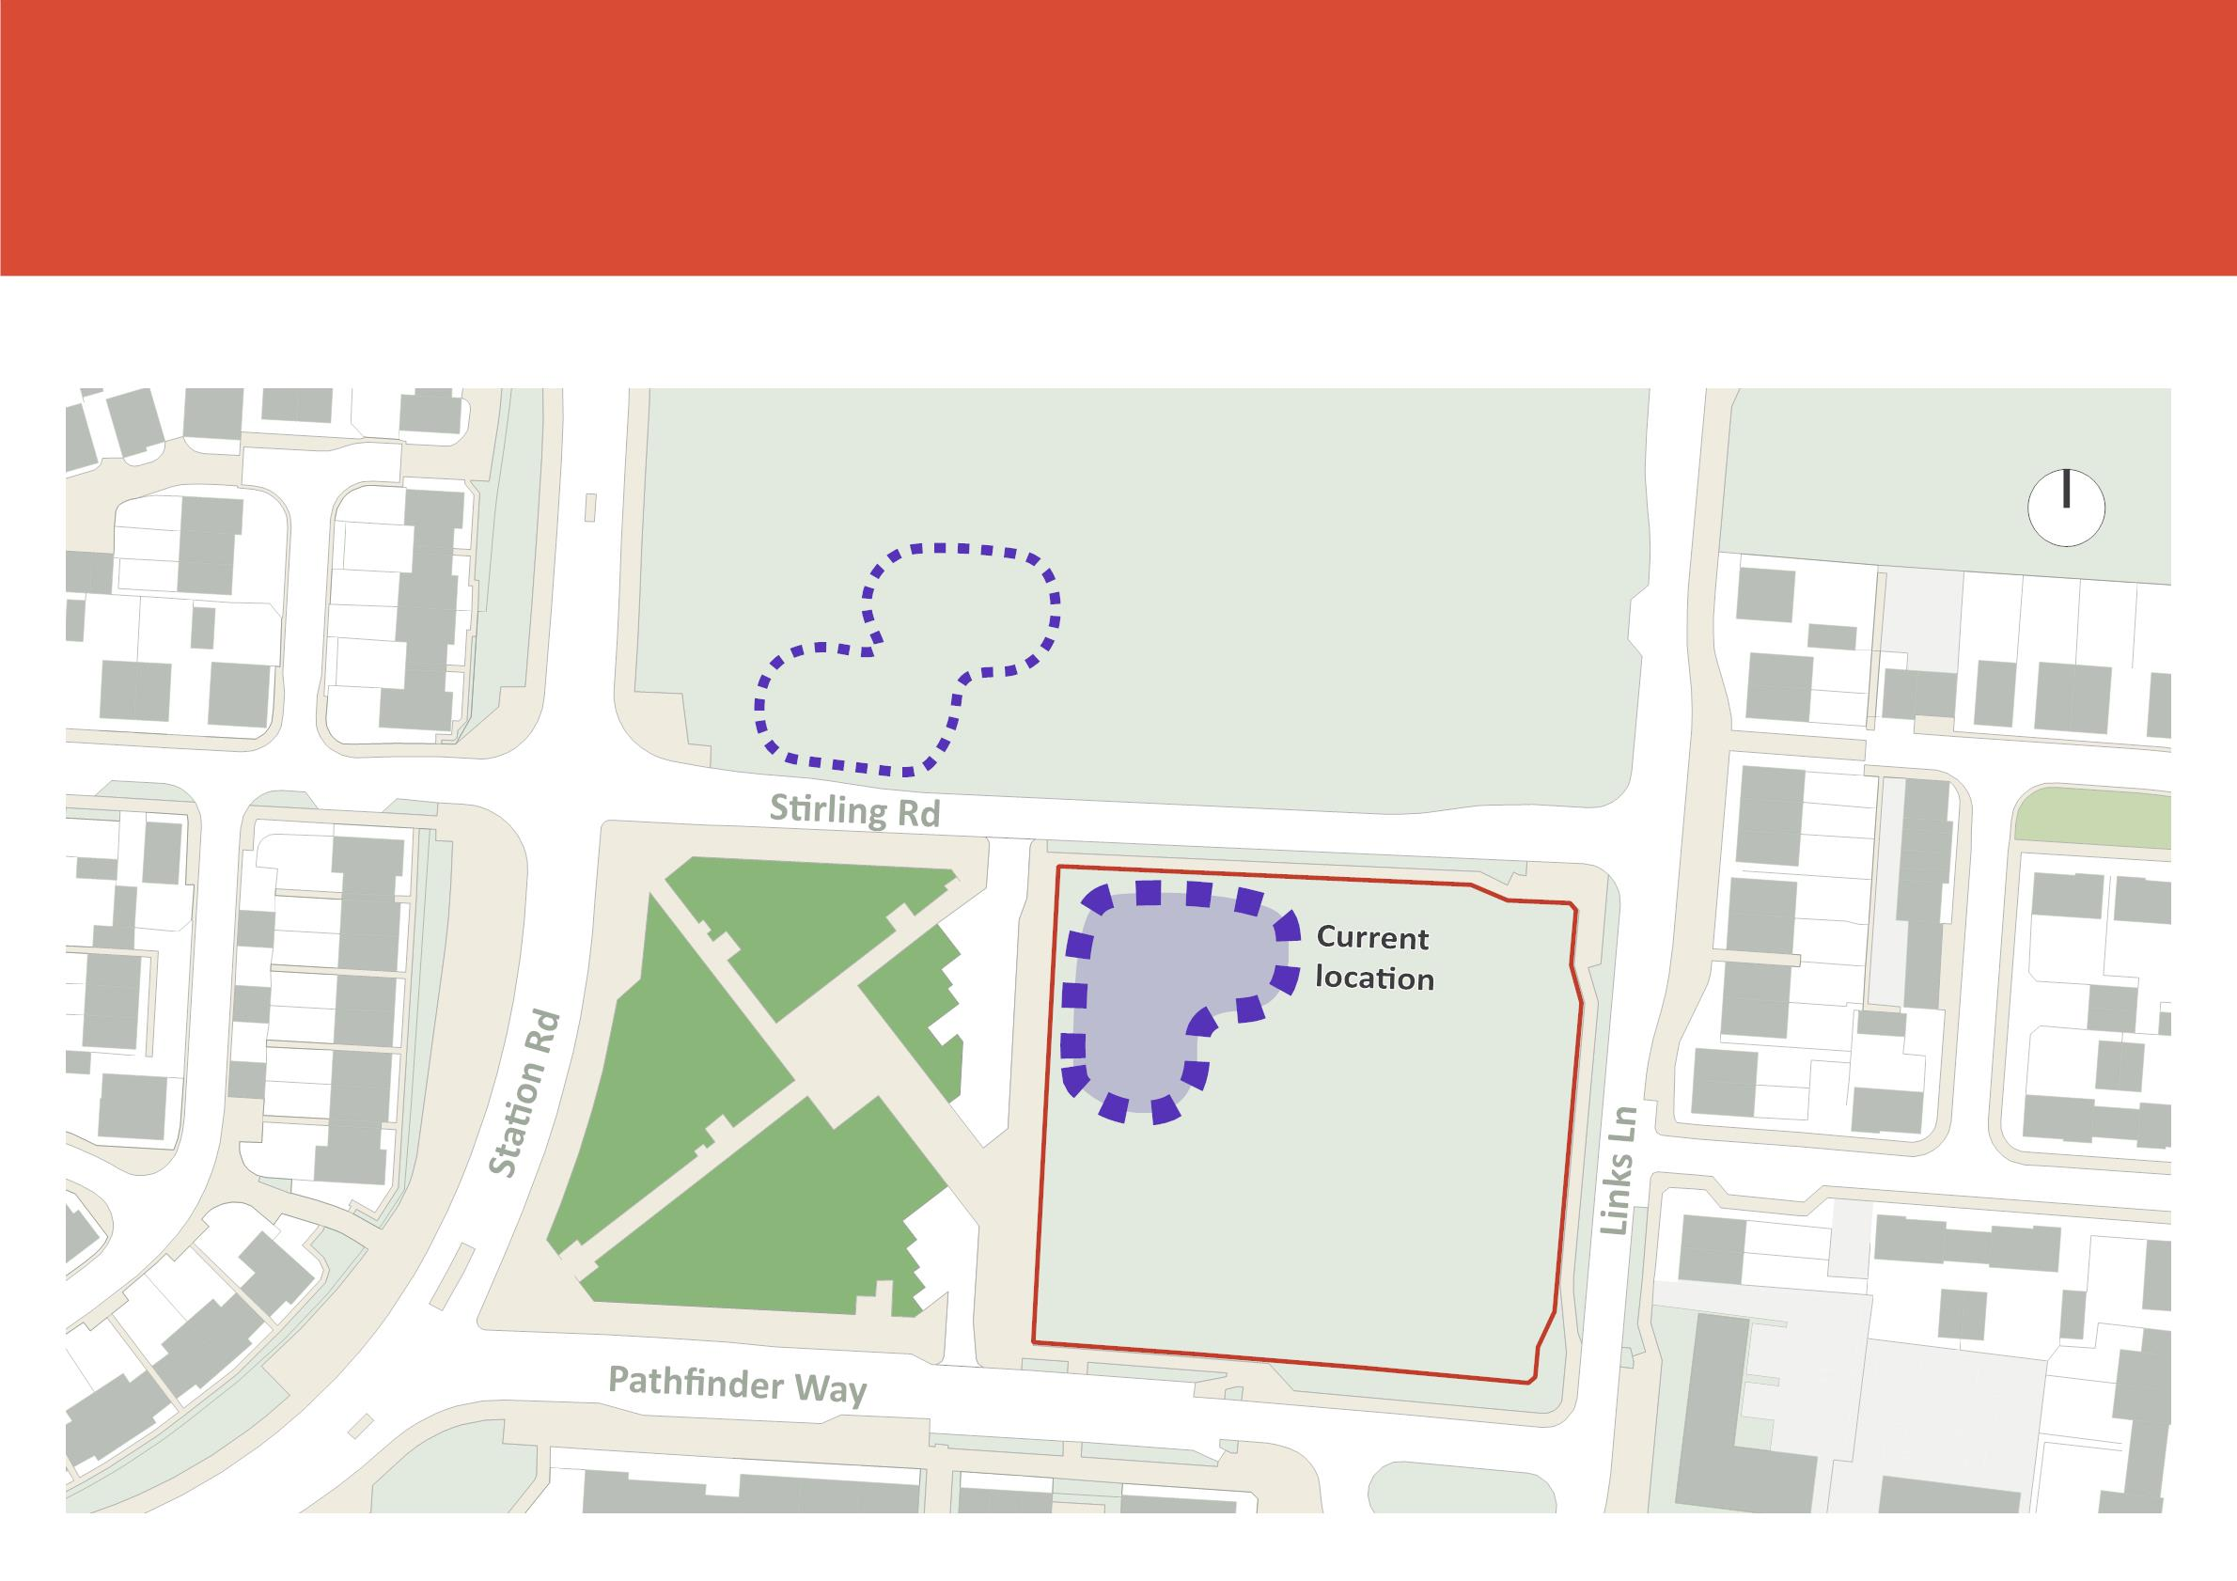
Where we are now
N
Pa
Iniꢀal
Locaꢀon
Parcel 2
The Green
Parcel 6

Slide 10
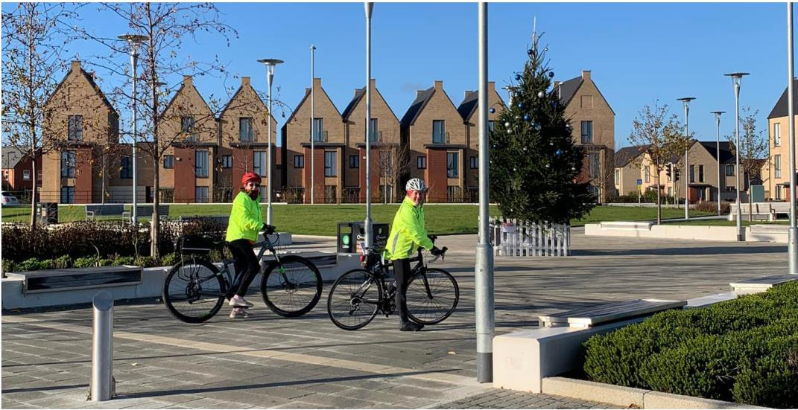
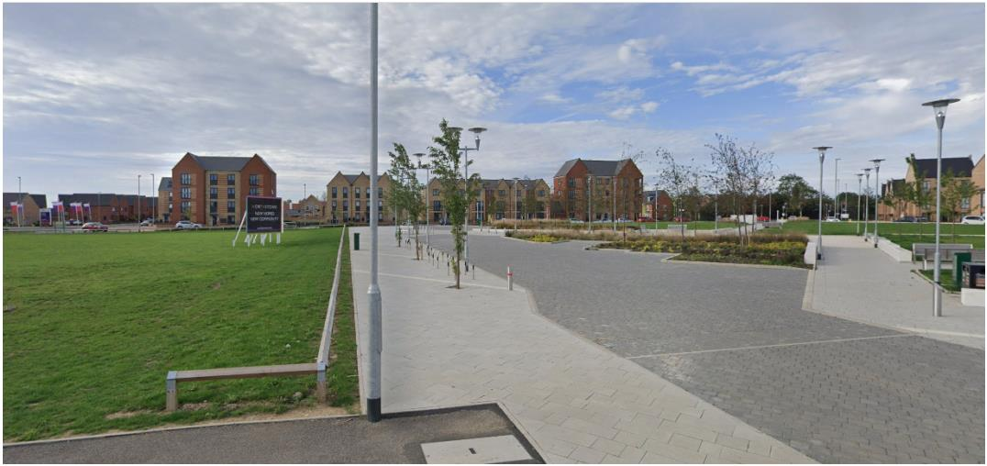
Where we are now
Location of The Permanent
Community Centre
• Good visibility across the Green and
from Station Road
• Direct access to the Green
• Good westerly exposure
• Good connection to proposed Linear Park
• Opportunity for the building to provide a
local landmark
• Easily accessible from the surrounding
residential areas
• Addressing Stirling Road and the Green
10

Slide 11
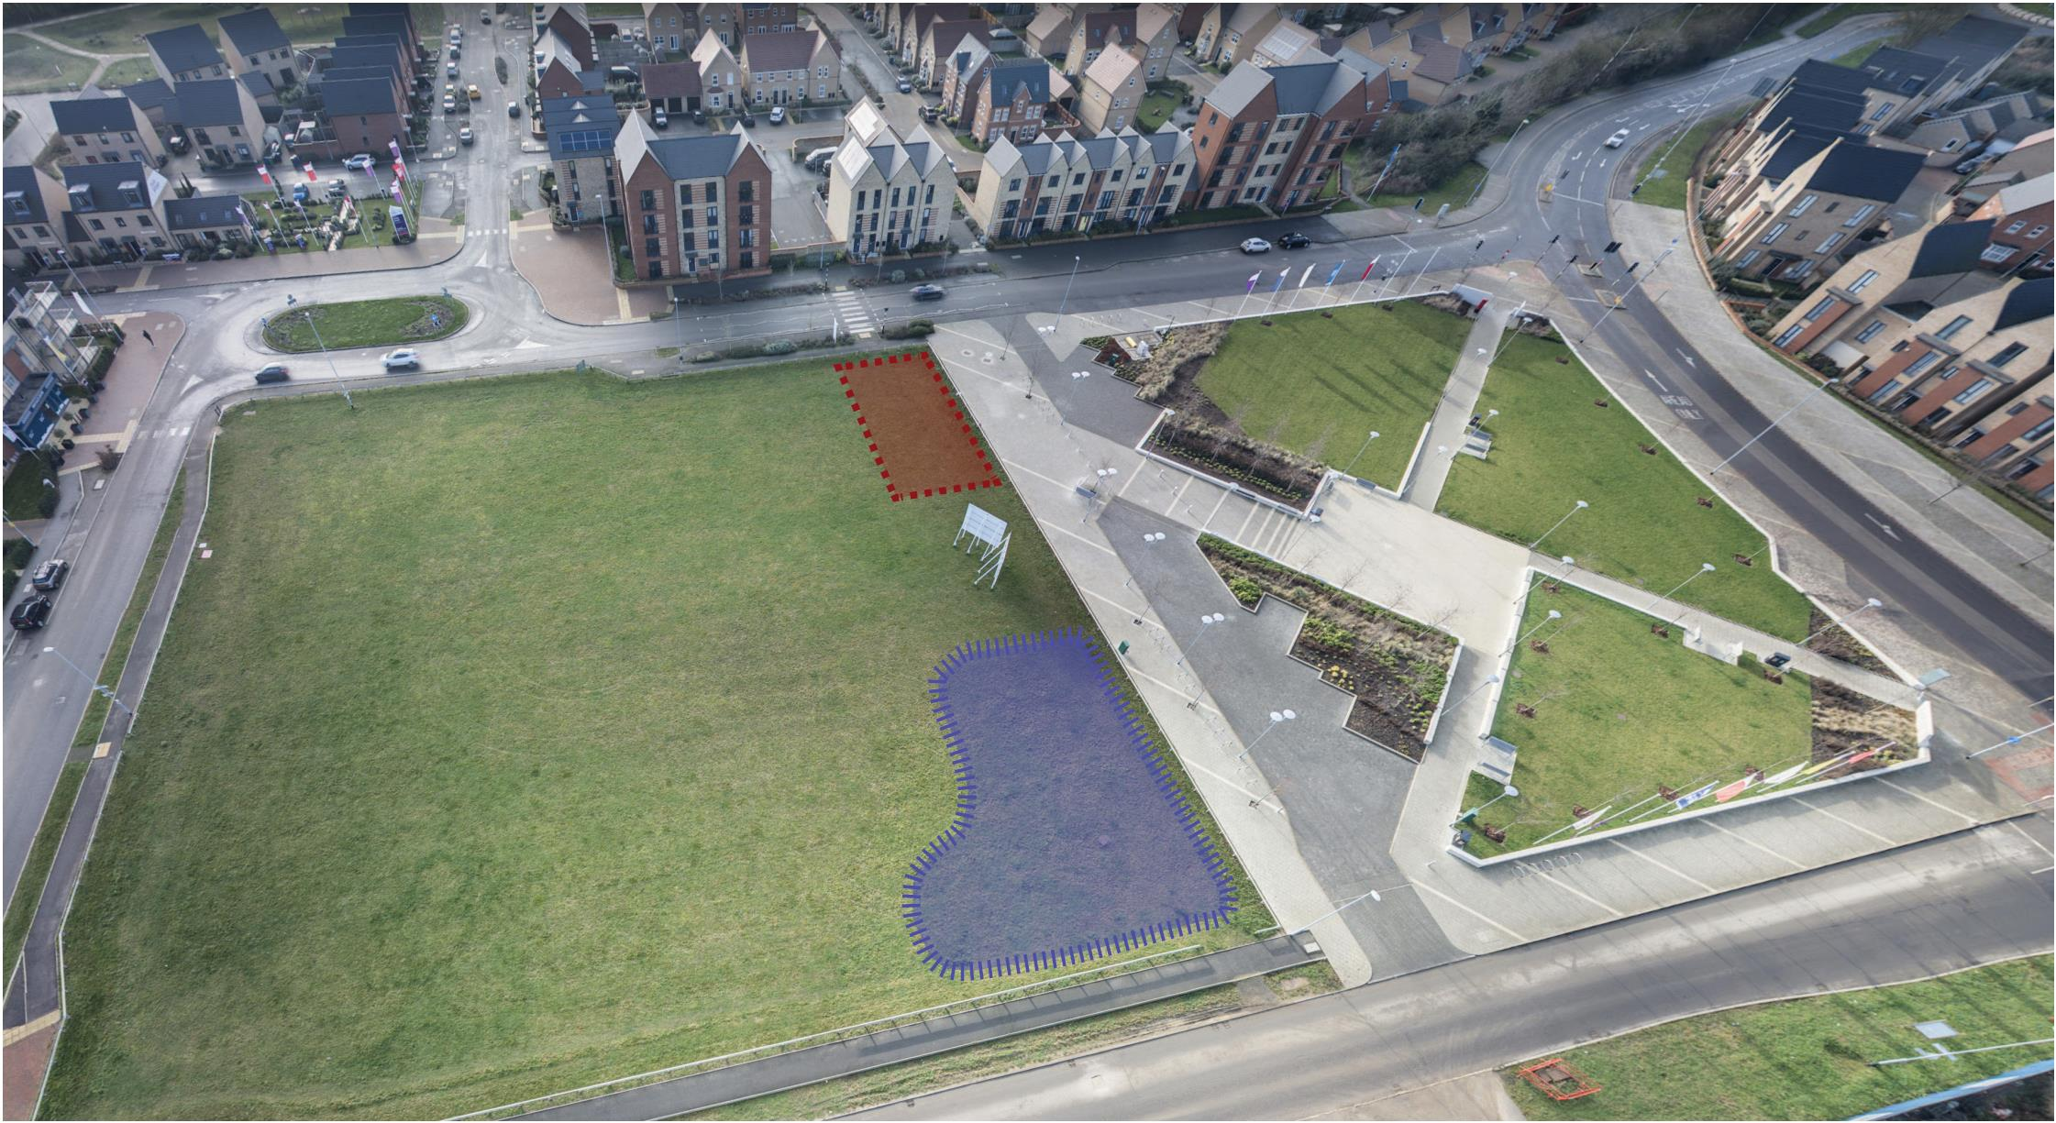
While you are waiting...
Pa
th
ay
ﬁnder W
Proposed
temporary
community
centre
The Green
Permanent
Community
Centre here

Slide 12
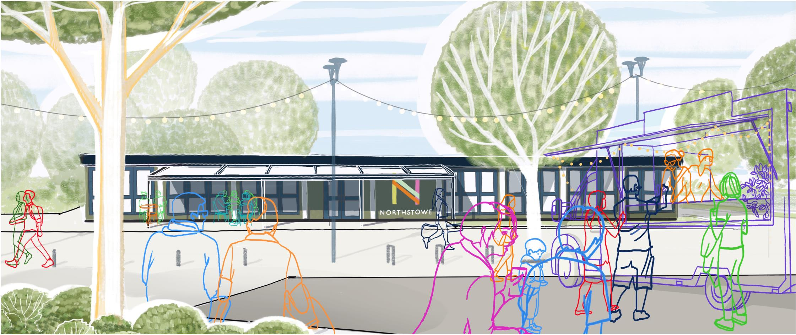
While you are waiting...
12

Slide 13
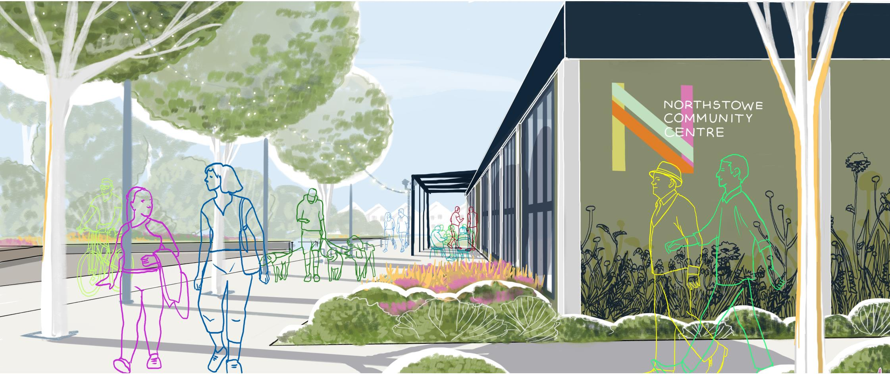
While you are waiting...
13

Slide 14
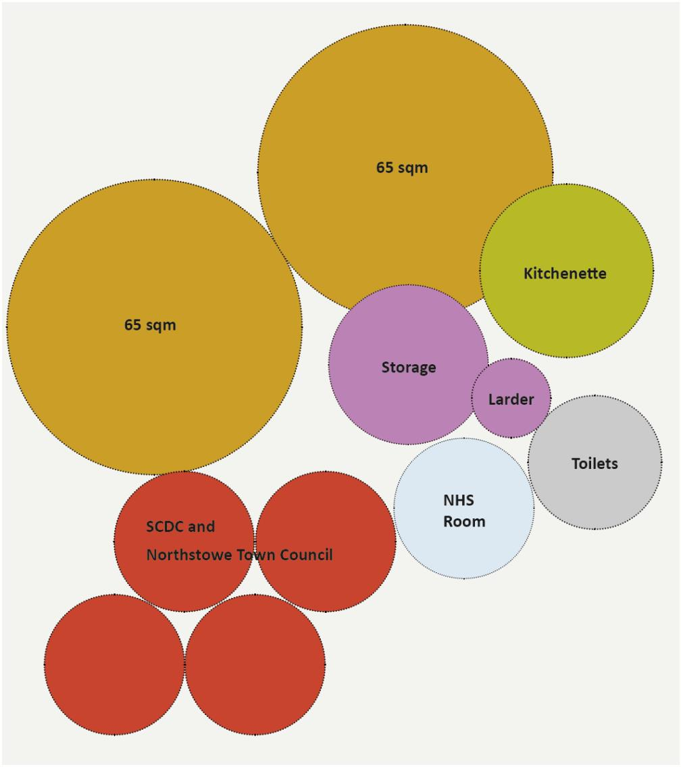
While you are waiting...
Temporary Community
Centre will provide:
• A large meeting and activity space
with a movable central partition allowing
ﬂexibility
• Oﬃces and touchdown spaces
• NHS room and waiting area
• Kitchenette and café and an informal
gathering area
• Community Larder
• External canopy over the entrance
• Community garden
14

Slide 15
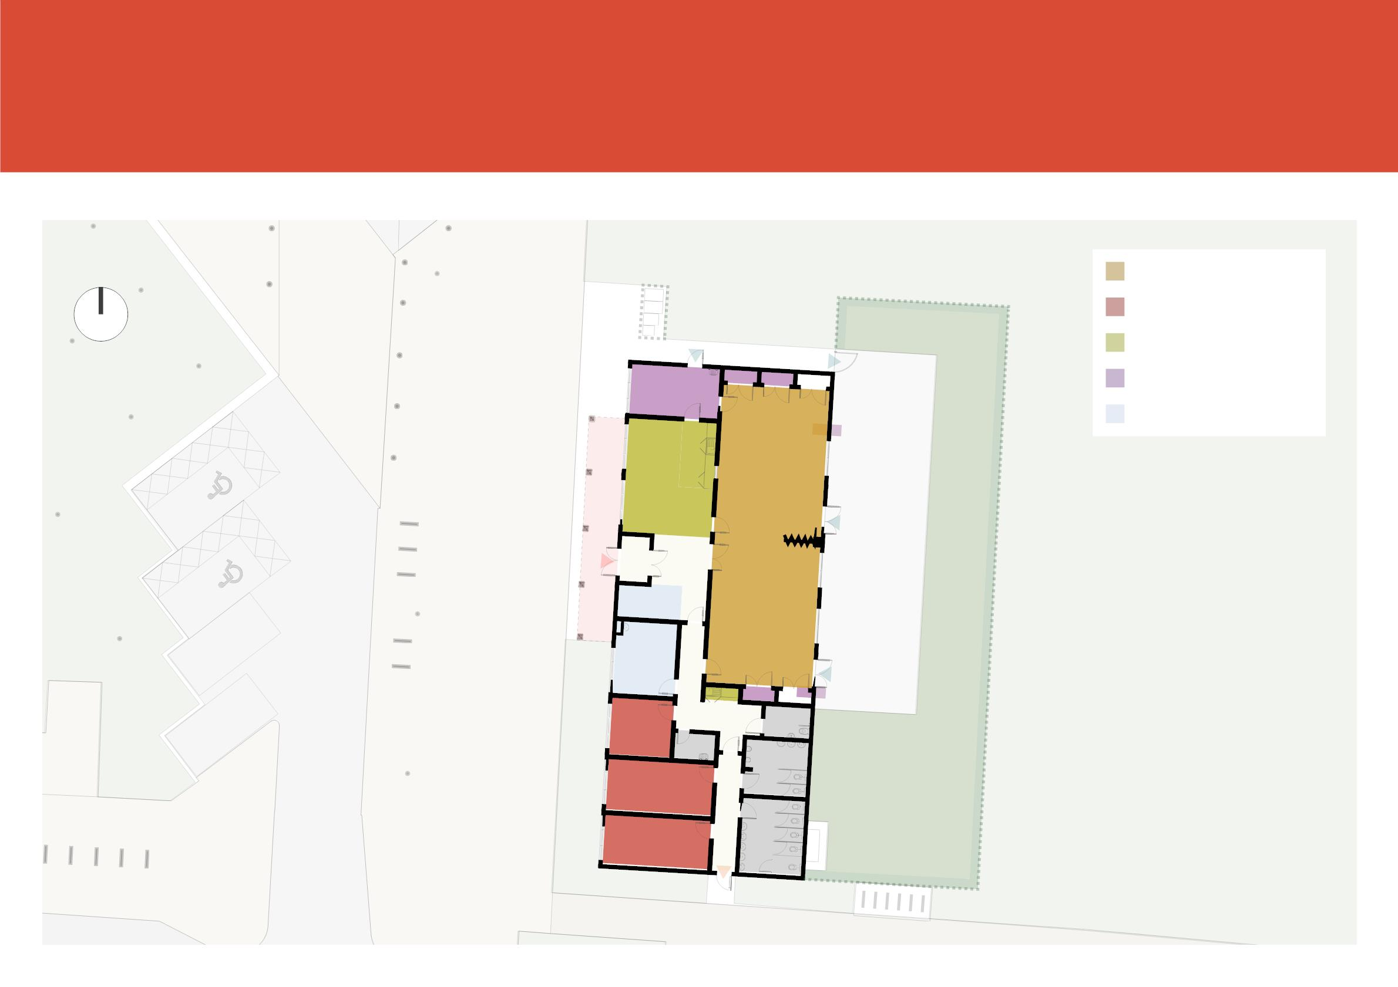
While you are waiting...
N
Assembly rooms
Oﬃces
Cafe
Storage
NHS
Garden
The building would operate for
approximately 3 years until the
new permanent centre opens.

Slide 16
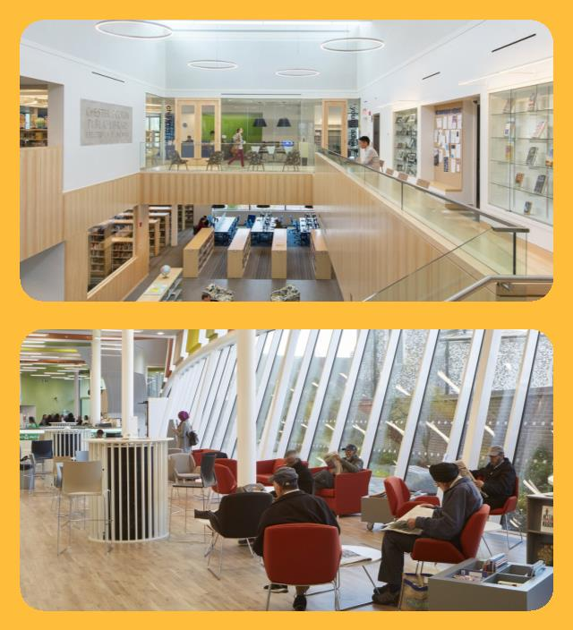
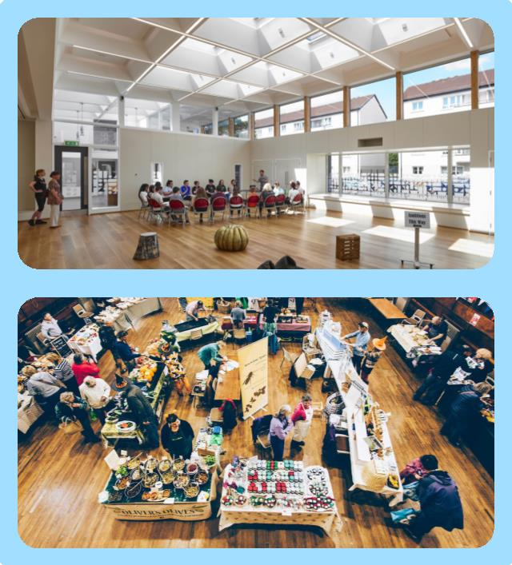
Your Permanent Community Centre
The Brief
MAIN HALL
A large multi-purpose hall for formal and informal
events; public assembly, visual and performing arts,
practice and tuition, lectures and demonstrations.
Fold out partitioning to enable hall to be split into
two or three separate spaces. Adequate storage
accessible to multiple groups.
FOYER/CAFÉ
An informal community gathering space, serving
hot drinks/snacks for waiting, meeting and greeting.
Welcoming and open, suitable for casually drop in.
A comfy space incorporating ‘nooks and crannies’
to enable quiet spaces for people to relax away
from general café area, breast feed etc.
KITCHEN
Small commercial kitchen to serve the main hall and
café.
FOOD BANK
Storage area with fridge/freezer. Discreet access
arrangements.
CENTRE STAFF OFFICE
A base for staﬀ; a reception and booking point,
records store and location for the centre’s master
service control.
16

Slide 17
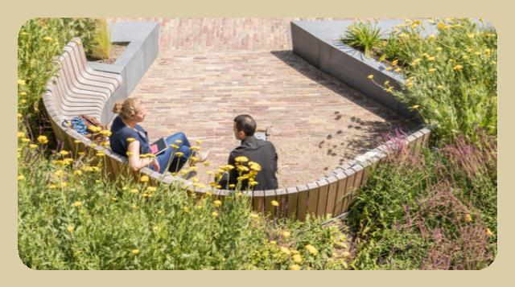
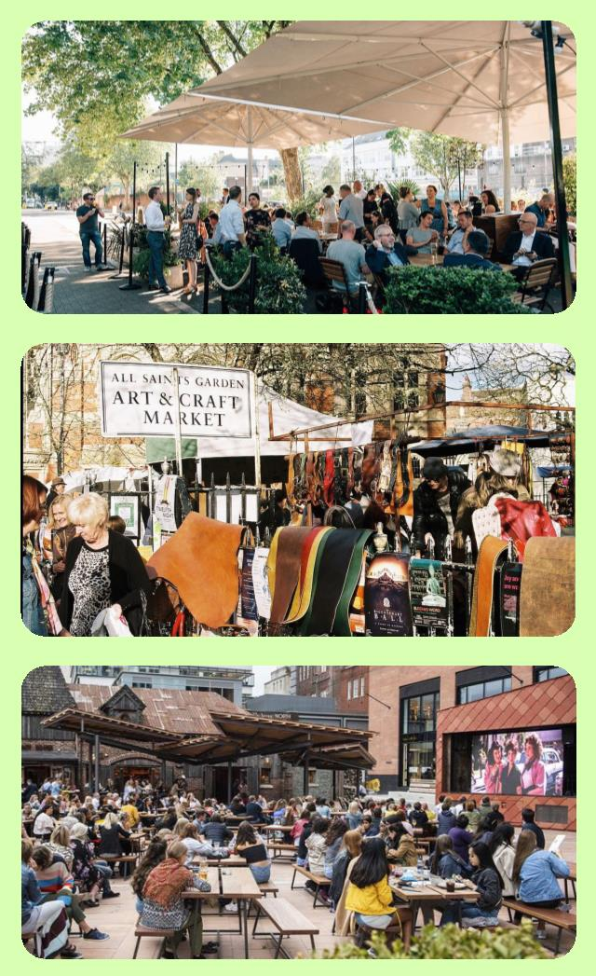
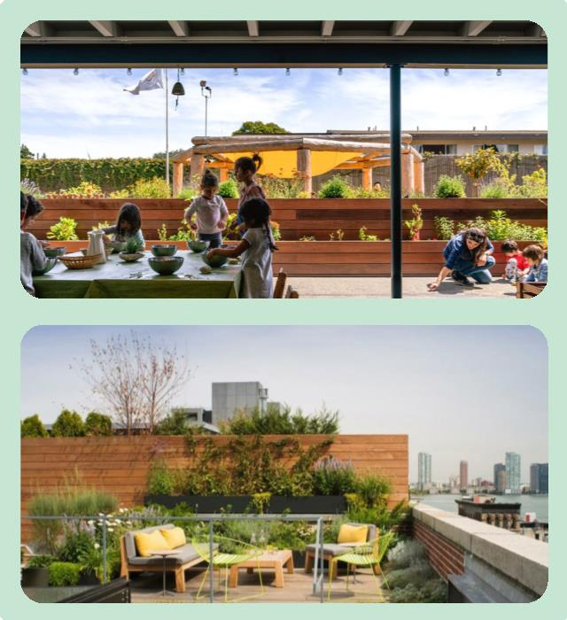
Your Permanent Community Centre
COMMUNITY CO-WORKING/SHARED SPACE
A free-range space for community book share/swap-
shop and co-working, including a computer area.
MESSY ACTIVITY SPACE
A robust ‘make space’ for arts and crafts, workshop
or other messy activities, ideally connected to the
secure courtyard garden. Could be used by play-
groups.
CONSULTATION/MEETING ROOMS
Multi-purpose spaces for meetings and groups,
visiting community workers, including police, and
potentially NHS clinics.
STORAGE
Rentable spaces convenient for clubs and groups
to store larger items, as well as community centre
equipment and furniture. To include outside storage
space.
TOILETS
Convenient locations, to include disabled toilets, a
‘family toilet’ and Changing Places toilet.
OUTDOOR SPACES
Public outdoor areas to include external seating with
easy access from the café and other public areas, as
well as a more secluded, outdoor space for ‘closed’
events and controlled, safe play space for children.
A roof terrace area would also be desirable.
17

Slide 18


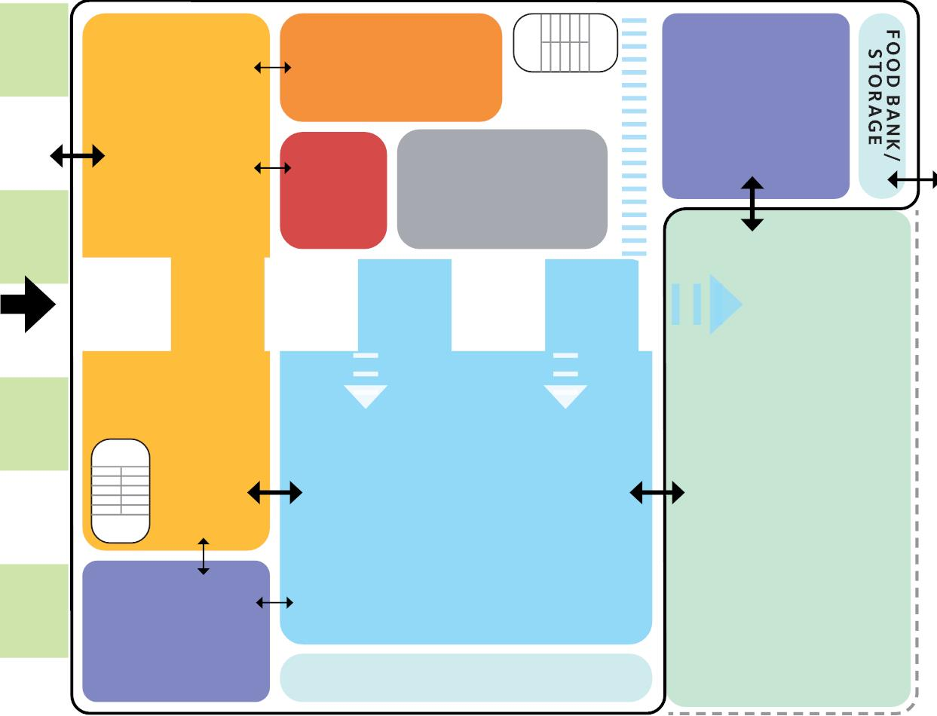

Your Permanent Community Centre
LINEAR PARK
GROUND FLOOR
KITCHEN
MESSY
ACTIVITY
SPACE
RECEPTION
SERVICES
/ WC
CAFE/FOYER
COURTYARD GARDEN
MAIN HALL
ACTIVITY
SPACE
STORAGE
18

Slide 19
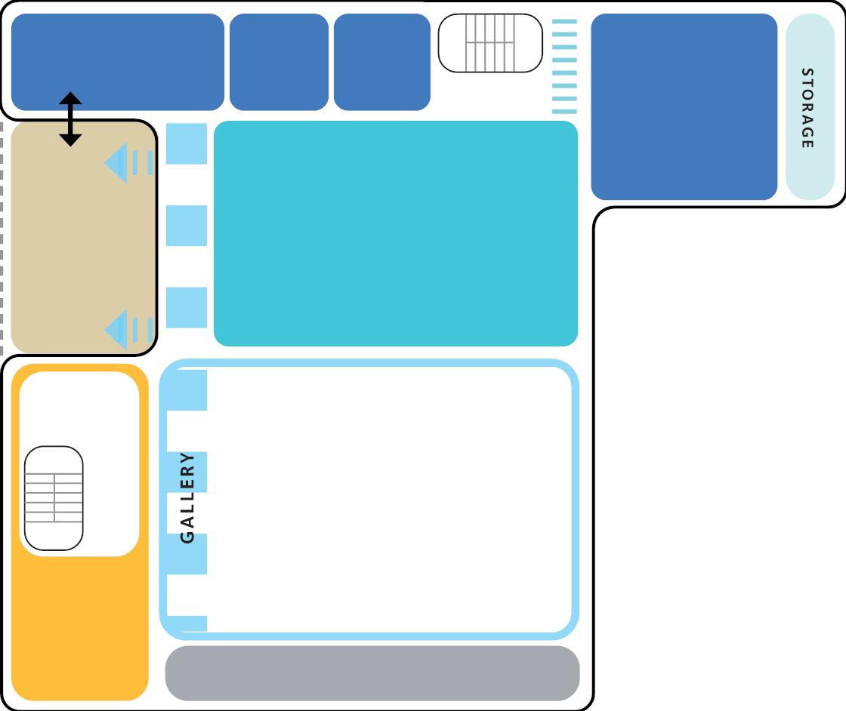
Your Permanent Community Centre
FIRST FLOOR
CONSULTATION / MEETING ROOMS
MEETING
ROOM
ROOF
TERRACE
WORK SPACE
VOID OVER
CAFE
VOID OVER
MAIN HALL
MEZZANINE
PL ANT
19

Slide 20
Discussion
1. Your Initial reaction to the overall approach in
relation to your speciﬁc needs,
2. Have we missed anything important?
3. What are your aspirations for the building?
4. What facilities and services are most
important for you and your organisation?
20

Slide 21
Next Steps
21

Slide 22

THANK YO U
northstowe@ar-urbanism.com

