Slide 1
Northstowe Town Council
Cllr. Jason Benedicic

Slide 2


Slide 3
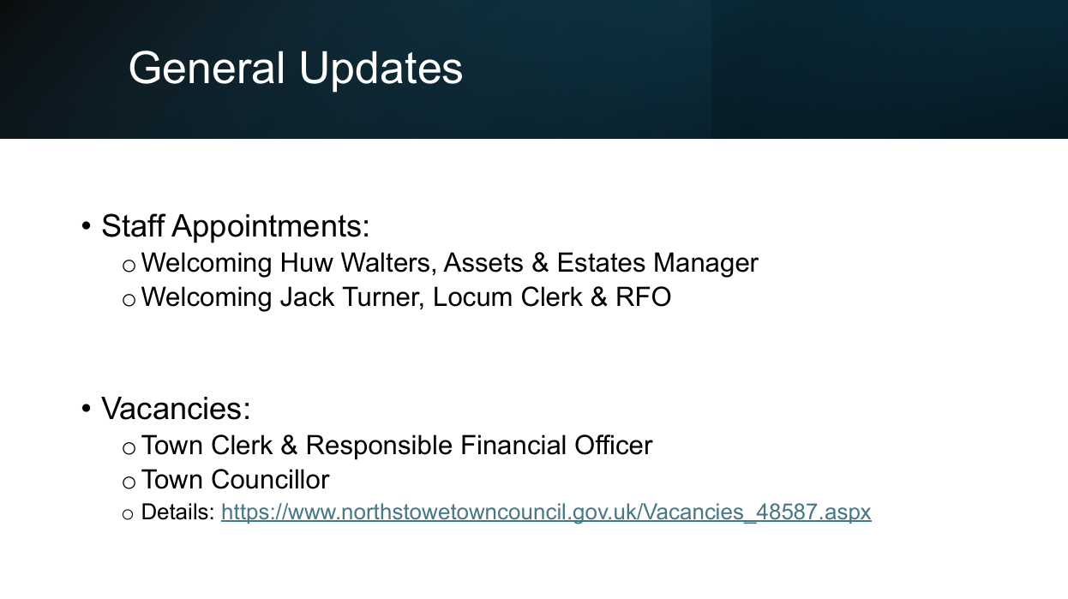

Slide 4
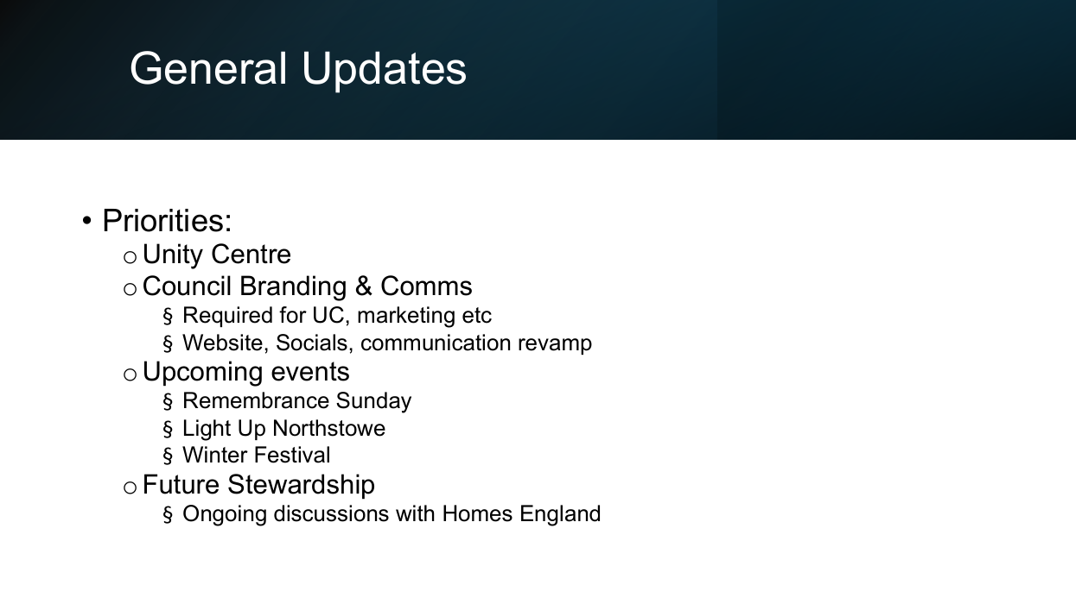

Slide 5
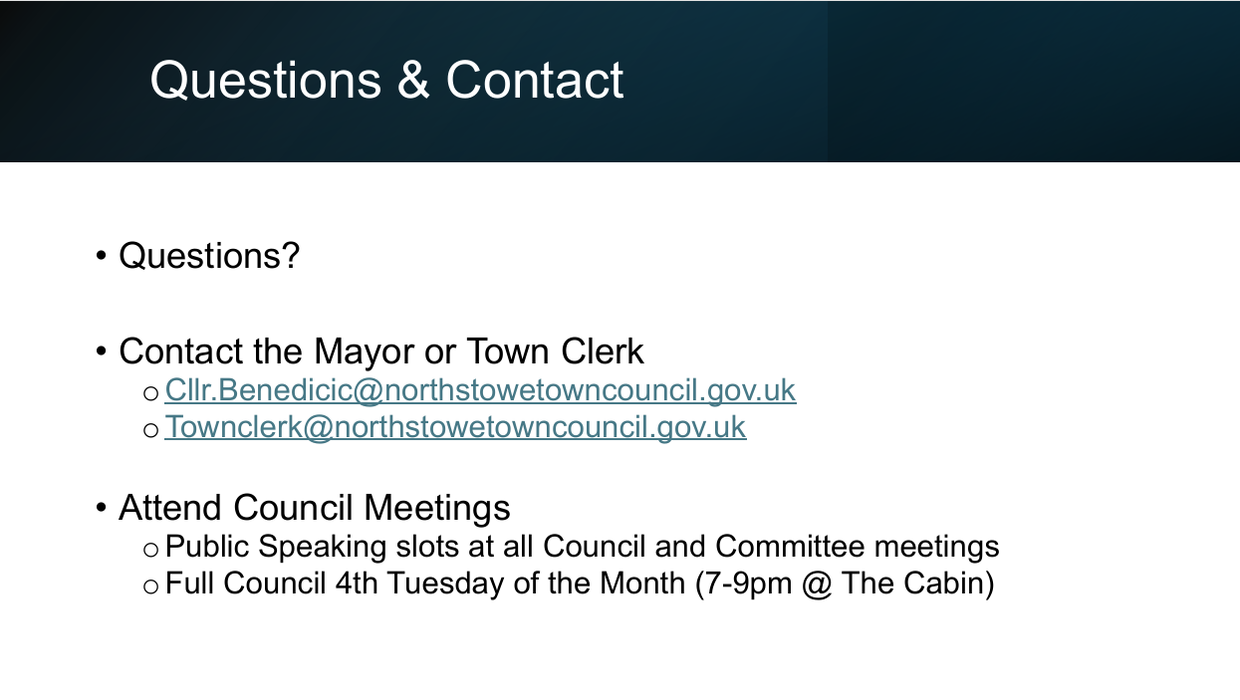

Slide 6
Northstowe Community Update
Mihaela Stan
and
Michele Eidevik-Skinner
Community Development Officers
Northstowe.community@scambs.gov.uk

Slide 7

Occupation Count
Phase 1 Newbuild total: 1463
Phase 2 Newbuild total: 188
Northstowe Newbuild total: 1651
Northstowe Overall Total: 1750

Slide 8


Slide 9
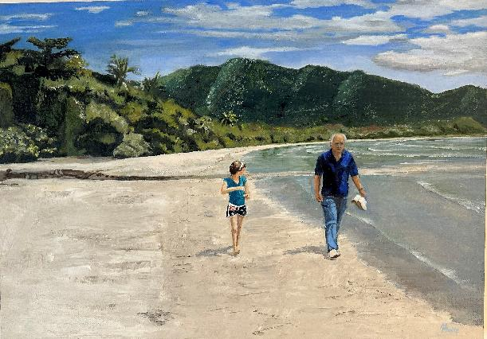

Northstowe Art Show
Submission date Friday 12 September
Preview: Friday 26 September, 6:30pm – 8:30pm
Exhibition: Saturday 27 September, 10am – 5pm

Slide 10


Slide 11
Any Questions?

Slide 12
Thank you for attending the Northstowe Community Forum
Next Northstowe Forum
Wednesday 3 December

