Slide 1
Cambourne to Cambridge
11 December 2024

Slide 2
Areas of focus
Background Project update Next Steps
Comberton Greenway

Slide 3
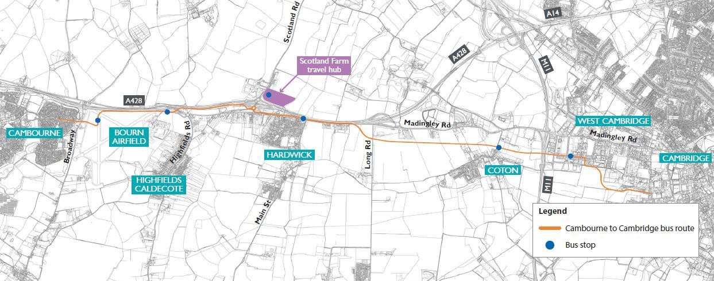
Cambourne to Cambridge - Background
A new travel route between Cambourne and Cambridge. The route includes:
a bus route via the Bourn Airfield development, Hardwick, Coton and the West Cambridge site,
a new, 2000 space travel hub at Scotland Farm, Dry Drayton,
a new path for walkers, cyclists and, where appropriate, horse riders

Slide 4
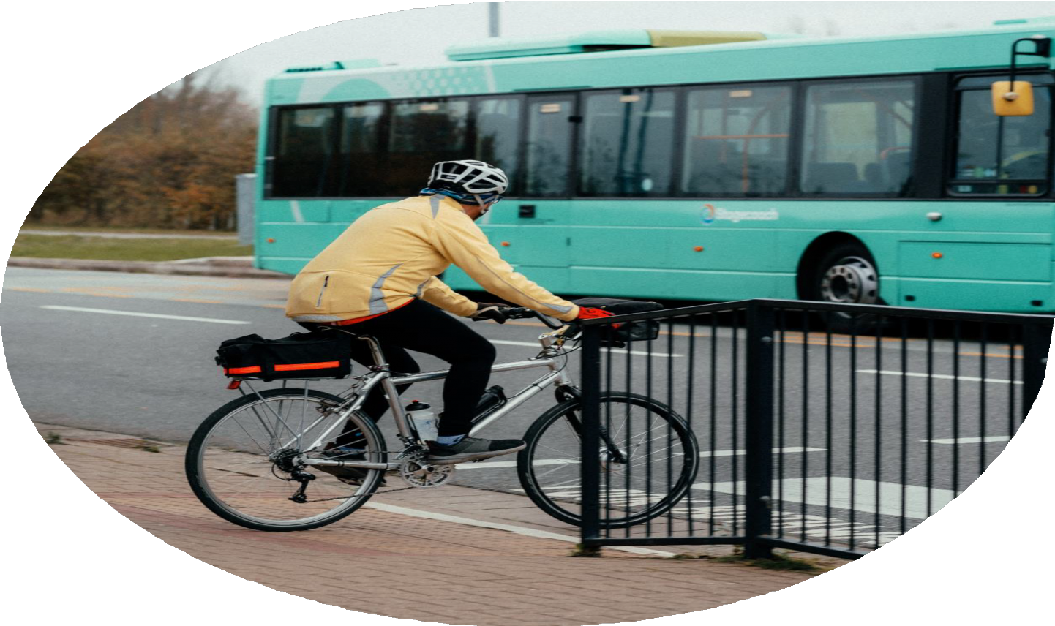
Background
Scheme developed over many years following government guidelines.
GCP consulted four times, including as part of the development of the Environmental Impact Assessment. Rigorous assessment of both off- road and on-road options. This included routes along the A1303 suggested by stakeholders. The business case and documents published on our website show these assessments.
An independent audit found that our process is robust.

Slide 5
Project update
Transport and Works Act Order Submission to Department for
Transport was made on 12 November 2024
All information publicly available:
www.greatercambridge.org.uk/cambourne-cambridge-twao
Further information hello@greatercambridge.org.uk 01223 699906
Representations and objections: transportinfrastructure@dft.gov.uk
Transport

Slide 6
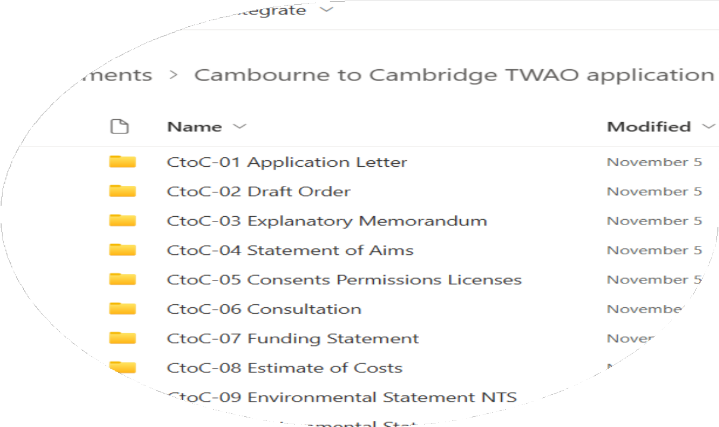
What information has been published
Full set of land plans and scheme drawings based on government guidance.
The deemed planning drawings may be most useful for anyone wanting to see detailed drawings of the proposals
The Planning Statement provides a list of conditions which GCP will need to comply with if the scheme is developed
The Design and Access statement explains some of the principles which will inform
detailed design of the scheme
GCP has been in contact with all landowners
and they have been advised to seek professional advice which GCP will fund

Slide 7
Next steps
Following the deadline the DfT will determine whether or not to call a Public Inquiry.
Assuming that a Public Inquiry will be called the timetable will be determined in early 2025 based on the number and type of objections received.
A public inquiry should start early summer 2025 and be concluded early autumn at the latest with an Inspector’s report later in the year or early 2026.
If the scheme is approved then construction would take place
2026 to 2028
Transport

Slide 8
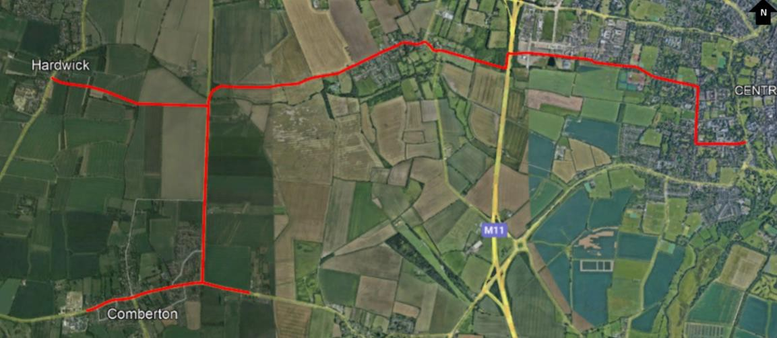
Comberton Greenway – Next Steps
Construction of Adams Road April 2025
Construction of Coton Village April 2025
Full planning application submitted Spring 2025 Continued engagement with landowners on the ‘off-line’ sections to bring forward the creation of Bridleways to connect the villages of Hardwick, Comberton, Barton and Coton

Slide 9
Questions

