Slide 1
Northstowe Community Forum
Wednesday 10 September
Drop-in 6:30pm
Presentations 7pm

Slide 2
Agenda
Chair’s Welcome
Greenbelt Update
Tree Planting Project
Homes England Update
Live Planning Applications
Urban & Civic Update
Unity Centre
Northstowe Town Council
Northstowe Community Update

Slide 3
Code of Conduct
All People attending the Forum will:
Treat all people with respect and act in a way which does not discriminate against or exclude anyone.
Observe the authority of the Chair or facilitator at all times
Listen quietly to and respect the views and experiences of other people contributing.
Agree to and follow the standard of behaviour expected at each event, according to what is happening at that event. (e.g. no interrupting or shouting)
Any person or people causing an event to be interrupted by reason of behaviours can be asked to leave the event by the Chair or staff at the event.
Where the Chair believes that:
There has been behaviour which threatens the safety of him or herself or others present, the Chair may opt to suspend the meeting or event until order is restored or to end the meeting or event if they feel that it is appropriate.
Any person or persons causing through their behaviour, any other individual or individuals present at a Forum event to fear for their personal safety may be subject to immediate removal from the event and/or the event premises.

Slide 4
Chair’s Welcome
Cllr. Natalie Warren-Green
Lead Cabinet Member
for
Environment
District Councillor, Longstanton Ward
(including Longstanton, Oakington & Westwick, Northstowe)

Slide 5
Greenbelt Update
Adam Lewis, Strategic Project Manager and Robin Waddell, Development Director

Slide 6
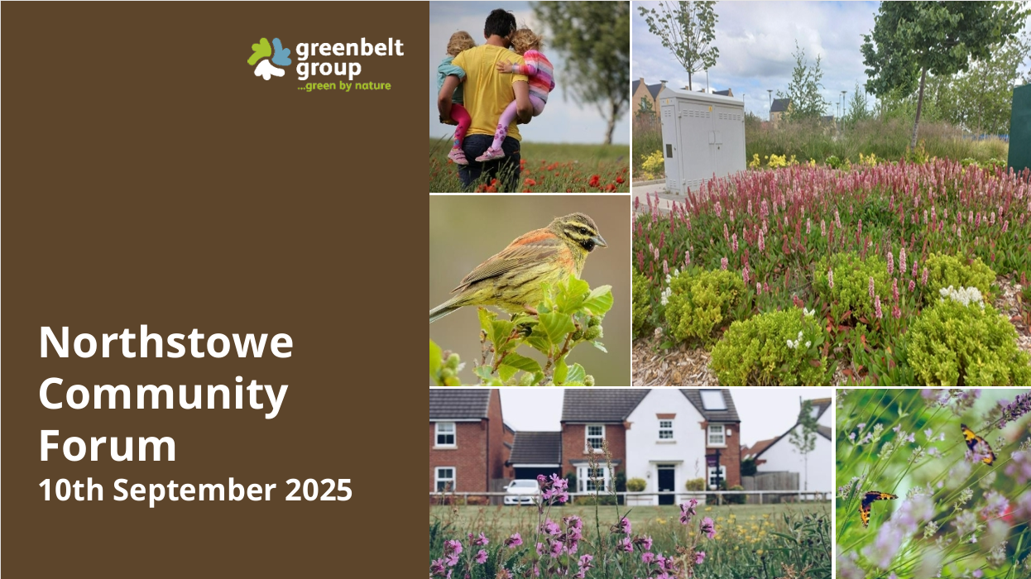

Slide 7


Slide 8


Slide 9
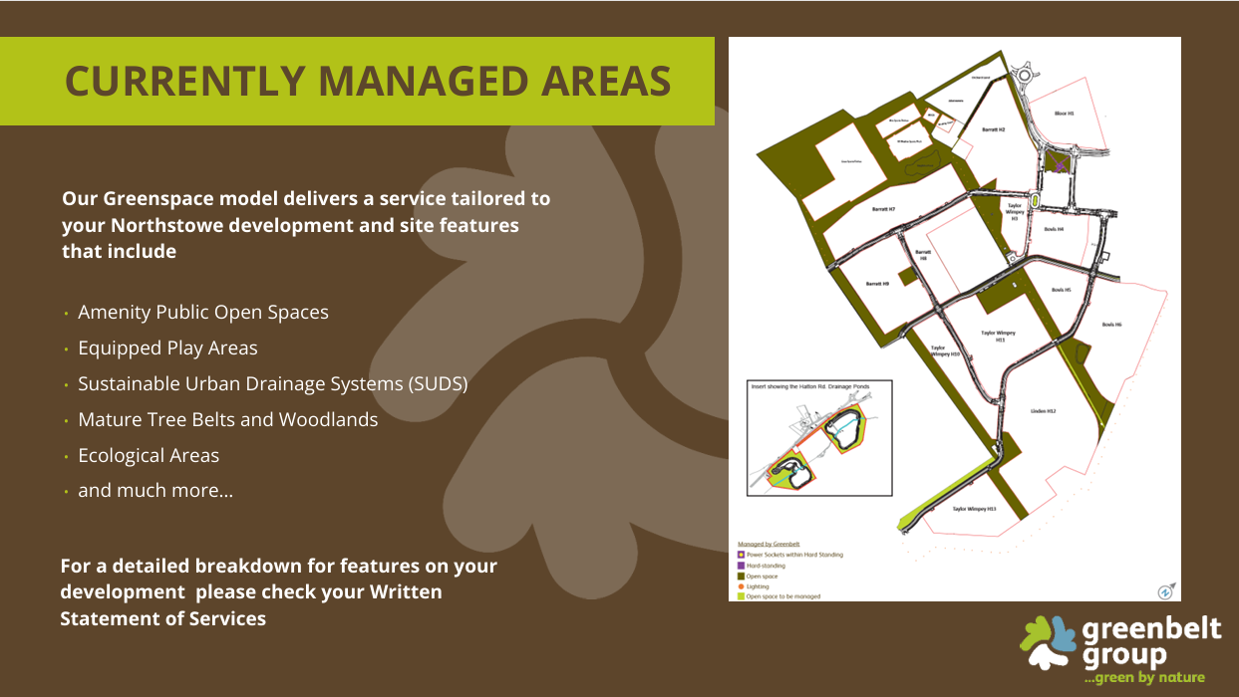

Slide 10
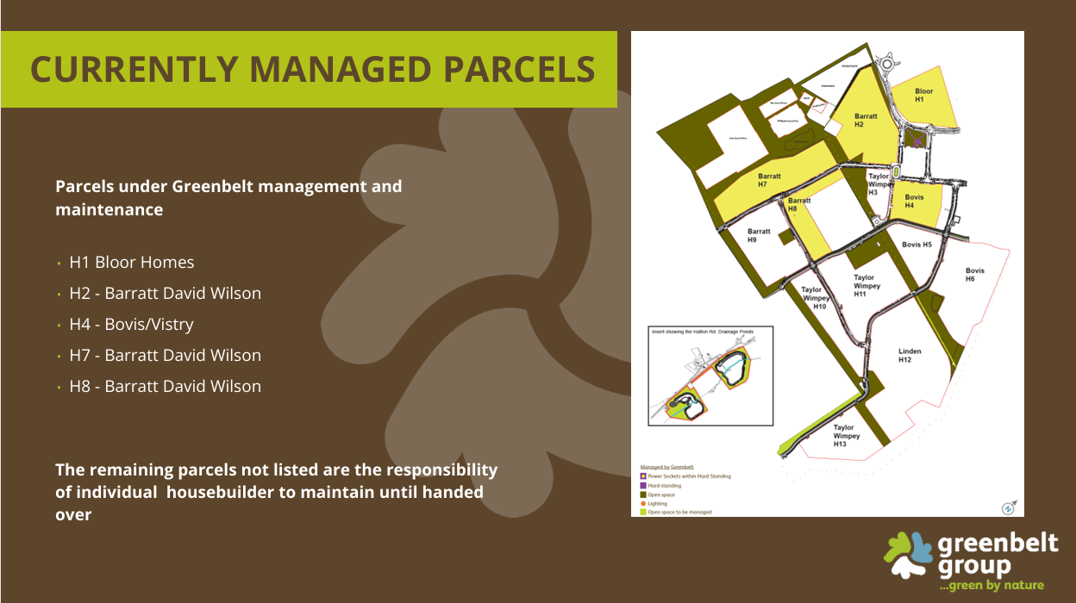

Slide 11
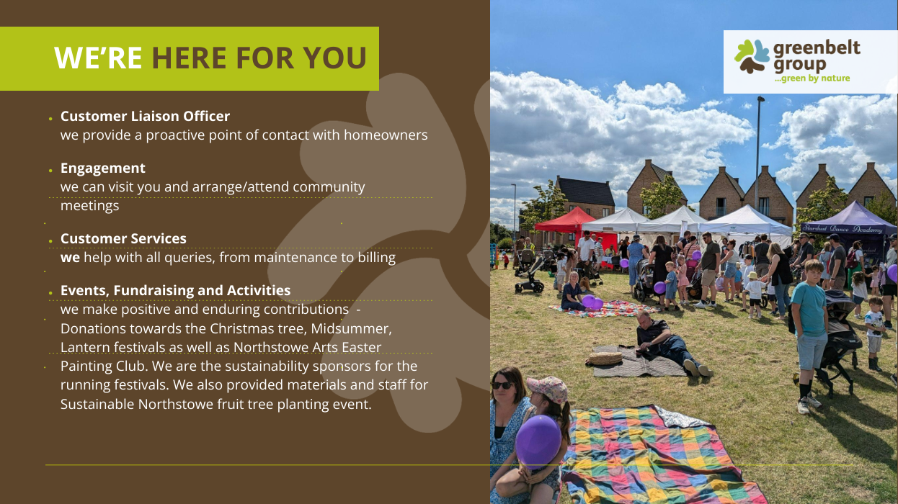

Slide 12


