Slide 1
Homes England Update
Catherine O’Toole, Planning and Enabling Manager (Large Sites – Northstowe)

Slide 2


Slide 3


Slide 4
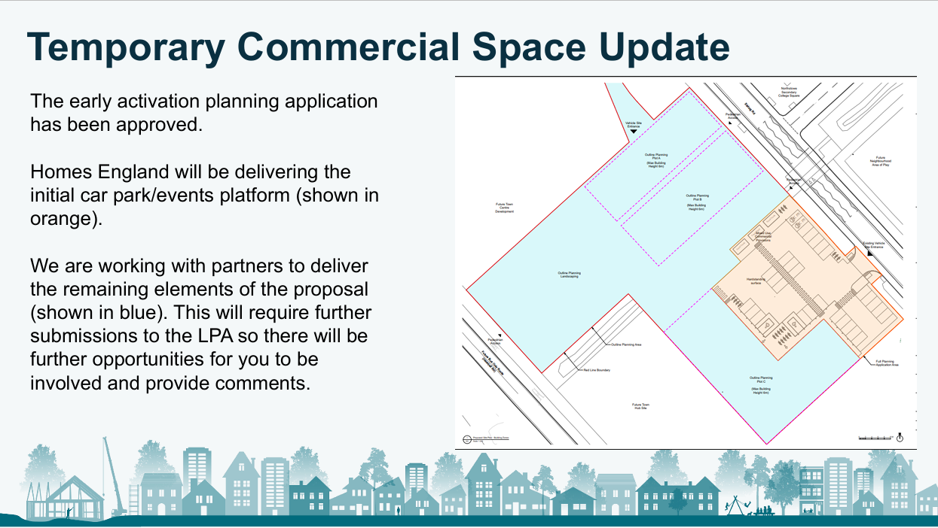

Slide 5
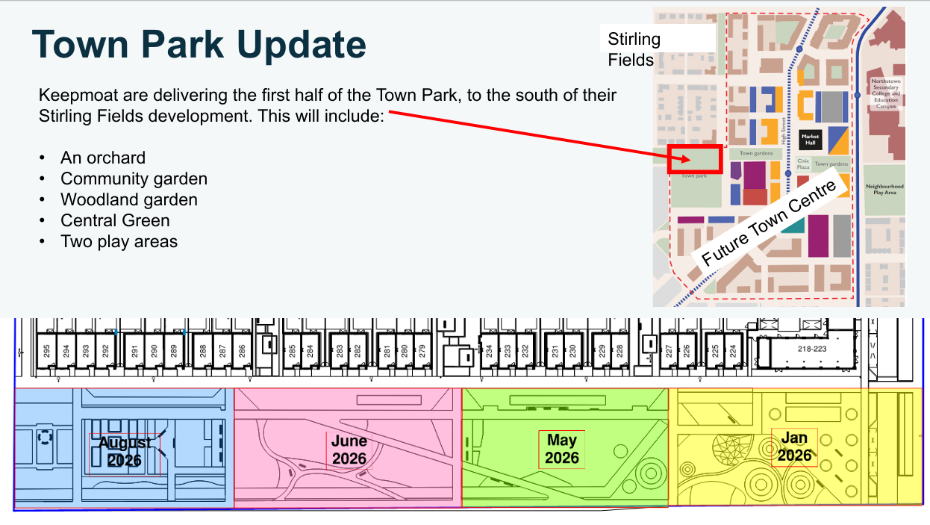

Slide 6
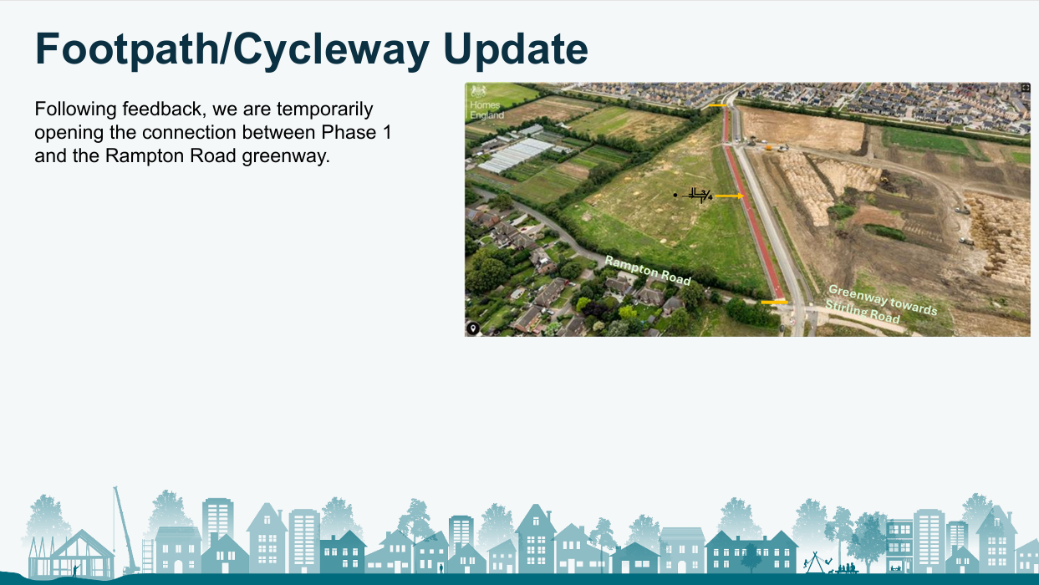

Slide 7
