Slide 1
Unity Centre
Kirstin Donaldson, Service Manager - Acquisitions and Development
South Cambridgeshire District Council

Slide 2
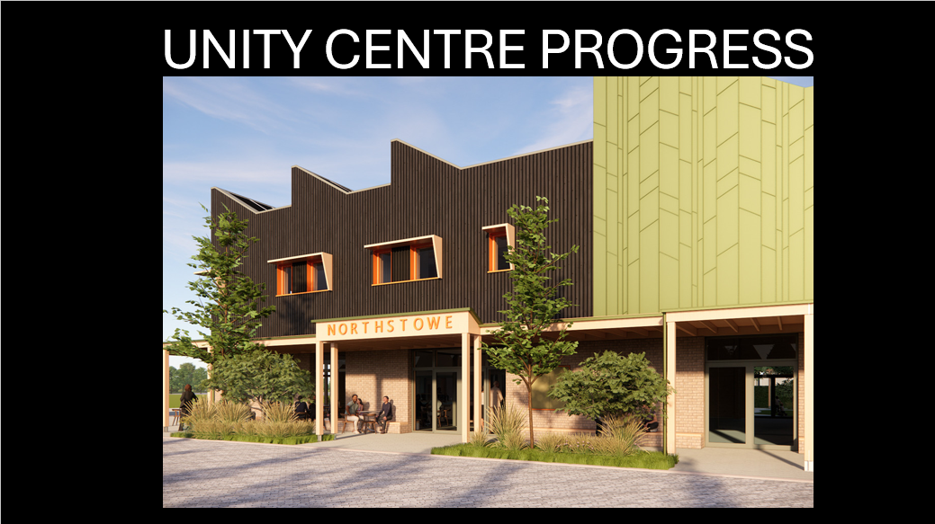

Slide 3


Slide 4
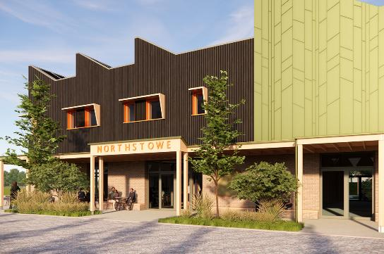
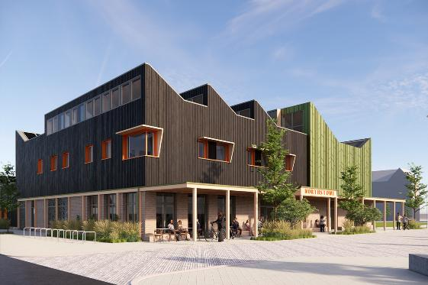
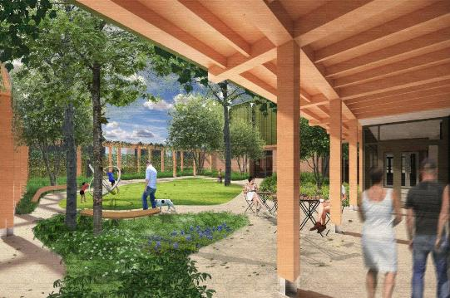
High-quality materials and outdoor space

Slide 5
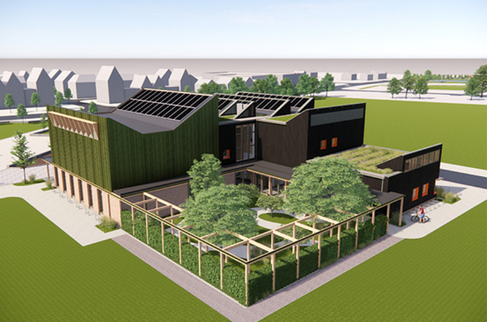
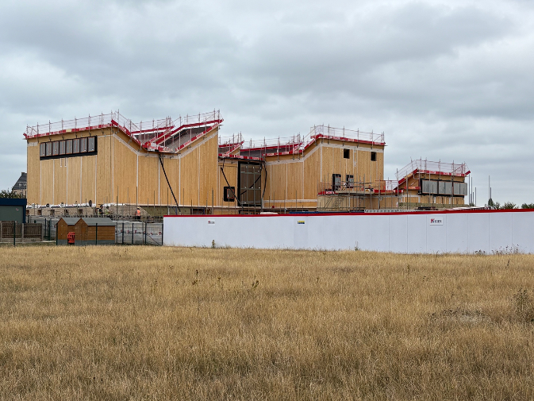

Slide 6
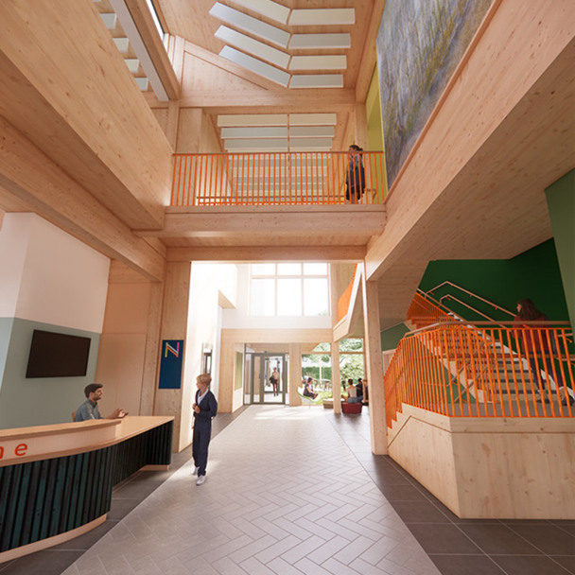
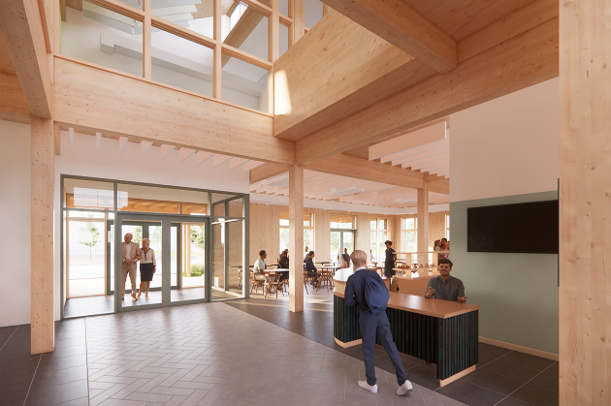
Open and welcoming reception and café area

Slide 7
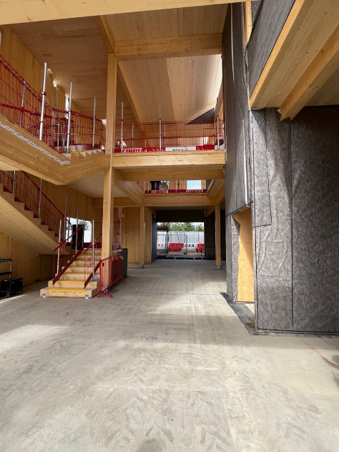
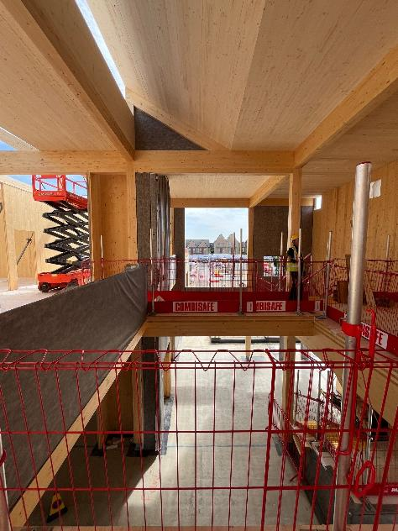
Views into and out of the building for connection and passive security

Slide 8
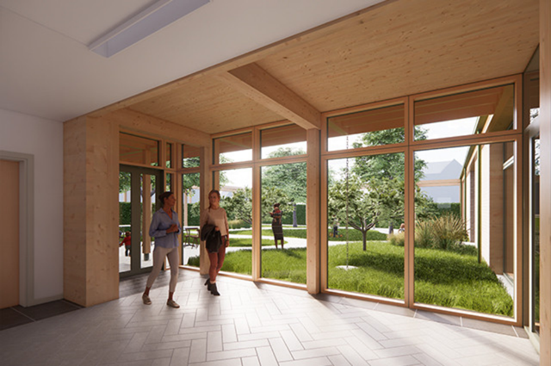
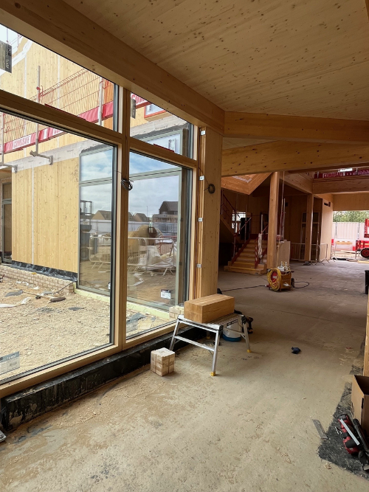
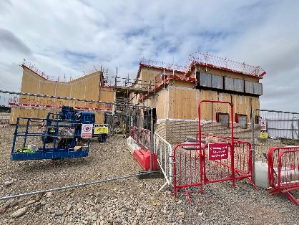

Slide 9
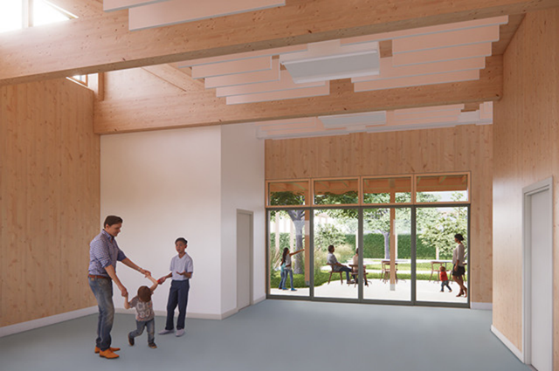
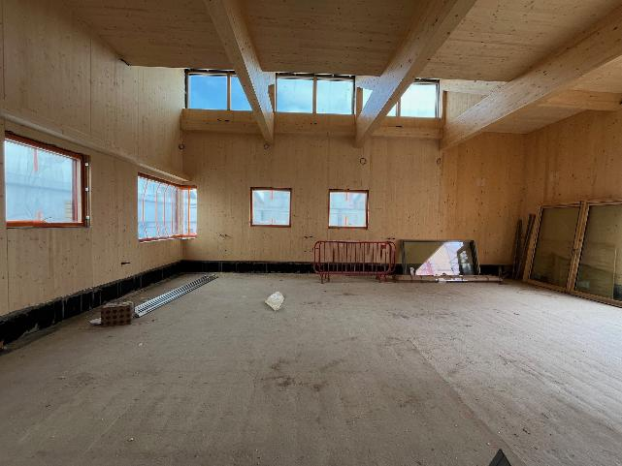
A secure and self-contained messy/noisy room that can be used by services supporting vulnerable people whilst remaining connected

Slide 10
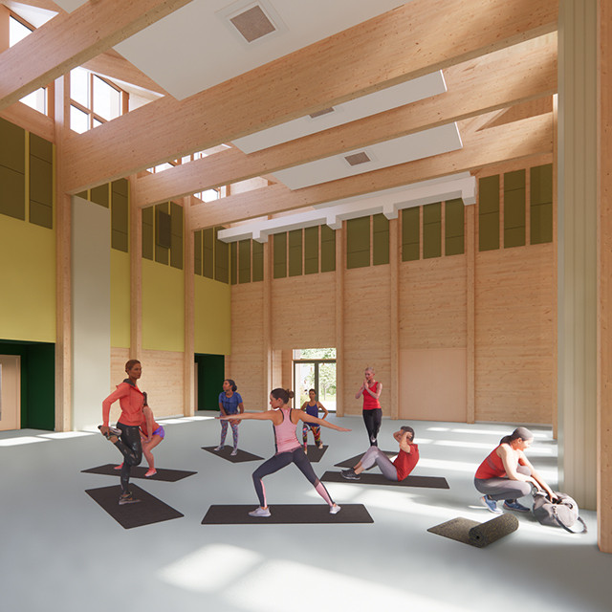
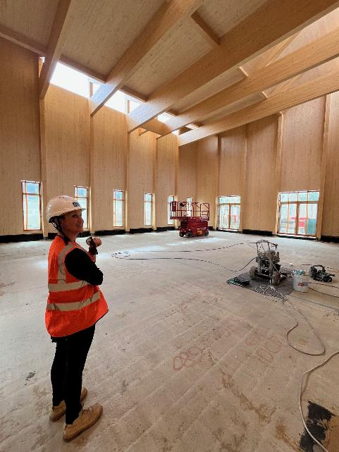
An outstanding, double-height main hall space that can be used for conferences, performances, weddings. Or divided and used for smaller non-impact bookings

Slide 11
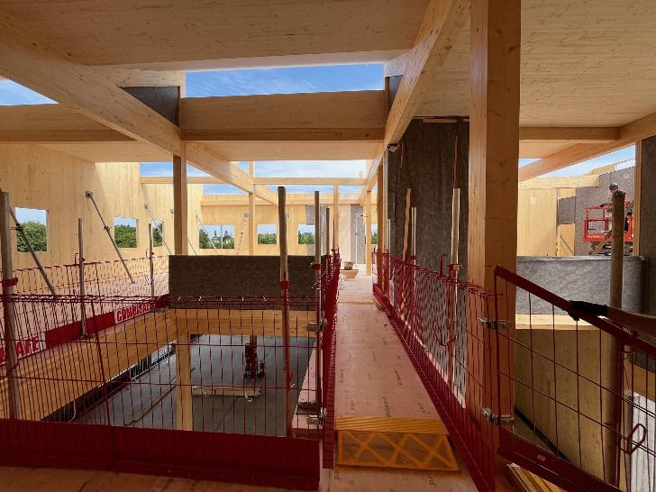
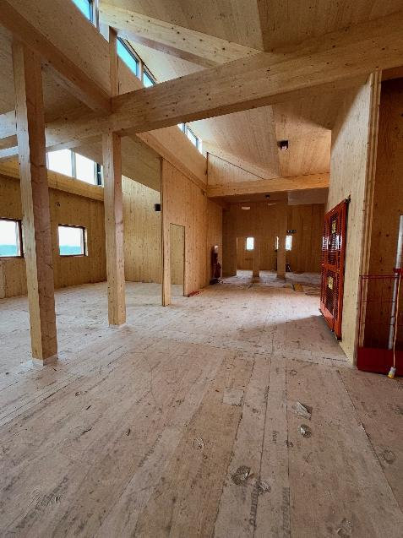
A multi-use collaboration space, with micro-library zone, Town Council Office, multi-functional meeting spaces, and NHS-ready consultation room.

Slide 12
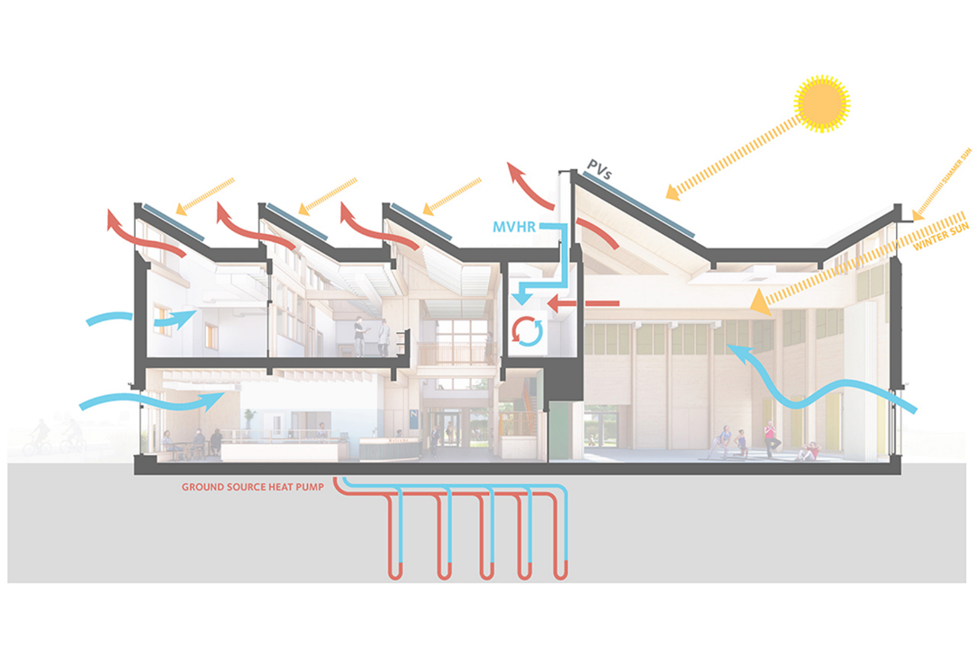
Green to its Core! The CLT and glulam construction, combined with GSHP, PV panels and 2-way MVHR system achieves a near passive standard and represents the cutting-edge in delivery

Slide 13
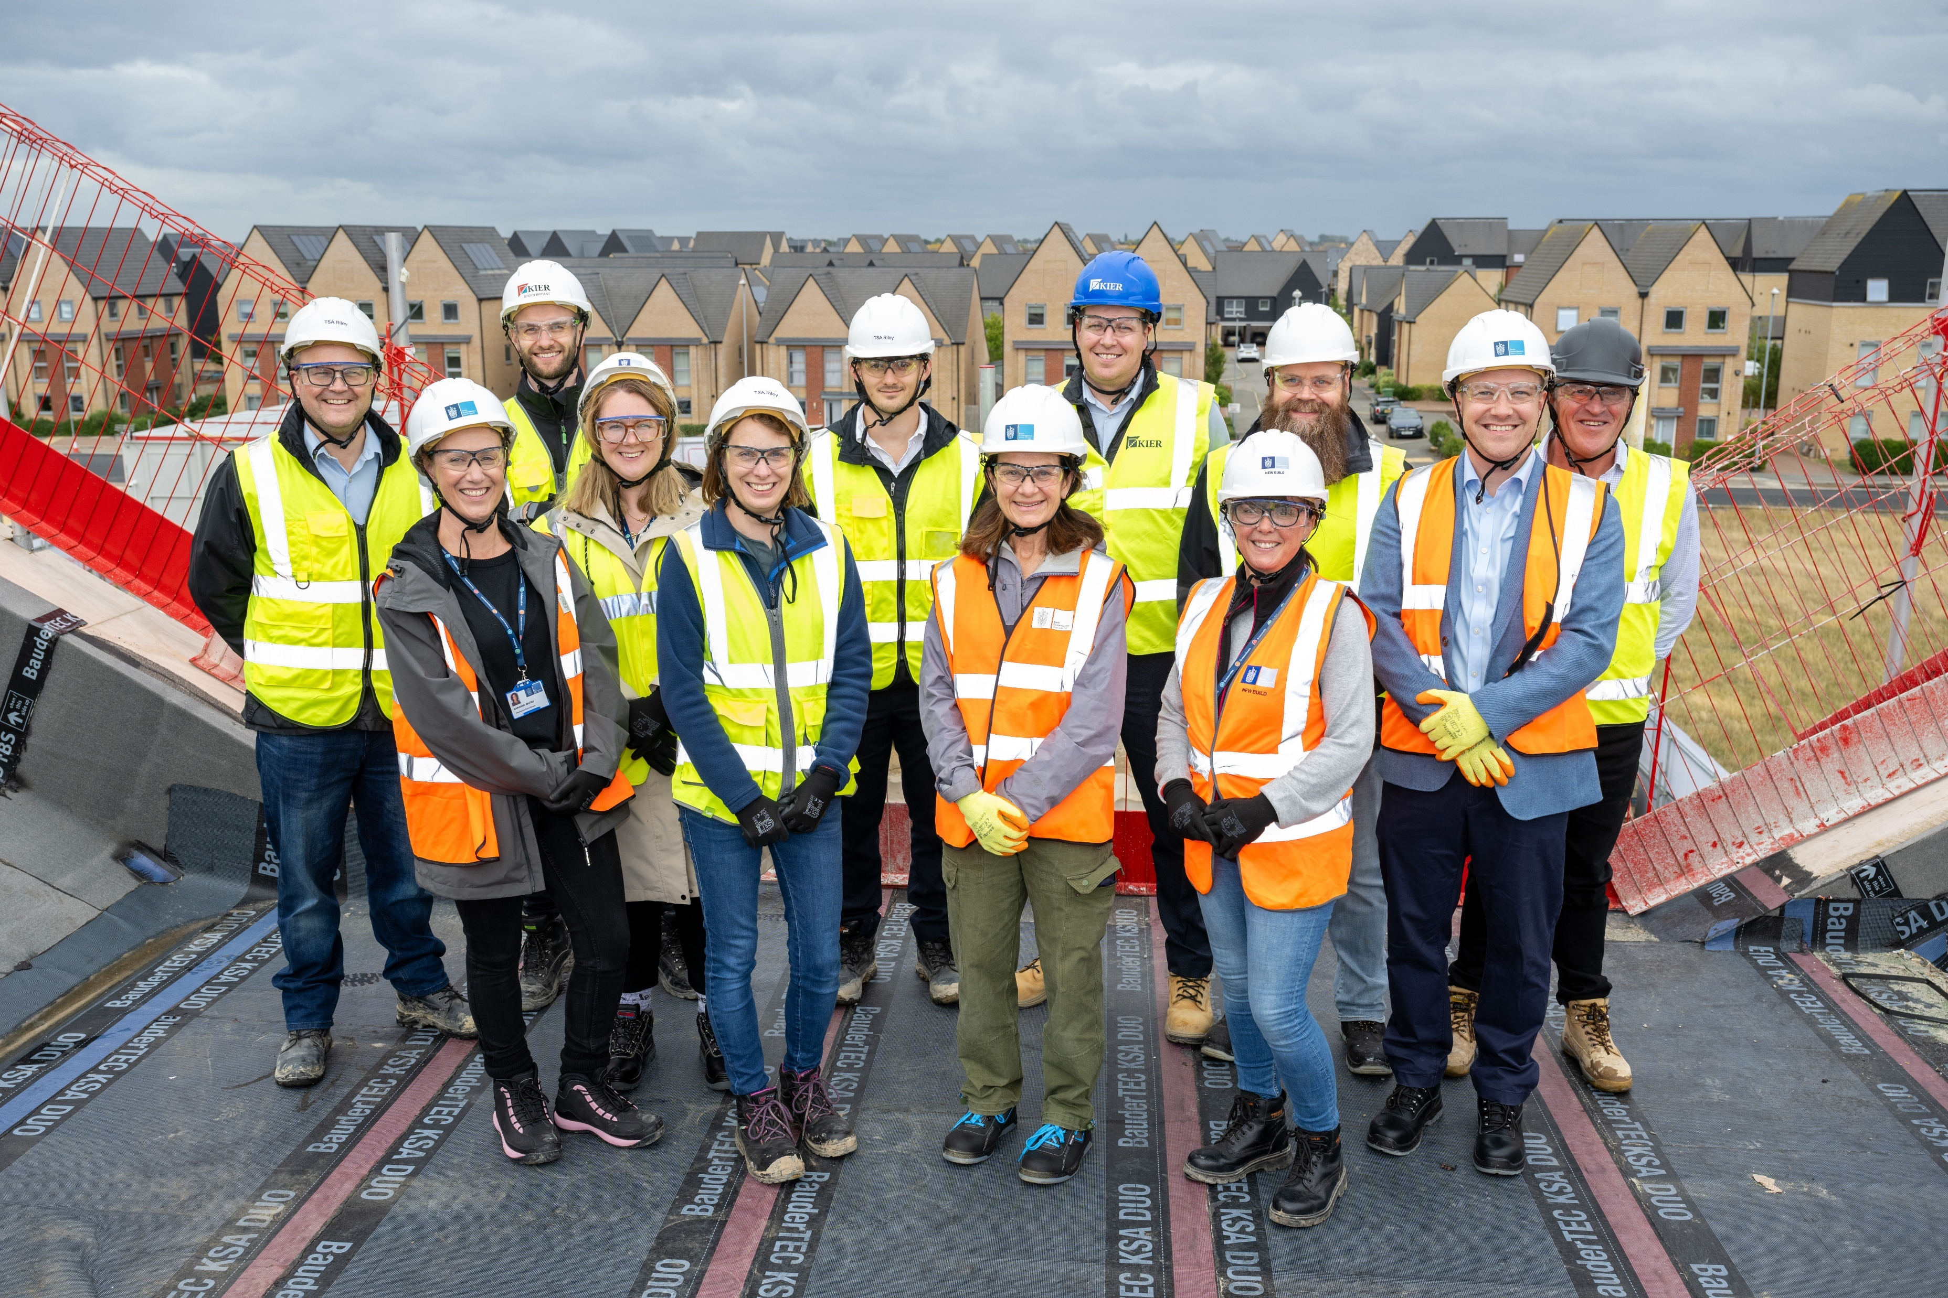

Topping Out. A topping out ceremony took place on 3 September marking completion of the highest point of the build. We are 55% through the build with an expected completion in February 2026.

Slide 14
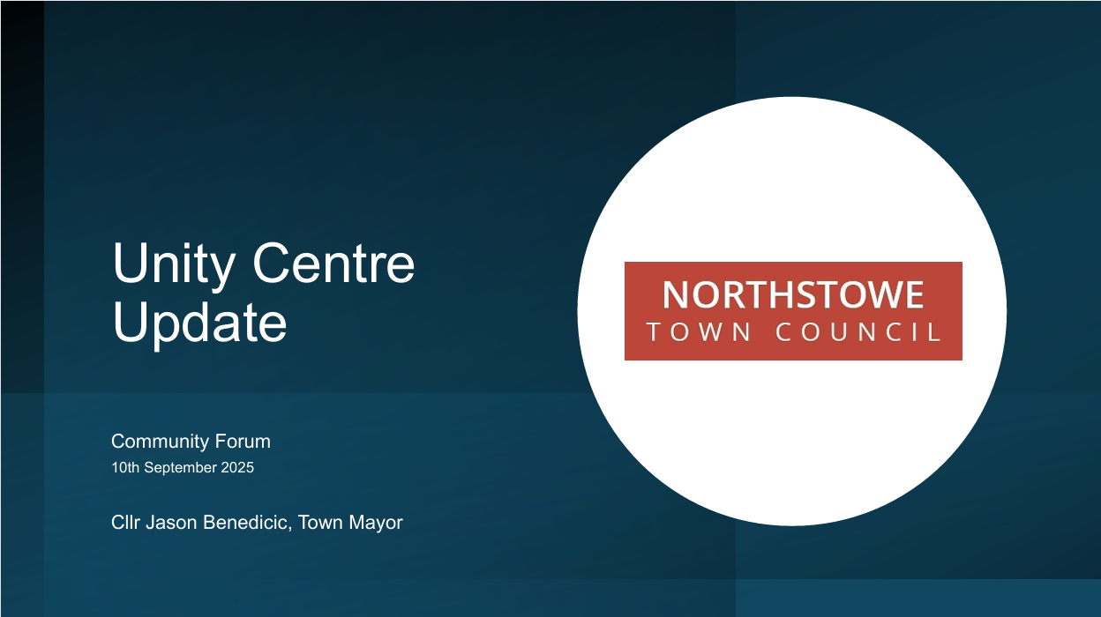

Slide 15
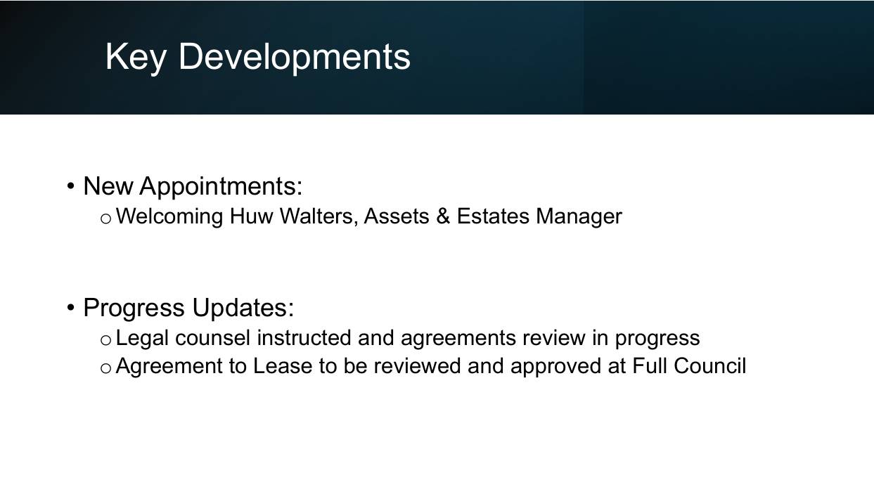

Slide 16
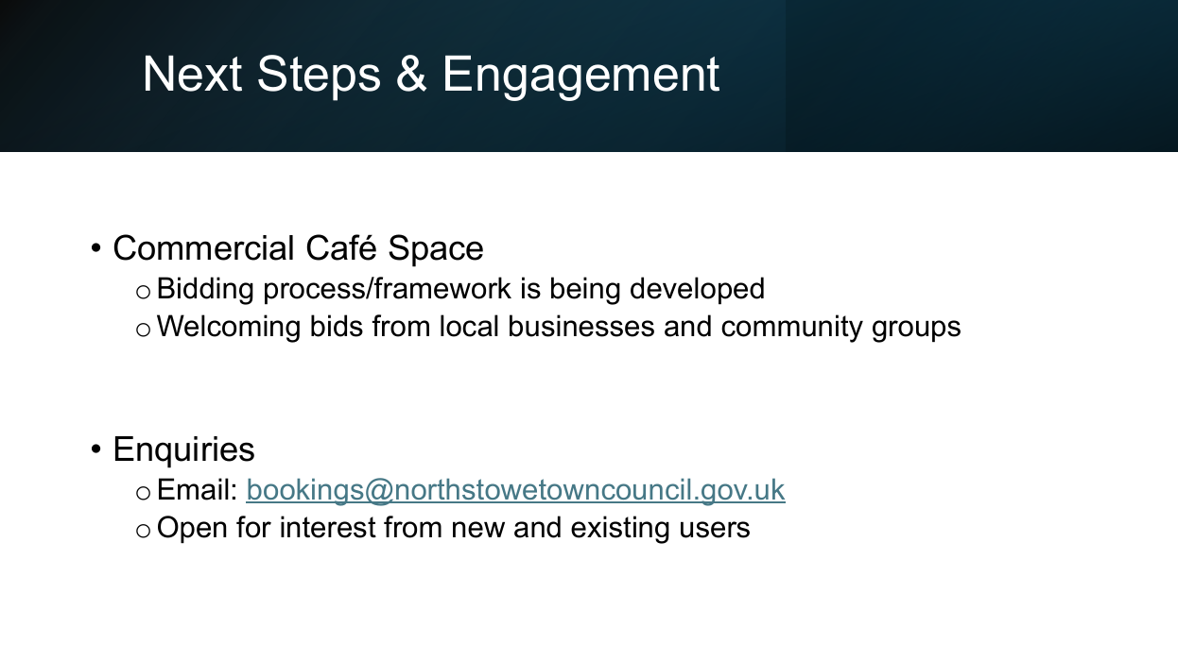

Slide 17
